Slide 1
Action Plan and
Countywide Transportation Plan Update
TRANSPAC -- TAC Meeting 5
October 27, 2022
Notes:
Test printing direction

Slide 2
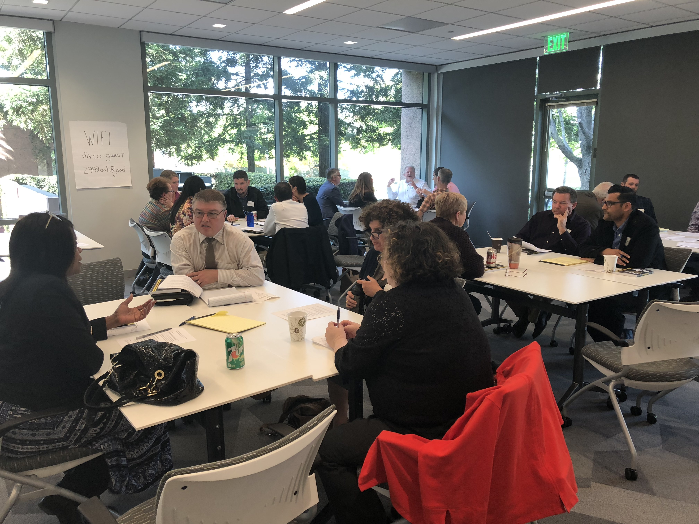
Agenda
Overview of Draft Action Plan
TAC Comments
Next Steps

Slide 3
Action Plan Outline
Chapter 1: Introduction
Chapter 2: Current Conditions, Trends, and Travel Patterns
Chapter 3: Vision, Goals, and Policies
Chapter 4: Routes of Regional Significance
Chapter 5: Transit
Chapter 6: Active Transportation
Chapter 7: Roadways
Chapter 8: Safety
Chapter 9: Equity
Chapter 10: Climate Change
Chapter 11: Innovation and Technology
Chapter 12: Financial Outlook
Chapter 13: Procedures for Notification, Review, and Monitoring

Slide 4
Chapter 1: Introduction
Measure J Transportation and Growth Management Program
Action Plan Purpose
Action Plan Contents
Relationship of this Action Plan to the Countywide Transportation Plan
Public Engagement for the Action Plan
Definition of Terms
Regional Transportation Objectives

Slide 5
Chapter 2: Current Conditions, Trends, and Travel Patterns
Travel Demand Modeling
COVID-19 Effects
Population and Employment
Commute Patterns and
Travel Demand Forecasts
Transit
Active Transportation
Roadways
Safety
Equity
Climate Change and GHGs
Innovation and Technology
Conclusion: Moving Toward a Multimodal Network

Slide 6
Chapter 3: Vision, Goals and Policies
Vision
Goals
Policies

Slide 7
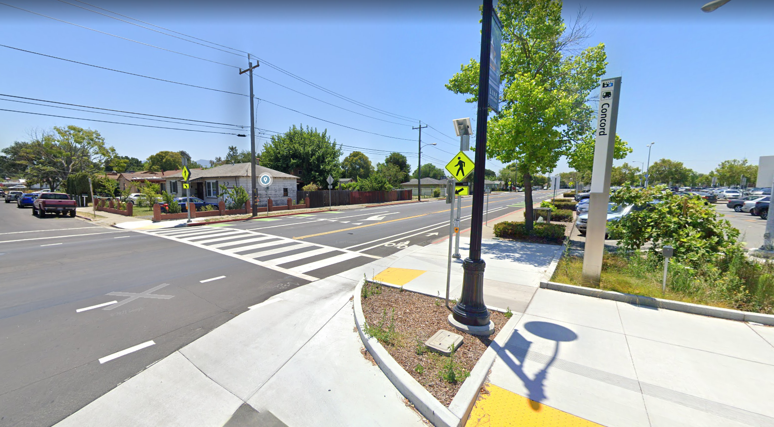
Chapter 4: Routes of Regional Significance
Corridor Maps combine the Routes of Regional Significance (RRS) maps to illustrate the multimodal nature of the transportation network
Caveats of the Corridor Maps:
They show desired future conditions
Corridors are highly generalized to show multimodal conditions where they do or will exist
Multimodal conditions at Concord BART Station

Slide 8
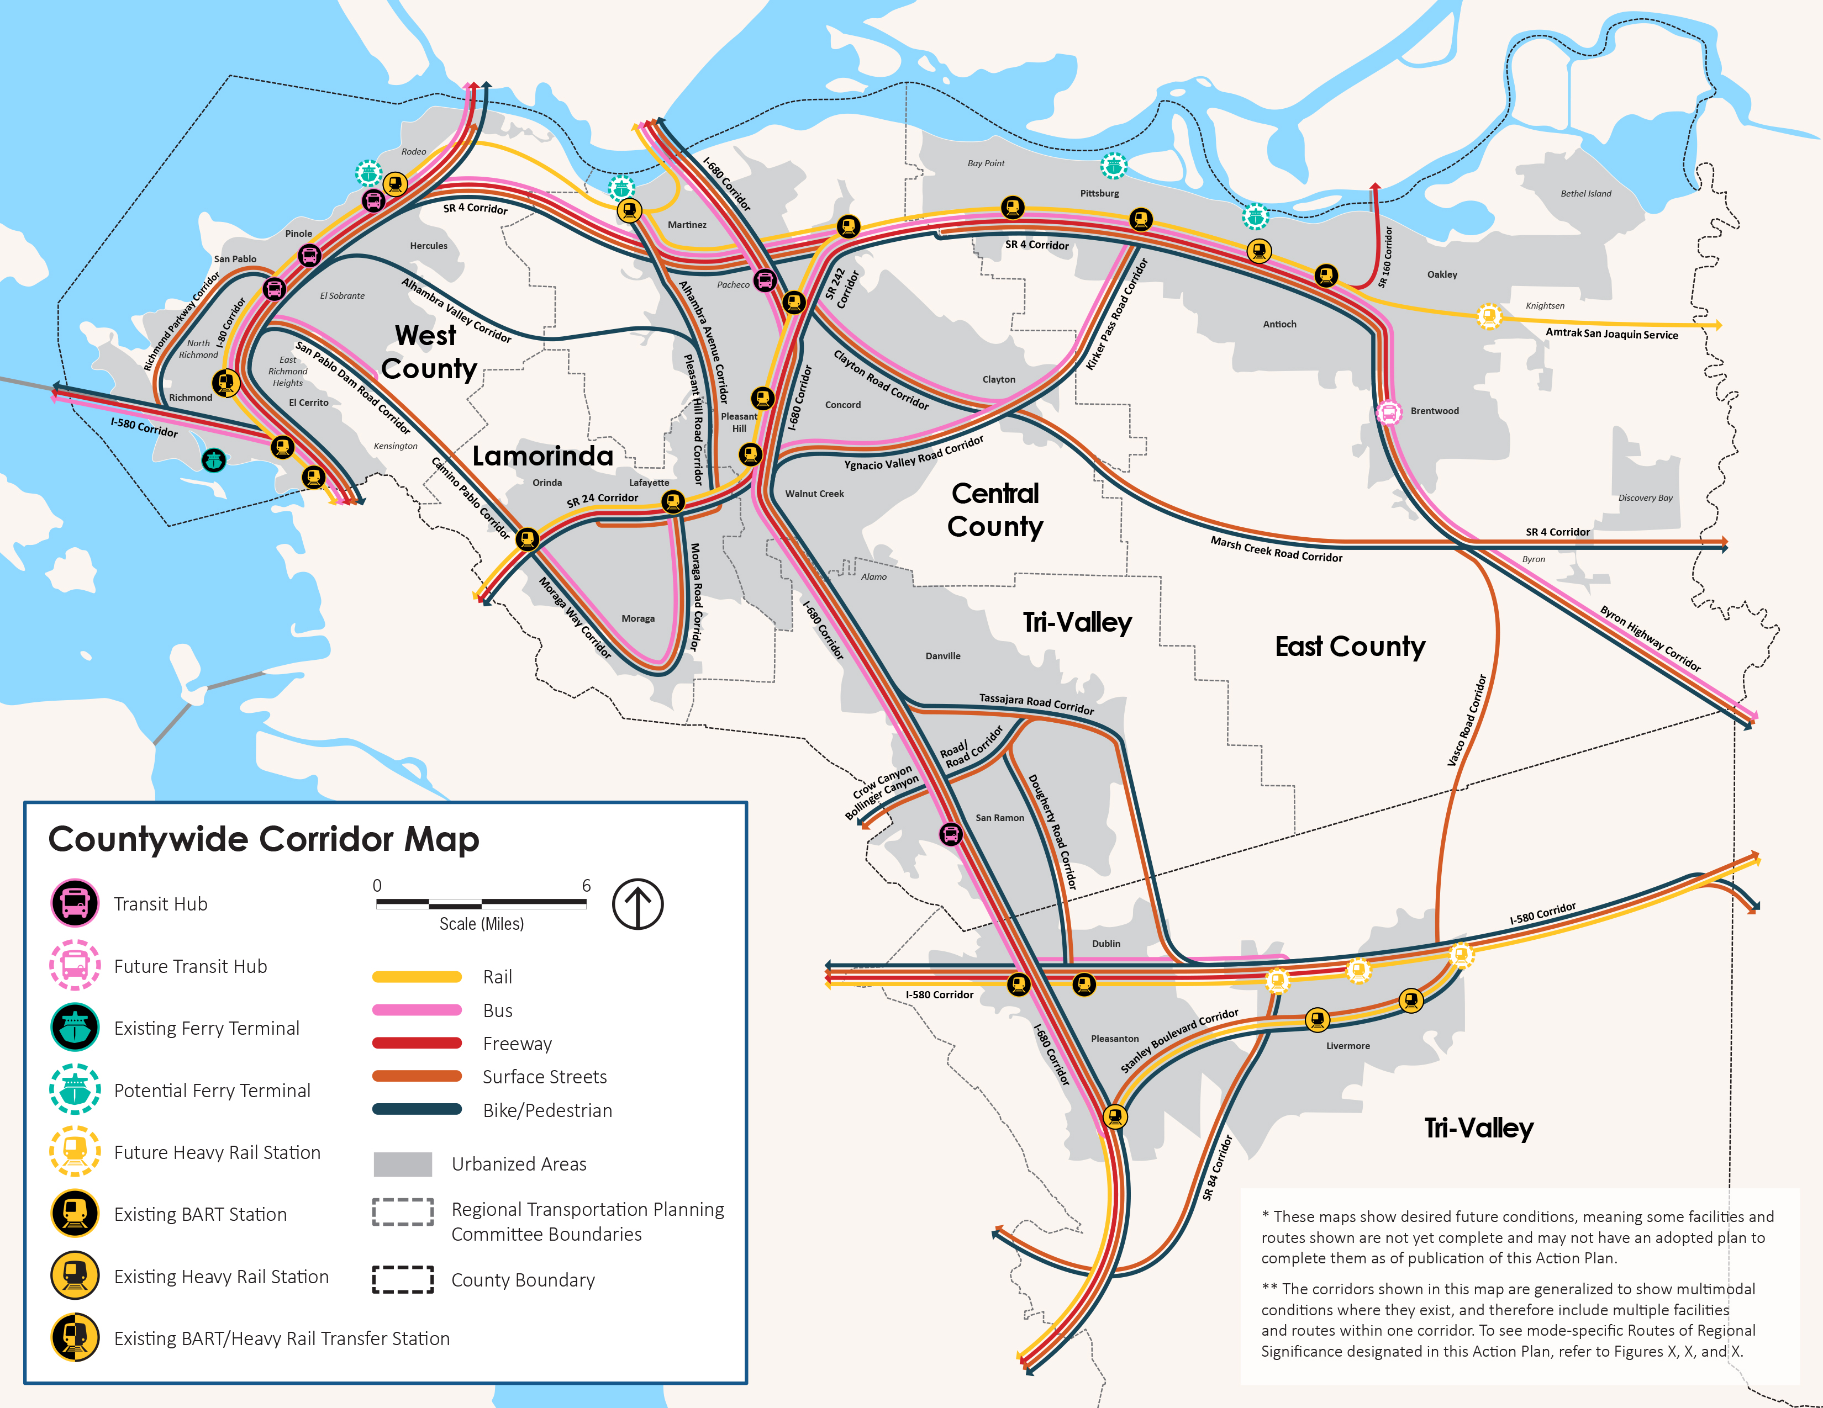
Countywide Corridor Map

Slide 9
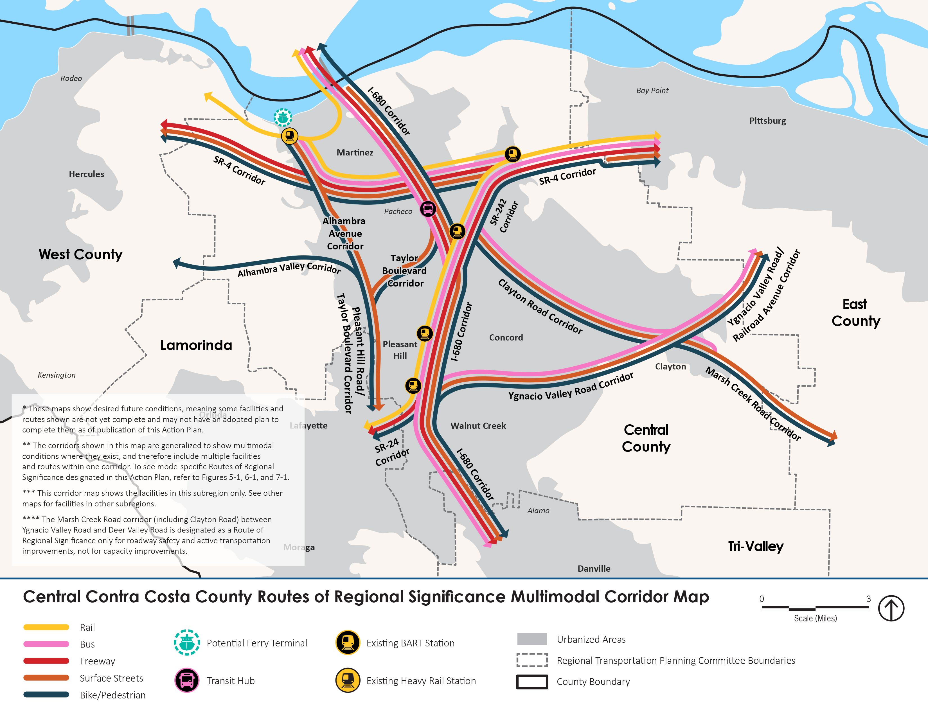
TRANSPAC Corridor Map

Slide 10
Chapters 5 through 11
Chapter 5: Transit
Chapter 6: Active Transportation
Chapter 7: Roadways
Chapter 8: Safety
Chapter 9: Equity
Chapter 10: Climate Change
Chapter 11: Innovation and Technology

Slide 11
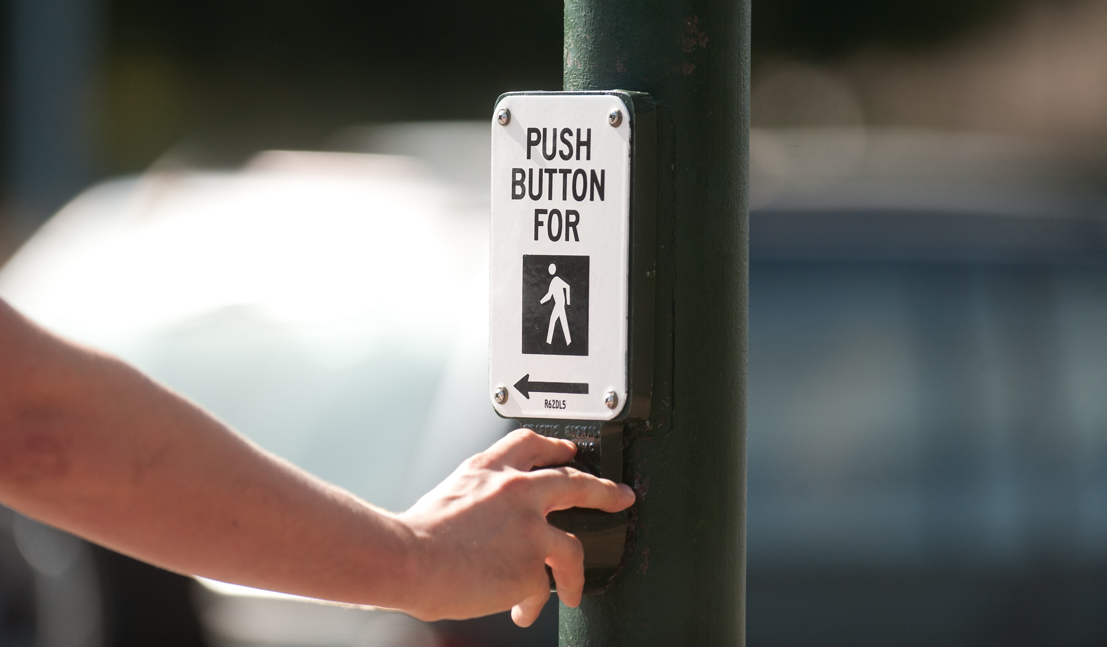
Chapters 5 through 11
Each chapter includes:
RTOs
Actions
Appendix will list responsible parties and timing

Slide 12
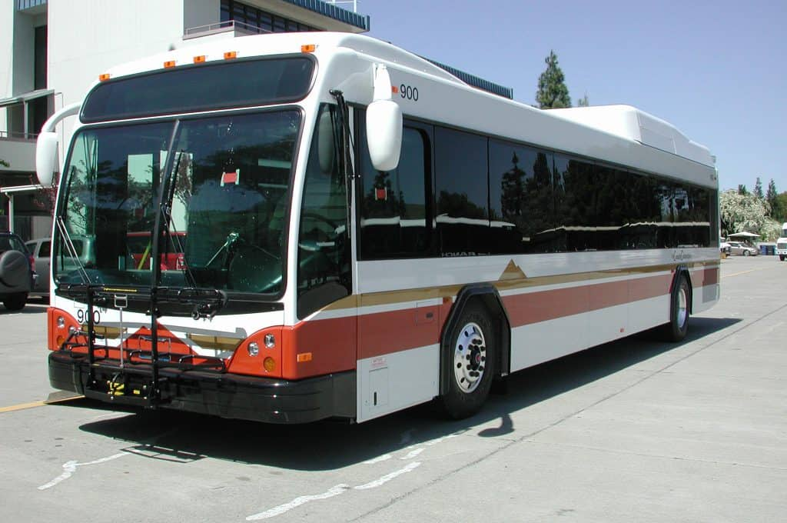
Transit
Transit Mode Share
Mode Share to/from BART
Transit Trip Time
High Quality Transit Access
Paratransit Access
Italics = new RTO added after the Round 4 TAC meeting

Slide 13
Active Transportation
Active Transportation Mode Share
Low Stress Bike Network
Unprotected Trail Crossings

Slide 14
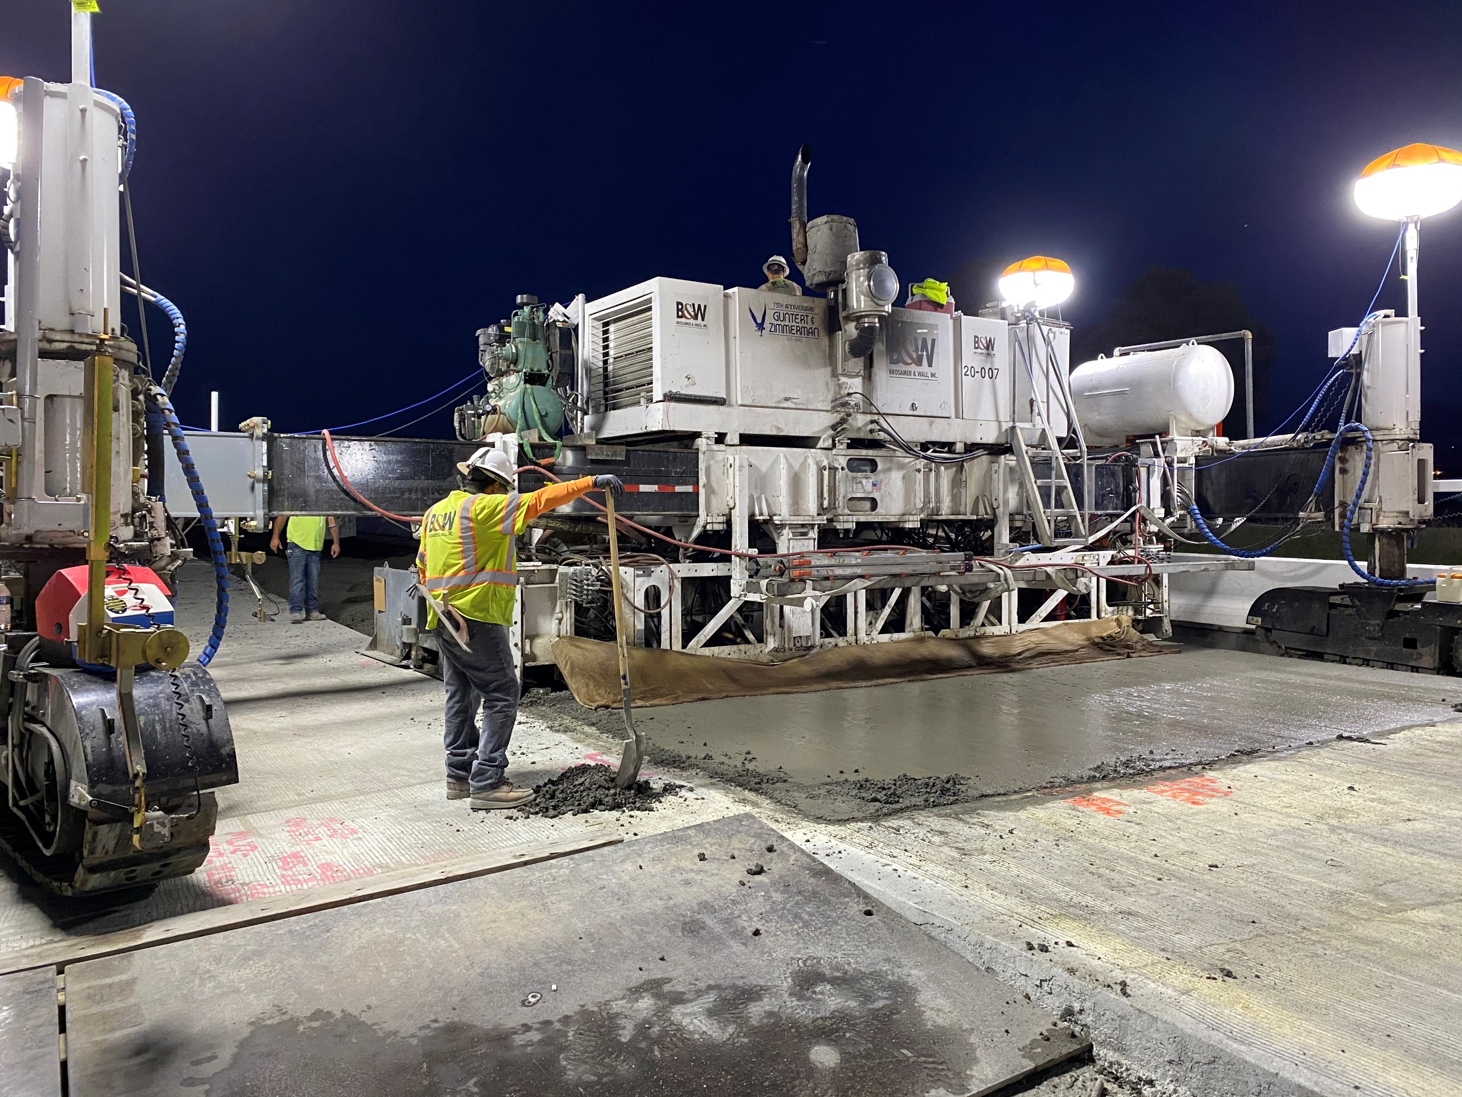
Roadways
Freeway Delay Index
Freeway Buffer Index
Intersection LOS
Roadway Segment LOS

Slide 15
Safety
KSI Collisions
Active Transportation Collisions
Active Transportation Collisions Near Schools

Slide 16
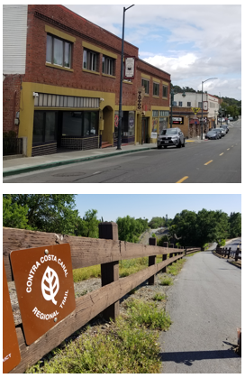
Equity
EPC Low Stress Bike Network Completion
Collisions in EPCs
EPC Job Access: Driving
EPC Job Access: Transit
EPC Access to High Quality Transit

Slide 17
Climate Change
Single-Occupant Vehicle (SOV) Mode Share
Carpool Mode Share
Vehicle Miles Traveled
Greenhouse Gas (GHG) Emissions
Zero Emission Vehicles
Italics = new RTO added after the Round 4 TAC meeting

Slide 18
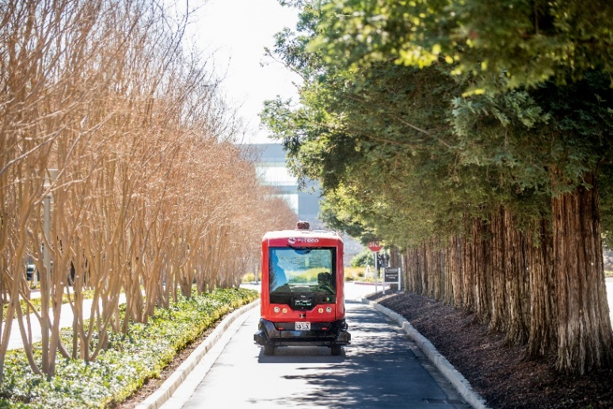
Innovation and Technology
Signal Interconnection Project

Slide 19
Chapter 12: Financial Outlook
Subregional Transportation Mitigation Program
Actions Related to Funding
Shared Facilities

Slide 20
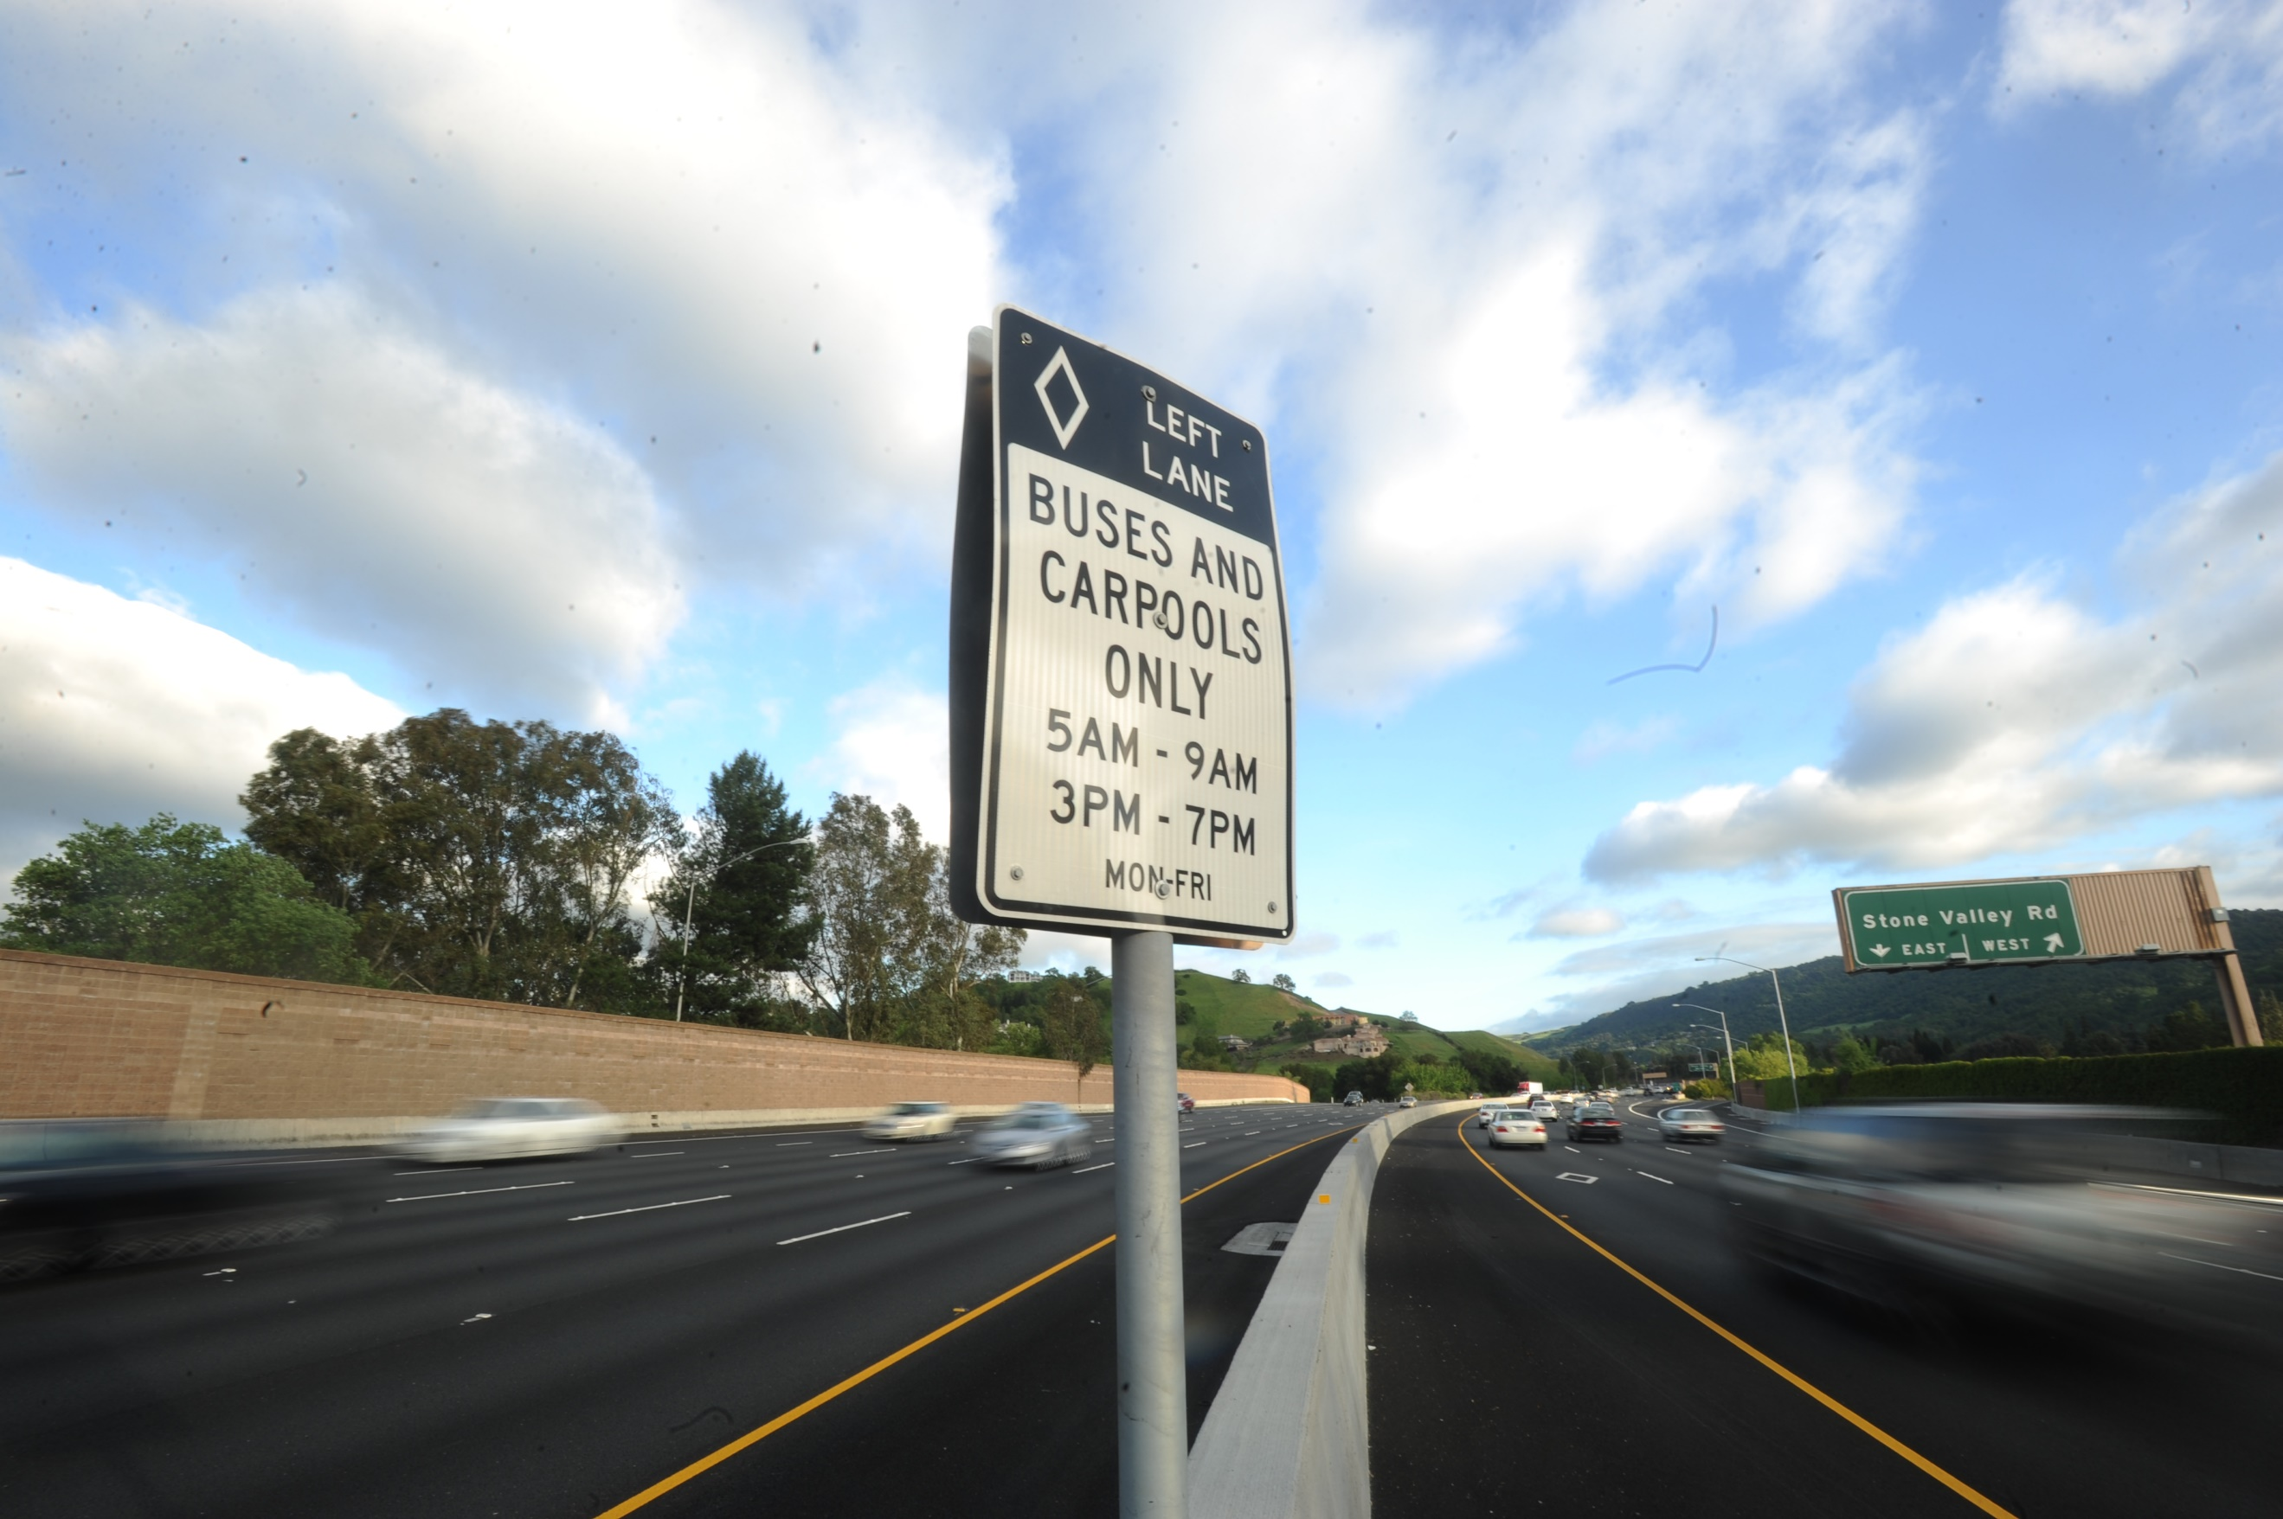
Chapter 13: Procedures for Notification, Review, and Monitoring
Role of Regional Transportation Planning Committees
Circulation of Environmental Documents and Transportation Impact Studies
Review of General Plan Amendments
Schedule for Action Plan Review
Implications for Compliance with the GMP
Process for Addressing RTO Exceedances

Slide 21
Next Steps
Written comments due Thursday, November 10th
Public review draft Action Plan based on:
TAC comments
Additional CCTA staff comments
Review and Adoption: TRANSPAC Policy Board– November 10th
TRANSPAC TAC – November 17th
TRANSPAC Policy Board – December 8th
Authority Acceptance: Early 2023
CTP process begins soon

Slide 22
Action Plan and
Countywide Transportation Plan Update
TRANSPAC -- TAC Meeting 5
October 27, 2022
Notes:
Test printing direction

