Slide 1
Action Plan and
Countywide Transportation Plan Update
TRANSPAC -- TAC Meeting 5
January 26th, 2023
Notes:
Test printing direction

Slide 2
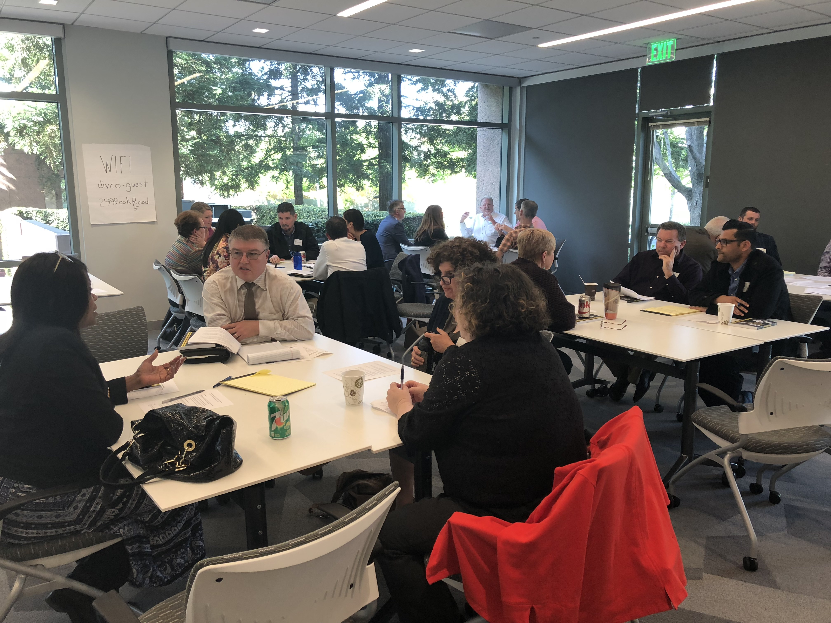
Agenda
Overview of Revised Draft Action Plan
Next Steps and Recommendation
Comments/Questions (by Chapter)

Slide 3
Edits Made to the Draft Action Plan

Slide 4
General Edits
Typos, grammatical errors, punctuation, formatting
CCTA requests to elaborate in various sections
Updates to several maps
Multimodal Corridor Map (higher resolution only)
High Quality Transit Map
Active Transportation Maps
Collision Maps
RTO Monitoring Location and Segment LOS maps
Action edits and/or new actions per CCTA and TAC comment
Bolstered several RTO sections
Paratransit and Community-Based Transportation Programs
High Quality Transit Access
Mode Share

Slide 5
General Edits
Added BART buffer times
Added discussion of housing development
Added graphic to Definition of Terms section
Added various clarifications and footnotes to clear up confusion
Added several mentions of public health and relation to the transportation system
Added to content in Appendix A
Filled in Appendix B (lead/responsible agencies and timeframe)
Added Appendix D information

Slide 6
Edits Specific to the Central County Action Plan
Added Lynne Filson to list of TRANSPAC TAC members
Revisions to LSBN map
Revision to high-quality transit map
Added extra notes on designation of Marsh Creek Road as an RRS (no capacity improvements)
Added clarification to RTO Equity-2 regarding the target and its relation to vision zero
Added definition of IPCC
Replaced and/or revised actions related to transit, active transportation, and innovation and technology
Revised name of facility formerly known as Kirker Pass Road
Revised STMP section to align with adopted language
Revised Climate Change RTO-3 to discuss the 2050 target assumption

Slide 7
Next Steps and Recommendation

Slide 8
Process for Action Plan Adoption
Step 1: RTPC TAC reviews the Draft Action Plan and forwards to the Committee
TRANSPAC TAC January 26th
Step 2: RTPC Committee approves the Draft Action Plan and forwards to CCTA for proposal for adoption into the Countywide Transportation Plan (CTP)
TRANSPAC Committee February 9th
Step 3: CCTA Planning Committee and Board accept the Draft Action Plans (April 2023)
Step 4: CCTA Board approves the CTP including adoption of all five Action Plans into the Draft CTP (late 2023 or early 2024)
Step 5: RTPC Policy Boards formally adopt the Action Plans (early 2024)

Slide 9
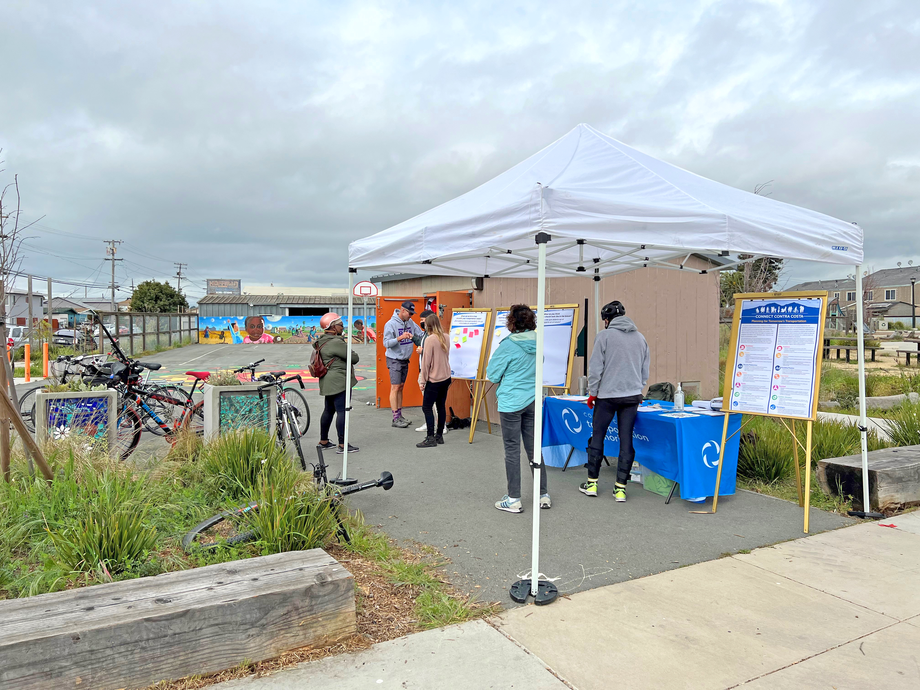
Recommendation
Move the Central County Action Plan, with edits as needed, and forward to the TRANSPAC Committee.
After review by the Committee, forward the Action Plan to CCTA for inclusion in the Draft Countywide Transportation Plan Update.
Final adoption of the Action Plan will occur after the CTP Update is adopted.

Slide 10
Comments/Questions?

Slide 11
Action Plan Chapters
Chapter 1: Introduction
Chapter 2: Current Conditions, Trends, and Travel Patterns
Chapter 3: Vision, Goals, and Policies
Chapter 4: Routes of Regional Significance
Chapter 5: Transit
Chapter 6: Active Transportation
Chapter 7: Roadways
Chapter 8: Safety
Chapter 9: Equity
Chapter 10: Climate Change
Chapter 11: Innovation and Technology
Chapter 12: Financial Outlook
Chapter 13: Procedures for Notification, Review, and Monitoring

Slide 12
Action Plan Appendices
Appendix A: Potential RTOs considered but not recommended
Appendix B: Summary of Actions, responsible parties and timing
Appendix C: RTO Monitoring Locations LOS calculations
Appendix D: RTO Methodologies

Slide 13
Action Plan and
Countywide Transportation Plan Update
TRANSPAC -- TAC Meeting 5
January 26th, 2023
Notes:
Test printing direction

