Slide 1
TRANSPAC
Line 20a Grant Request

Slide 2
The City of Concord & Concord Senior Center
Concord - population of
approximately 130,000, of which over 20 % is aged 60 or over.
Concord Senior Center serves as the hub for these seniors and their families.

Slide 3
Concord Senior Center
Concord Senior Citizens Club
Social Activities
501(c)3
Health and Human Services:
HICAP & Peer Counseling
AARP Programs
Legal Aid
Meals on Wheels Diablo Region
Cafe Costa
Care Management
Free Health and Wellness Classes
Inclusive Recreation Program
Dances
Game Nights
Bowling

Slide 4
Partnership with GoGo Grandparent to offer on-demand curb to curb rides for seniors 24 hours a day/7 days a week.
Participant adds money to their GoGo Concord account through the Senior Center, and the City will match it up to $30 a month.
Current Transportation Program

Slide 5
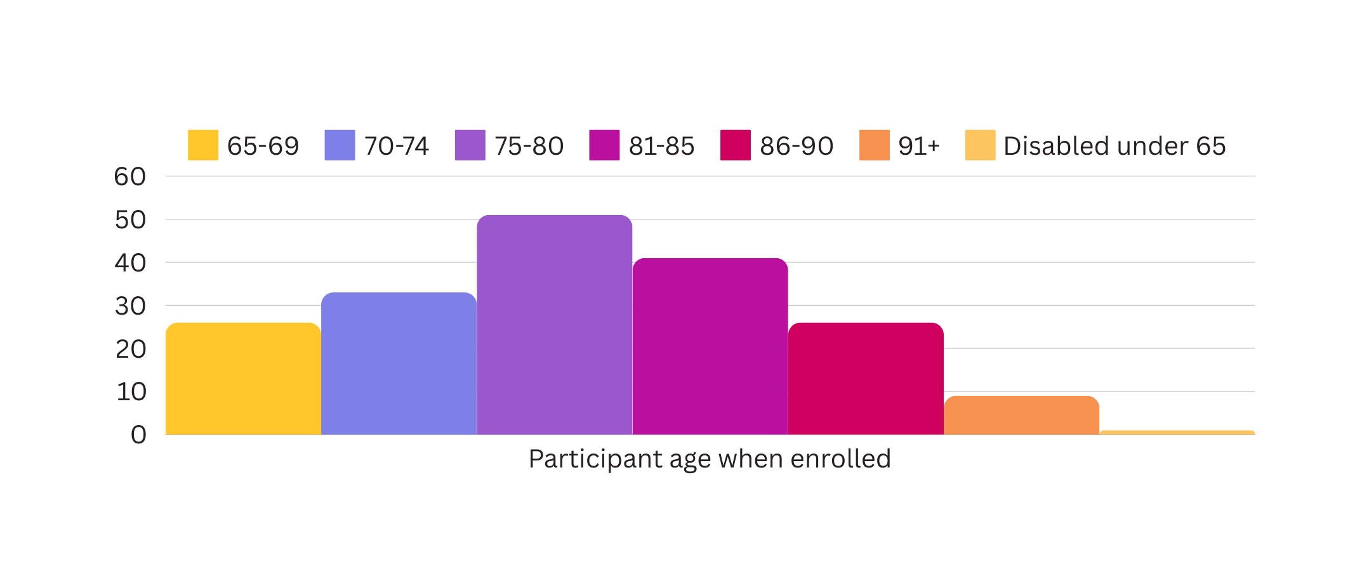
Age demographics of GoGo Participants

Slide 6
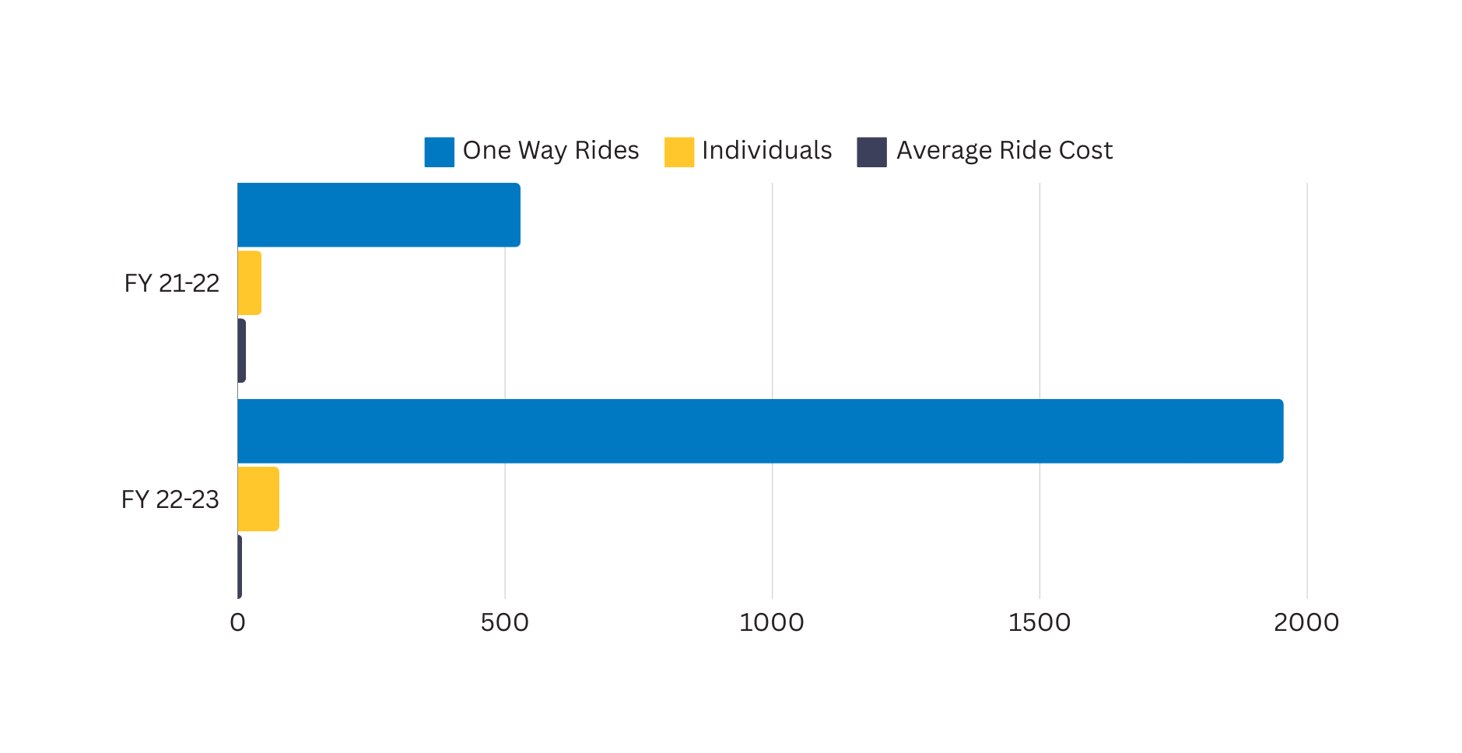
One Way Passenger Trips
Almost a 4x increase in use of the GoGo Concord TNC program

Slide 7
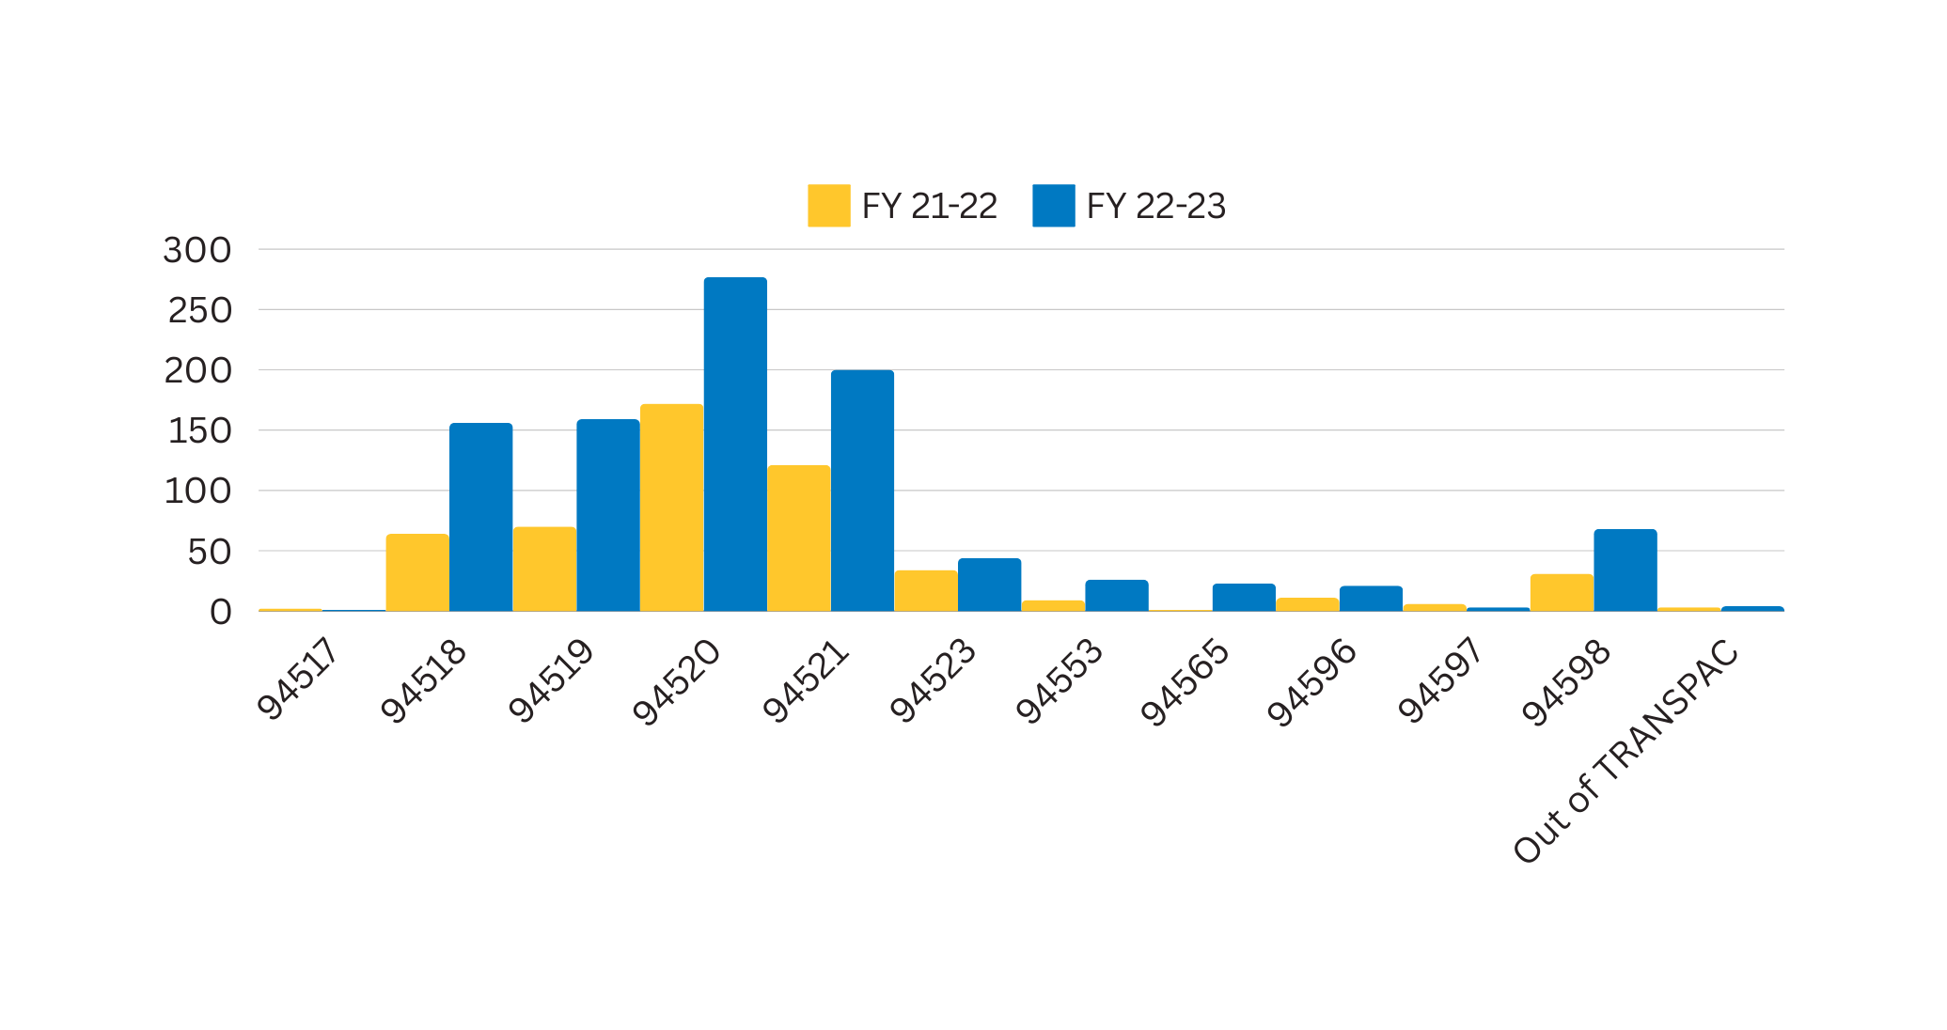
Trip orgin by Zip Code

Slide 8
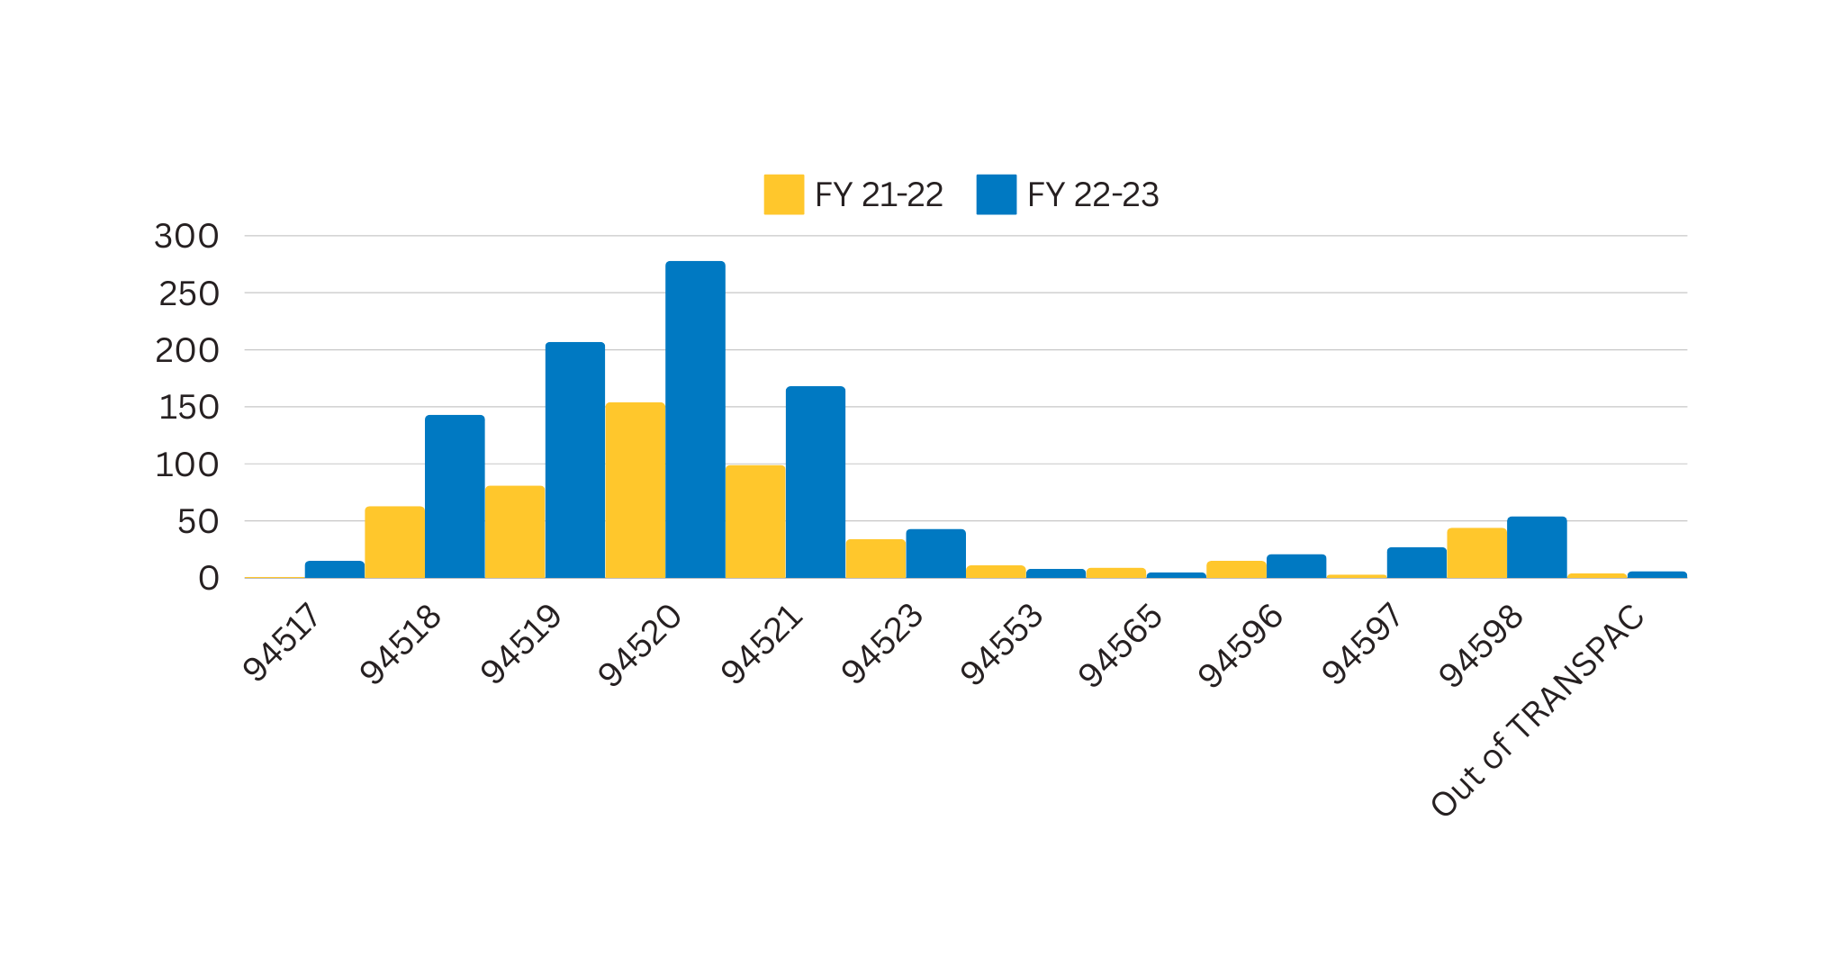
Trip end by Zip Code

Slide 9
Key Issues needing to be addressed
Unaccessible to low-income seniors
Unavailable for some medical appointments
Lack of Personal Service

Slide 10
Shared ride experience to specified places in Concord and the TRANSPAC Area
10 passenger van
Paid drivers
Affordable for lower income seniors
Can provide additional assistance with door to door service for some medical appointments
Higher level of personalized service
Fixed Route Van Service

Slide 11
$15 yearly application fee
Apply for LINK Service
GoGo Grandparent subsidy
Free Van Service
Flexibility to adjust and grow

Slide 12
Equity Priority Community

Slide 13
Coordination Efforts
Referrals to:
County Link
Mobility Matters
Medicare Programs
Referrals from:
Mobility Matters
Medical Client Managers
Veterans Offices
Educational efforts:
Independent Living Resources - travel training
Commission on Aging Transportation Survey

Slide 14
On-Going Funding Strategies
Donations & Sponsorships
Look for
additional
grants
Fundraisers
We hold quarterly fundraisers at the Concord Senior Center to help fun the Senior Transportation and Scholarship Programs
We have an event and program sponsorship program
Actively looking for additional grants to assist with sustaining and growing program

Slide 15
Thank You
Do You Any Question?
Kathryn Monroy
Recreation Program Manager
kathryn.monroy@cityofconcord.org

Slide 16
Contact Information
925-671-3074
www.cityofconcord.org
kathryn.monroy@cityofconcord.org
Concord Senior Center
2727 Parkside Dr., Concord

