Slide 1
Moving BART Forward
TRANSPAC Committee March 14, 2024

Slide 2
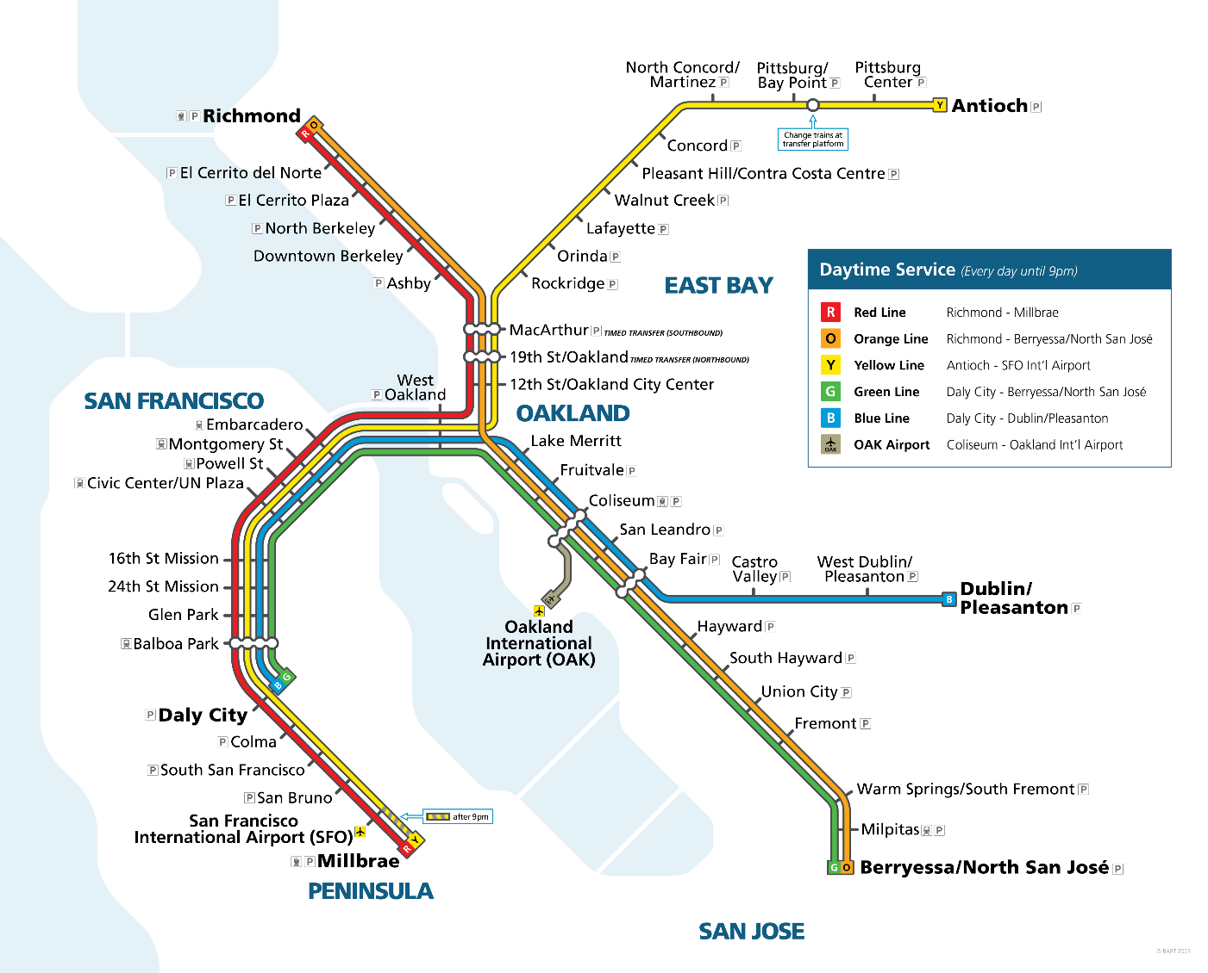
BART’s Safe and Clean Plan
BART launched its Safe and Clean Plan this past September, to enhance the rider experience by committing to rider safety, cleanliness, and better night and weekend service.
Who we are doing this for:
31% of BART riders live in households with income under $50,000.
44% of BART riders do not have a vehicle.
67% of BART riders identify as non-white.
As the Bay Area’s backbone public transit system, BART is rolling up its sleeves to make sure riders feel safe, to keep our trains cleaner than ever, and to provide the best service yet—from departure to destination.

Slide 3
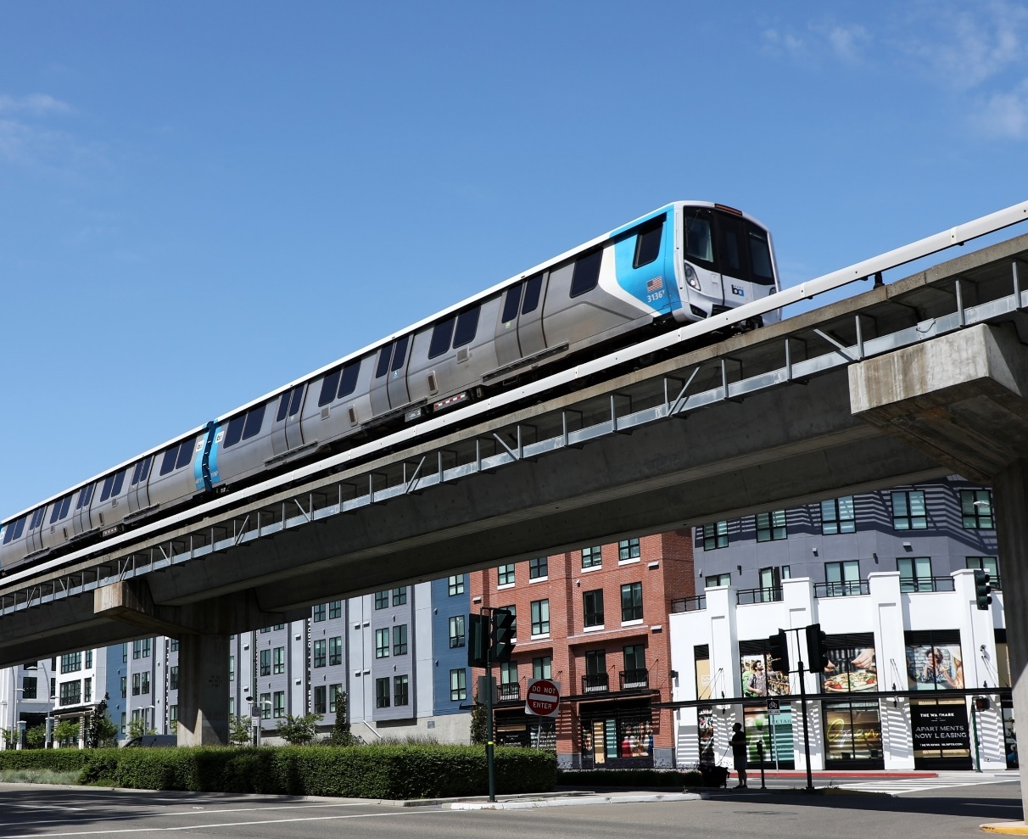
Commitment to Service Reliability
New schedule relies less on traditional commute riders.
Encourages leisure and other non-work trips by increasing night and weekend service.
Running only new Fleet of the Future trains as base schedule.
No rider will wait more than 20 minutes; Yellow line waits are even shorter.
Customer on-time performance has improved to 93%.

Slide 4
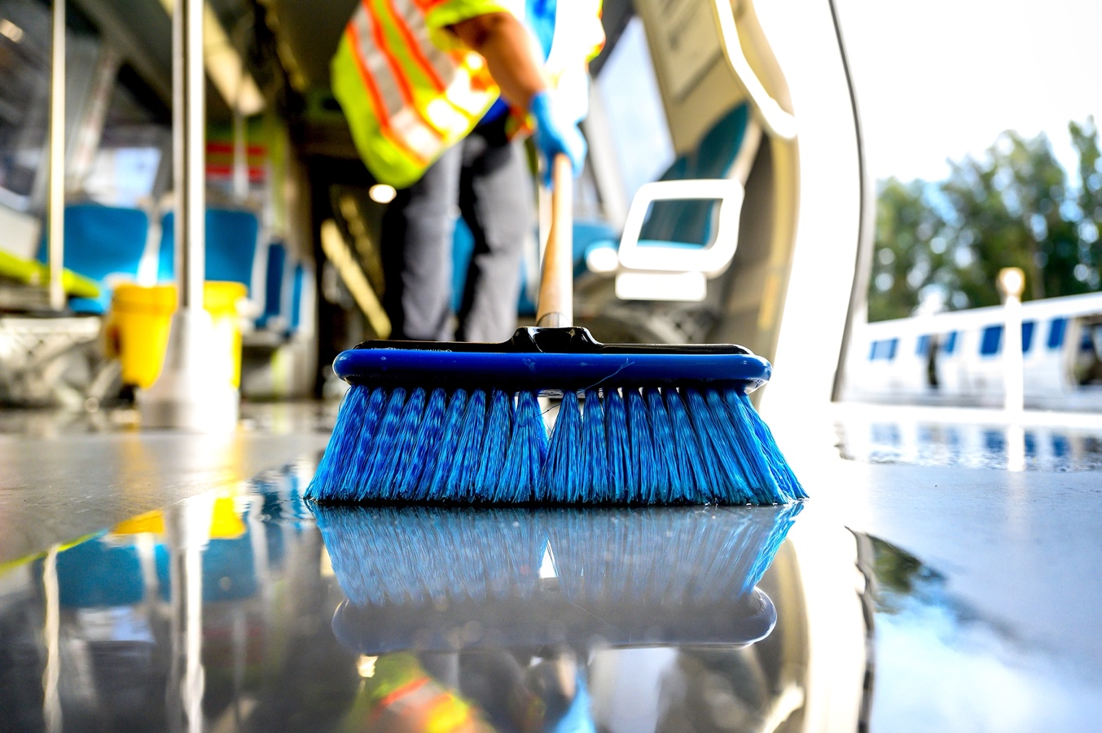
Commitment to a Clean Ride
Doubling the rate of deep cleaning on train cars.
Adding nearly 66% more dedicated crews working to keep stations clean.
Staffing restrooms at high-volume stations with attendants to guarantee cleanliness and safety.
Report a biohazard on the BART app or through bart.gov/biohazard.

Slide 5
Commitment to Safety and Security
Doubling BART Police presence systemwide and ensuring officers are riding trains to increase visibility and keep riders safe.
Increased patrols help deter crime, aid in apprehending suspects, and enforcement of BART Code of Conduct.
Running shorter trains to enhance safety.
Number of trains delayed by unwanted behavior dropped by nearly 40% from May to October.

Slide 6
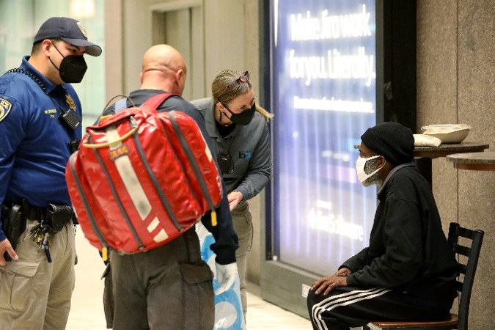
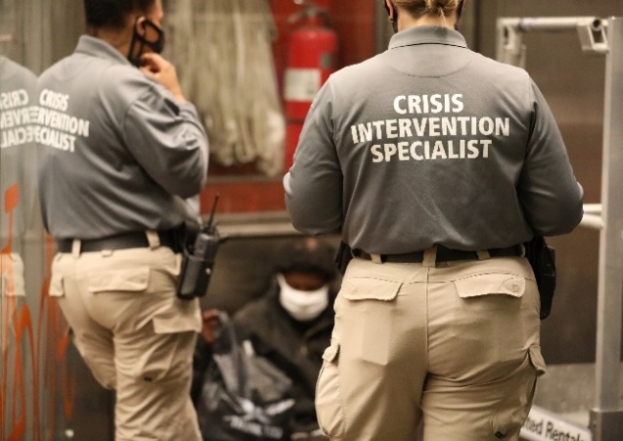
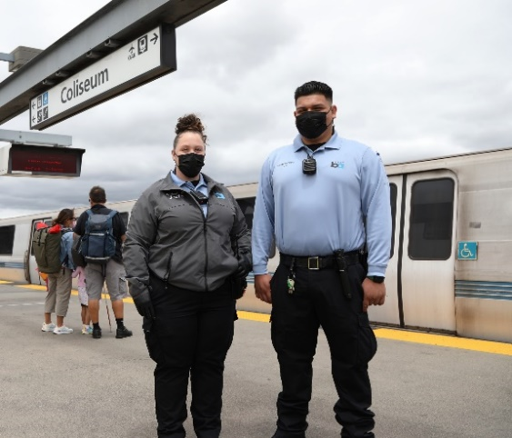
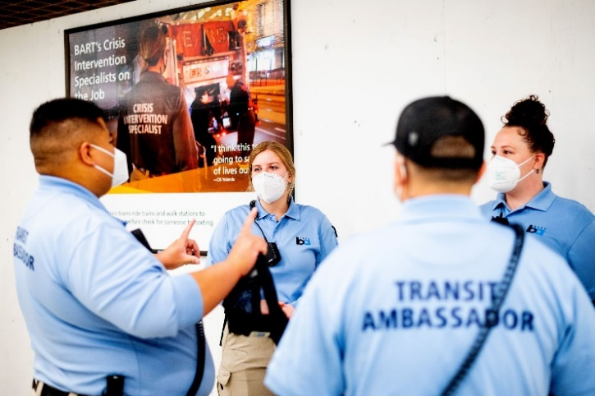
Commitment to Progressive Policing
The Progressive Policing Bureau connected 188 people with services from July through September 2023.
Crisis Intervention Specialists
Background in social work and provide outreach to people in crisis struggling with homelessness, mental health, and substance abuse.
Ambassadors
Unarmed personnel trained in de-escalation, equipped with masks, Narcan, and a police radio.
A report to MTC on the effectiveness of Progressive Policing programs is required for BART to receive state and regional operations funding.
Notes:
We’ve also made significant reforms to our police force.
We now have Crisis Intervention Specialists
They have a background in social work and provide outreach to people in crisis struggling with homelessness, mental health challenges, and substance abuse.
They are deployed 5 days a week in teams of 2 on every line covering early morning and late evening.

Slide 7
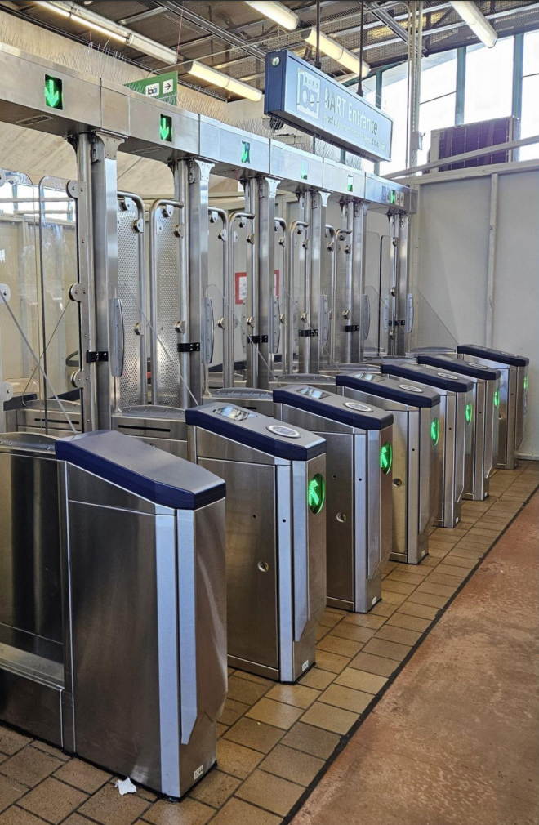
Commitment to New Fare Gates
Antioch Station is included in the next phase of deployment in Summer 2024.
Other stations include: Civic Center, Montgomery, Powell, 24th Street, SFO, Fruitvale, and Richmond.
Gates are taller and stronger to deter fare evasion.
Improve accessibility and reliability with modern equipment and advanced sensors.
BART is committed to robust outreach to community groups, local businesses, and riders in the coming months.
Systemwide installation of 700+ new fare gates by the end of 2025.
Project completion is required for BART to receive state and regional operations funding.
Notes:
Additional talking points:
The gate design implemented additional deterrence features for climb-overs:
One is to have sloped features at both the base and top of the console
The other is to insert a polycarbonate, triangular fin, attached at the center of the fare gate console, so someone cannot leverage the console for fare evasion
The over-head bridge, adds another deterrent for climb overs, and provides visual information for riders
The top od the overhead bridge is 7ft 7 5/8in tall, and the bird spikes add another approximate 5 inches to the height
The gap between the gate door panels is 1 inch at standard width gates and 2 inches at accessible gates
The gap at the bottom of the door panels is 7 7/8 inch high
•The Prototype at West Oakland will have 3 door variations – Polycarbonate, Metal Frame with a Metal infill panel and a Metal Frame with a Polycarbonate infill panel – all variations are transparent
•In addition, as part of the design evolution of the door, we reduced the 3" gaps between the door paddles, to 1" for standard aisles, and 2" at accessible aisles.
Additional info on points on slide:
- W. Oakland gates will close once a pre-set amount of time has elapsed after the clipper card is tapped unless sensors detect persons, wheelchairs, luggage, strollers, bikes. In that case gate remains open for safety while persons, wheelchairs, luggage, strollers, bikes is detected. Once gate is functioning with TR4, gate will open and close fully based on the sensors and the integration with TR4 reader, not based on a pre-set gate open duration.

Slide 8
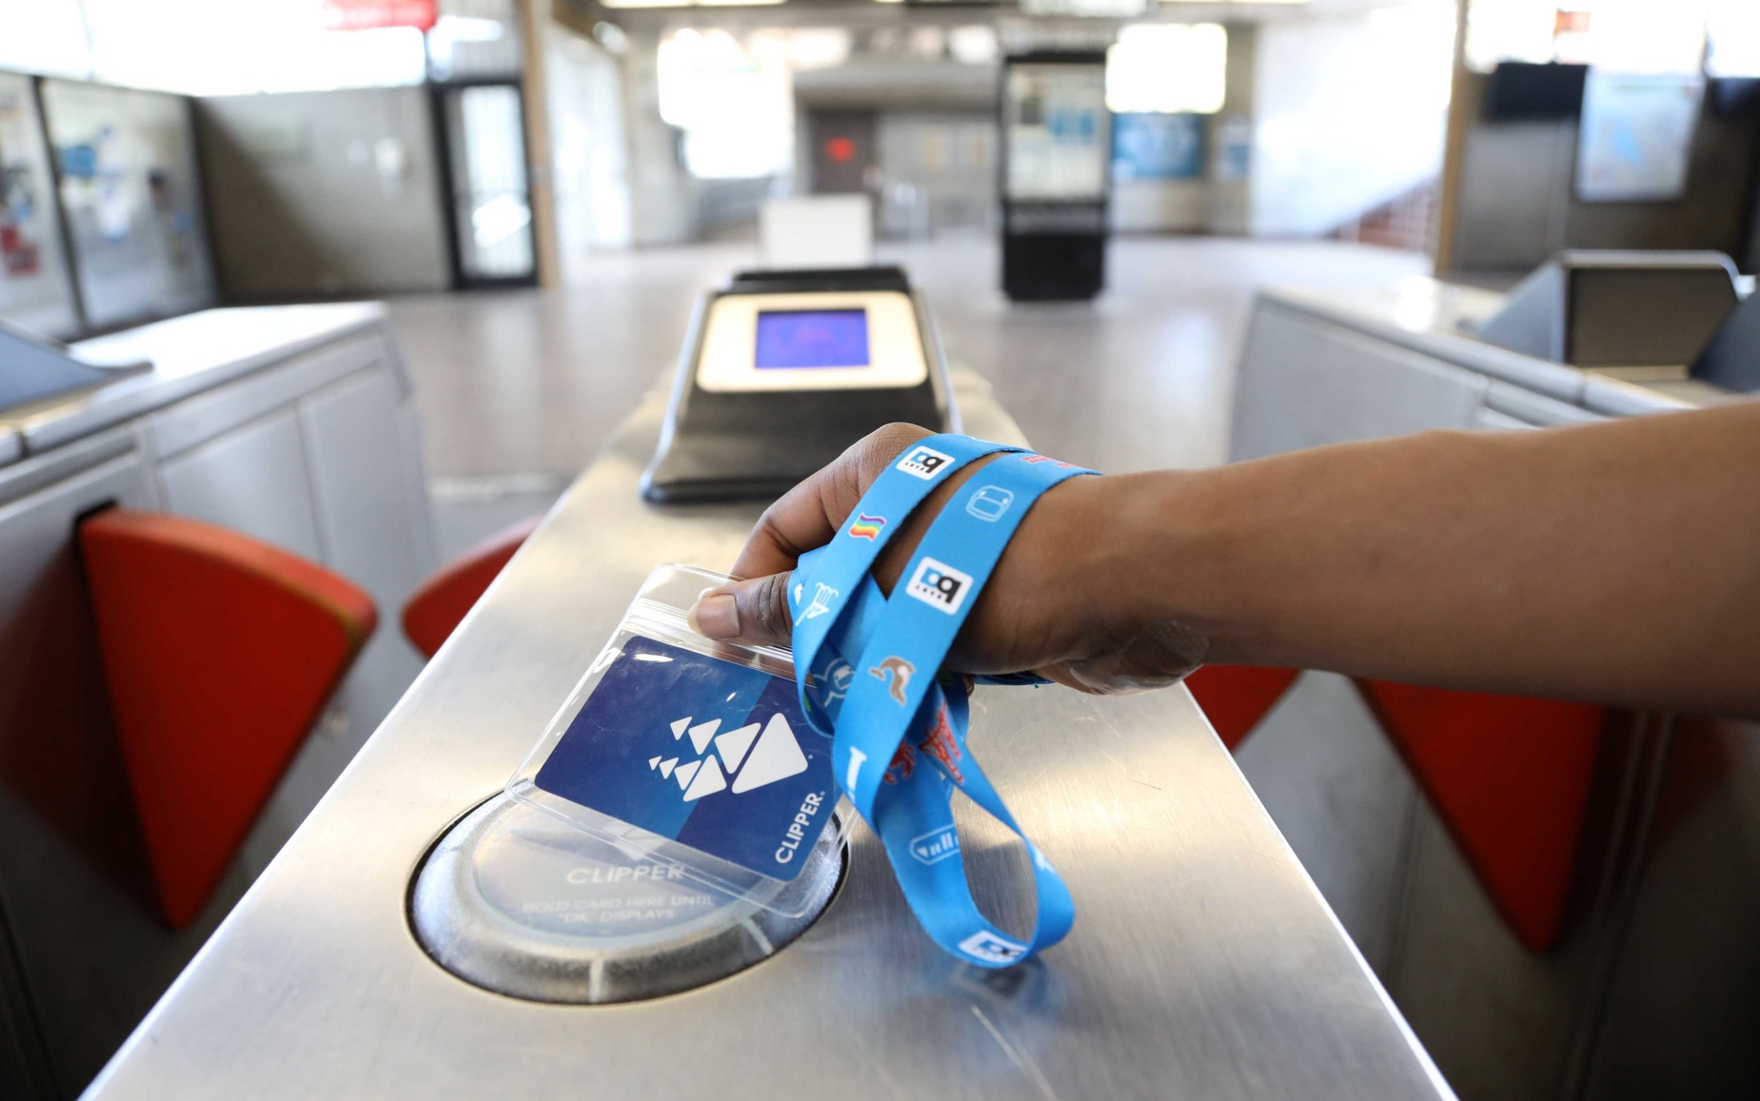
Commitment to Equity: Clipper START
Clipper START is a pilot program to provide discounts to eligible riders.
Riders are eligible if household income is under 200% of the federal poverty level (a four-person household must earn under $60,000).
BART expanded our discount to 50% this year.
Apply online at www.clipperstartcard.com.

Slide 9
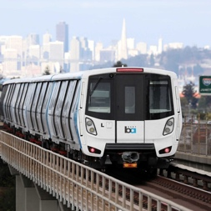
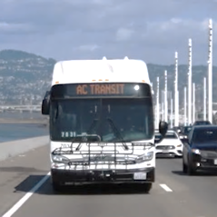
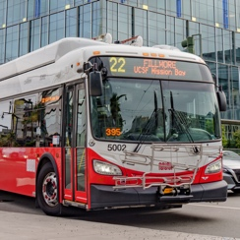
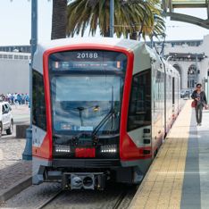
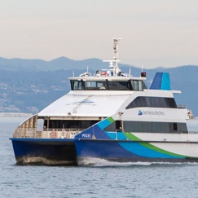
Clipper BayPass is the Bay Area’s first unlimited regional transit pass
For rides on all bus, rail and ferry services in the Bay Area
MTC and BART are inviting 10 employers to participate in a 2-year pilot for unlimited travel.
Complete the interest form for more information at www.clipperbaypass.com or email ClipperBayPass@bart.gov.

Slide 10
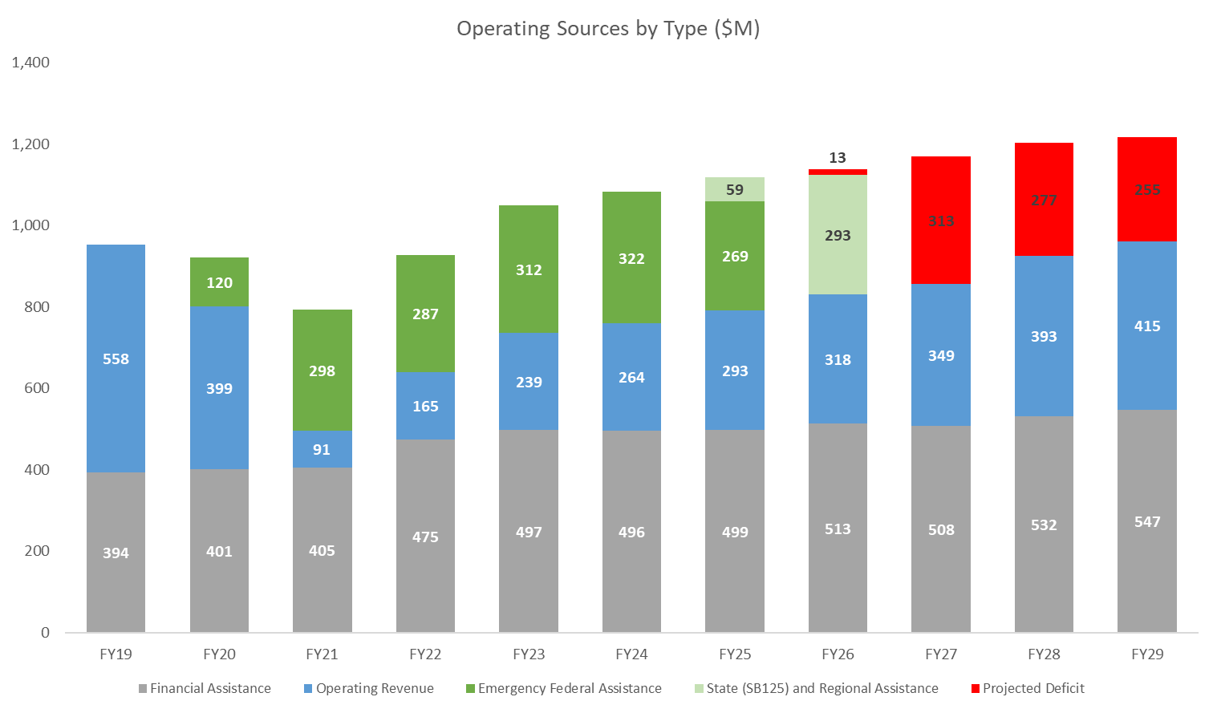
BART’s Financial Outlook
Notes:
Pre-pandemic, BART was highly self-sufficient at 60-70% fare box recovery
$1.6 billion in federal emergency assistance is being used to fill the fare revenue gap
$59 million shortfall in FY25
Approximately $300 million annual shortfalls starting in FY26

Slide 11
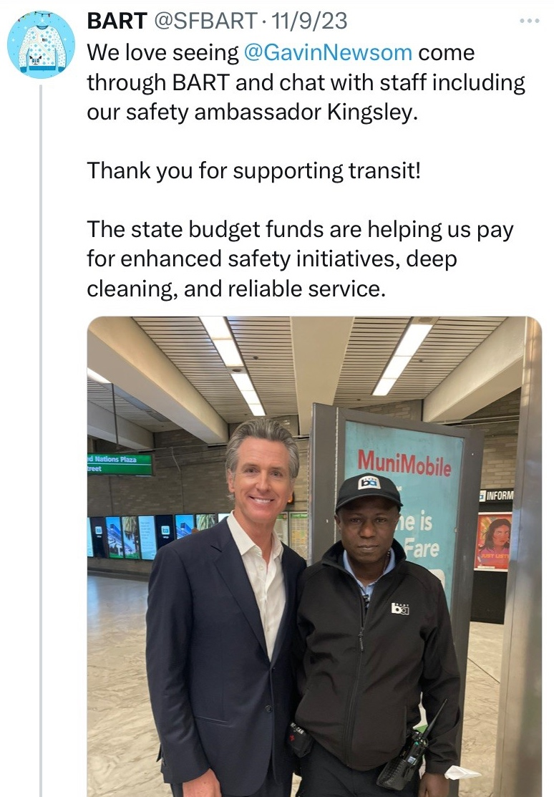
Long-term Reliable Funding Needed
The Metropolitan Transportation Commission approved enabling legislation framework for a regional transportation measure in January 2024.
Senator Wiener introduced Senate Bill (SB) 925 which will be a vehicle to enable the measure.
Revenue options:
MTC is proposing a menu of options.
Transit advocates have urged $2B annually for transformational investment.

Slide 12
Contact Information
Kerry Hillis
Principal Government and Community Relations Representative
Khillis@BART.gov
(510) 724-7492
Bradley Dunn
Manager of Local Government and Community Relations
Bradley.Dunn@BART.gov (510) 402-2987

