Slide 1
Central Contra Costa Rural Lifeline Transportation Program
John Sanderson, Director of ADA and Special Services

Slide 2
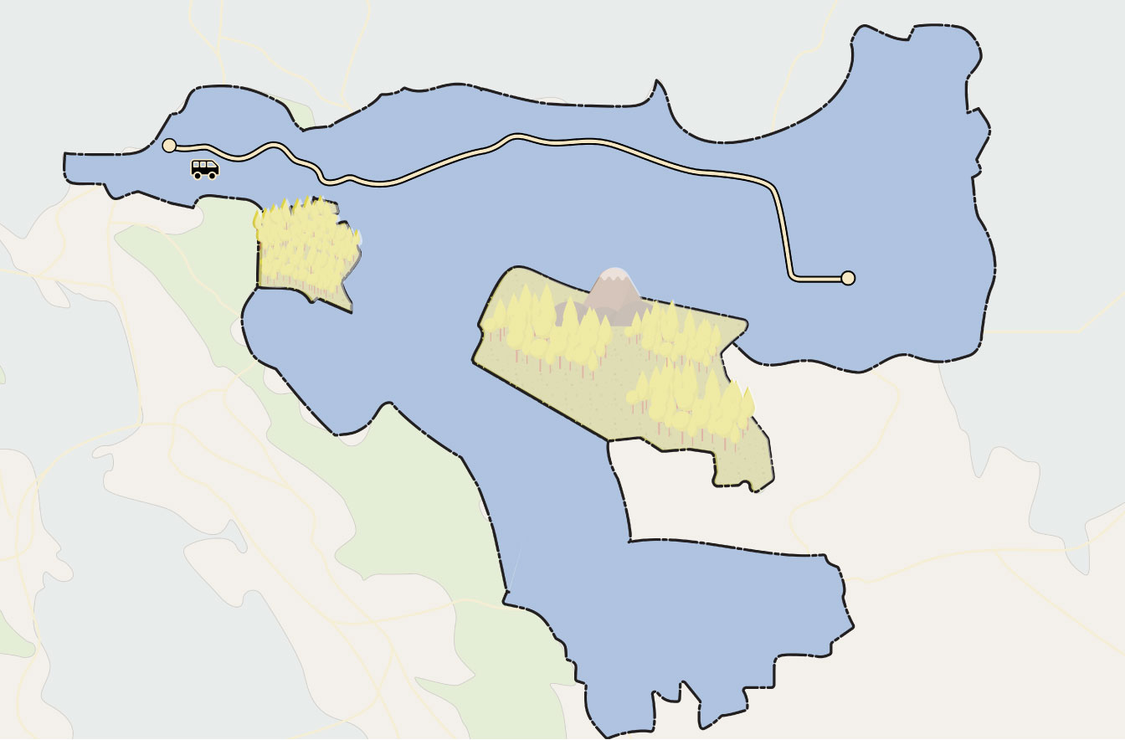
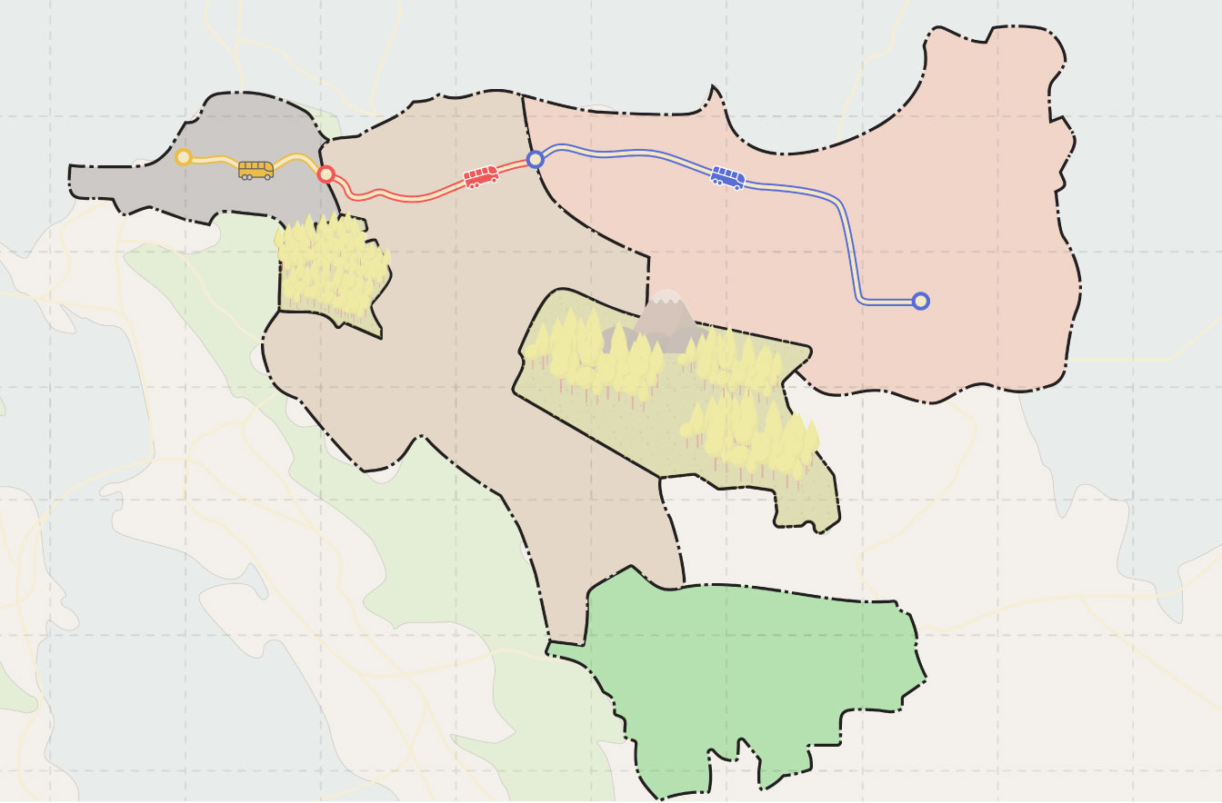
Background
One-Seat Ride allows easy travel throughout (most of) the County via Cost-Sharing between Operators
Briones/ Alhambra Vly.
Morgan Terr.
Blackhawk/ Tassajara
But major gaps remain in unincorporated/rural areas where cost of service remains unsupported…

Slide 3
Service History & Next Steps
County Connection LINK began providing limited/ad-hoc out of area service during the Pandemic when paratransit trip counts were very low and resources were underutilized
At the same time, we:
Partnered with Meals on Wheels to deliver food
Partnered with County Health Dept. to provide (non-ADA) non-emergency transport
Paratransit trip counts are back to pre-covid levels & other special programs have been discontinued or transitioned back to previous arrangements
Currently no other option available for out of area paratransit service
Marginal cost ~$32/trip for out of area portion; in-area portion covered by existing funding sources
County Connection seeks Measure J, Line 20A funding to continue providing out of area trips w/ plans to expand OOA service via a formal program
Long Term Goal: provide paratransit service throughout central county regardless of service area

Slide 4
Questions?

