Slide 1
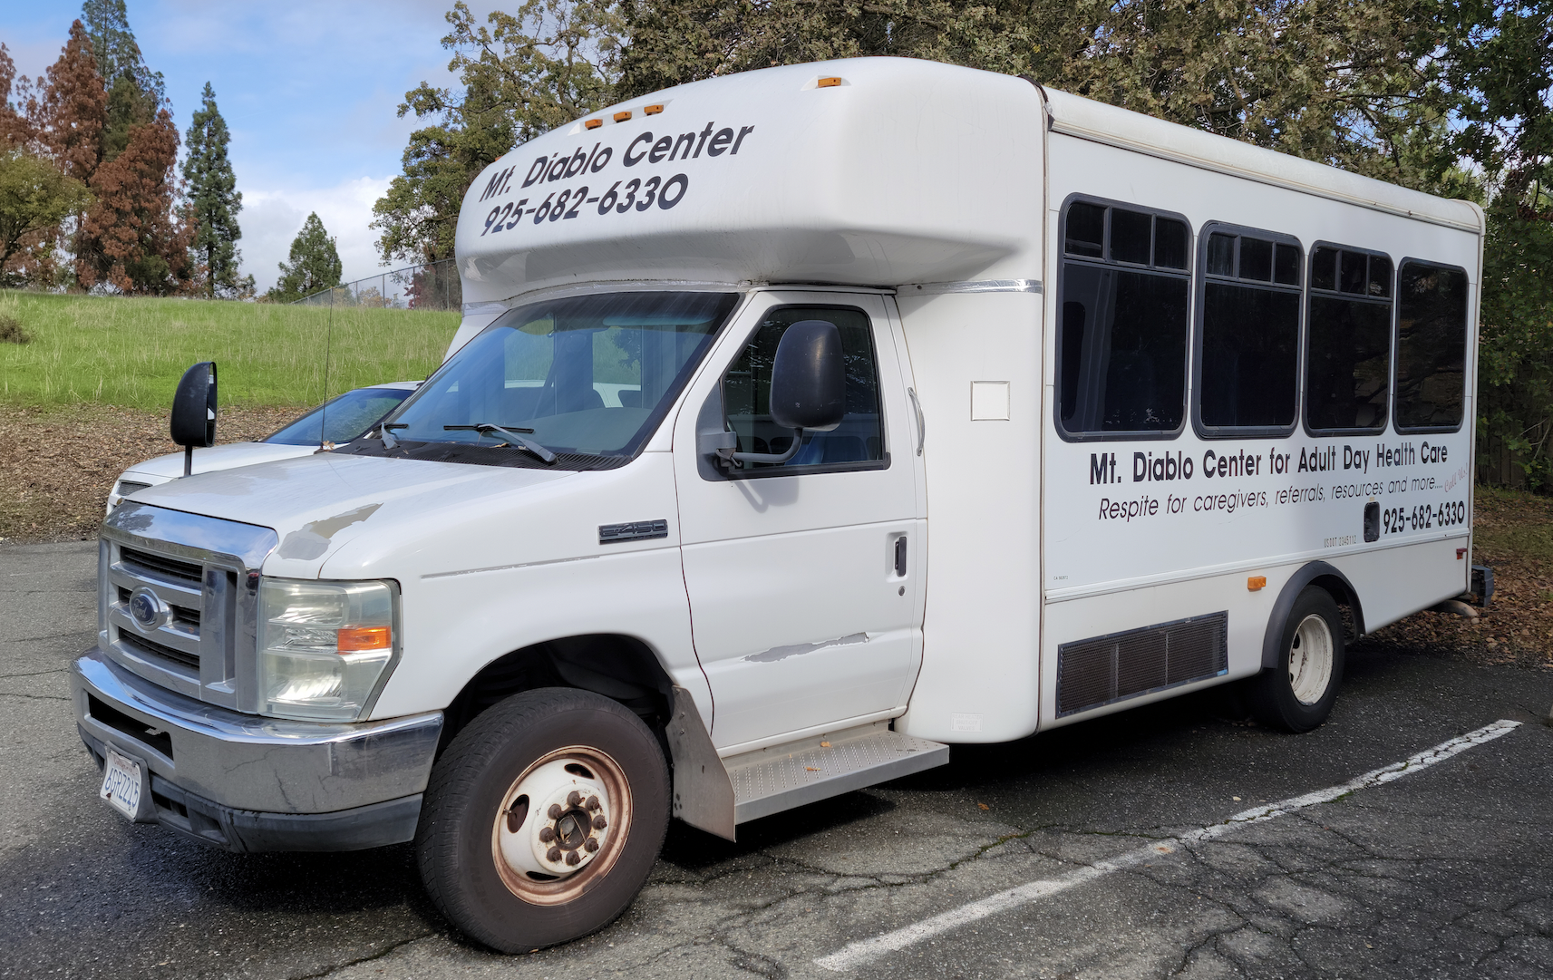
Mt. Diablo
Mobilizer
TRANSPAC Board Meeting
April 11, 2024
Notes:
Will be discussing:
Overview of our Mt. Diablo Mobilizer Program, who we serve, and transportation services we currently provide
Purpose and Need for this funding: how it addresses a transportation gap (Note: we are requesting $117,700 over 2 years)
Impacts of the Mt. Diablo Mobilizer on our Community

Slide 2
Mt. Diablo
Mobilizer
TRANSPAC Board Meeting
April 11, 2024
Notes:
Will be discussing:
Overview of our Mt. Diablo Mobilizer Program, who we serve, and transportation services we currently provide
Purpose and Need for this funding: how it addresses a transportation gap (Note: we are requesting $117,700 over 2 years)
Impacts of the Mt. Diablo Mobilizer on our Community

Slide 3
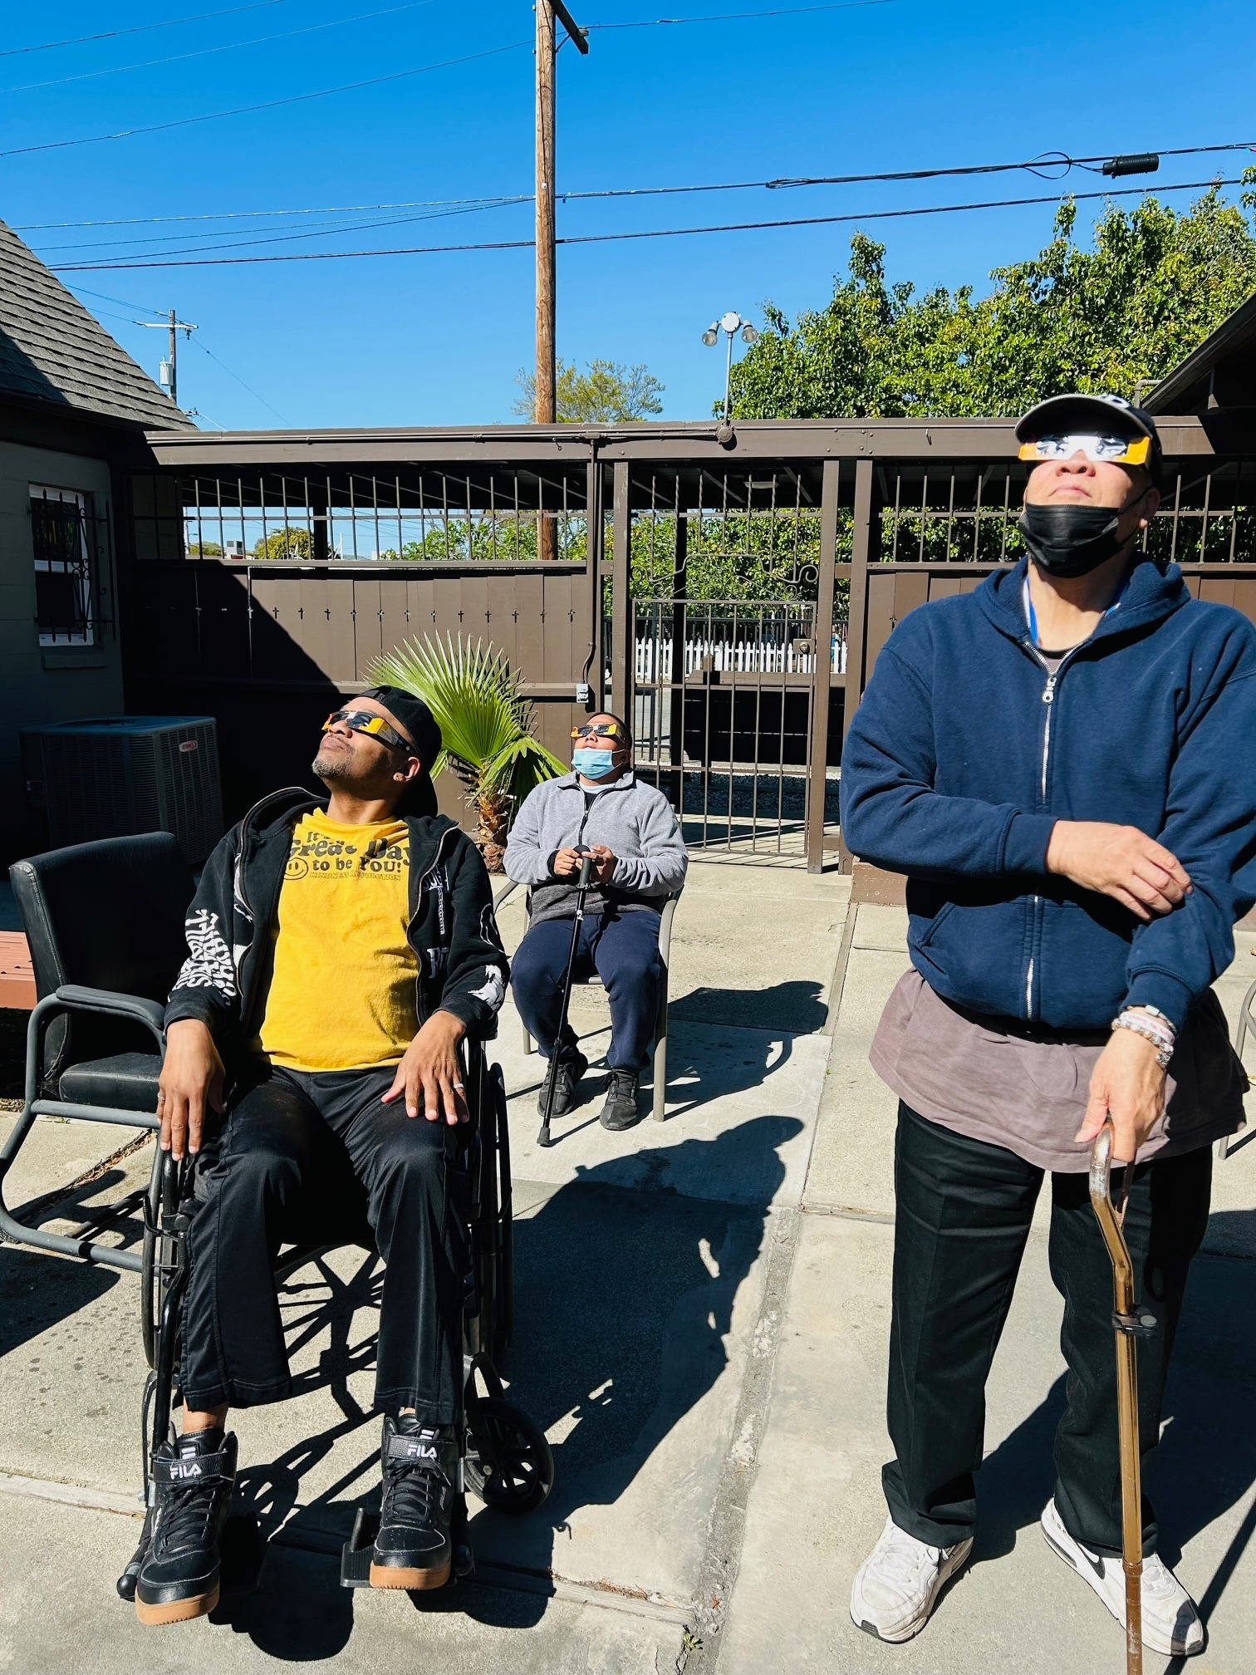
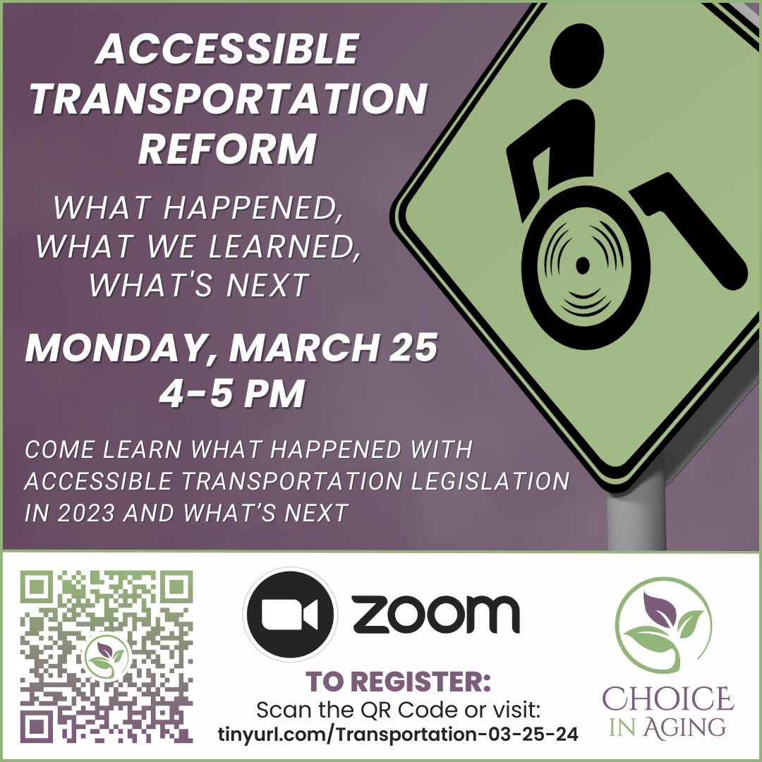
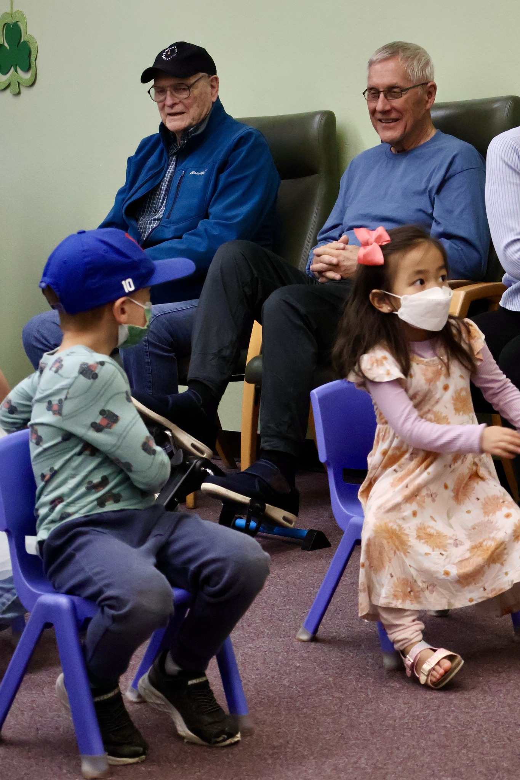
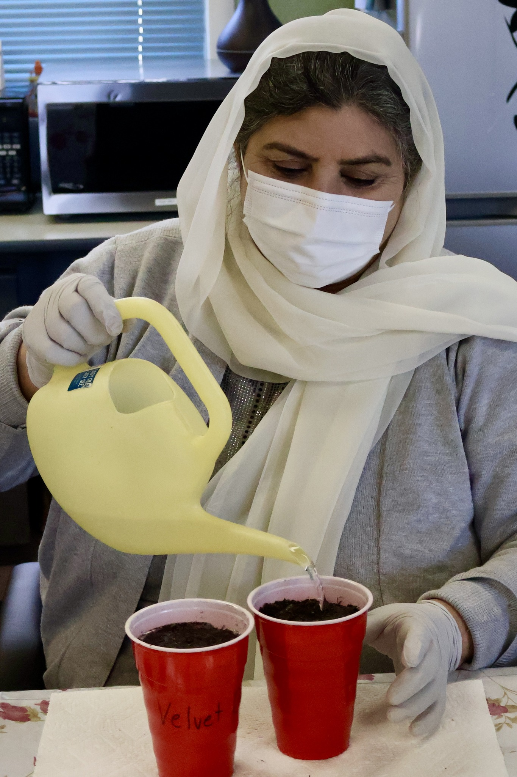
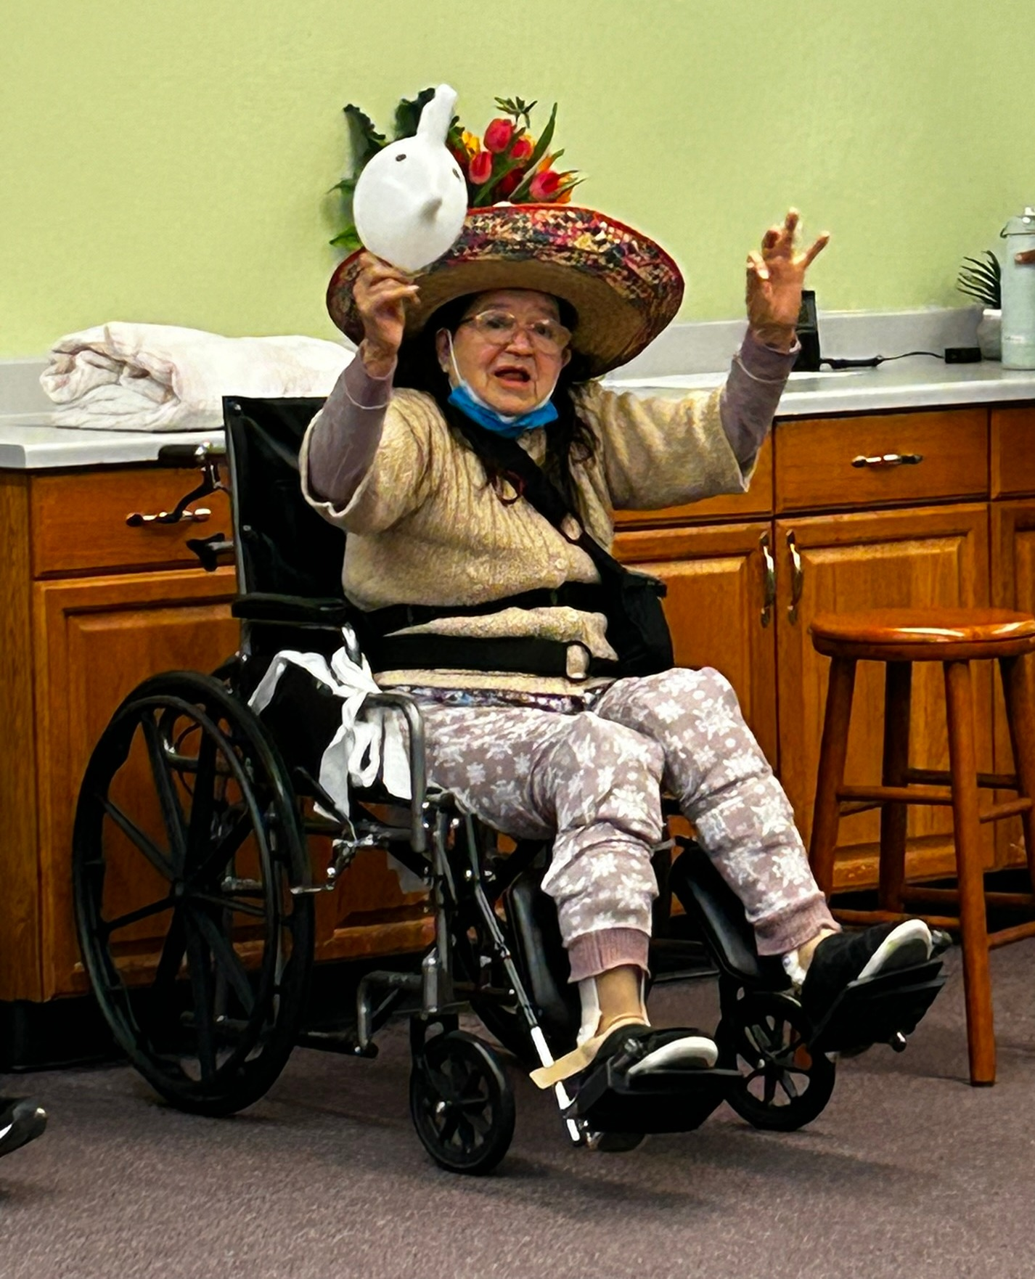
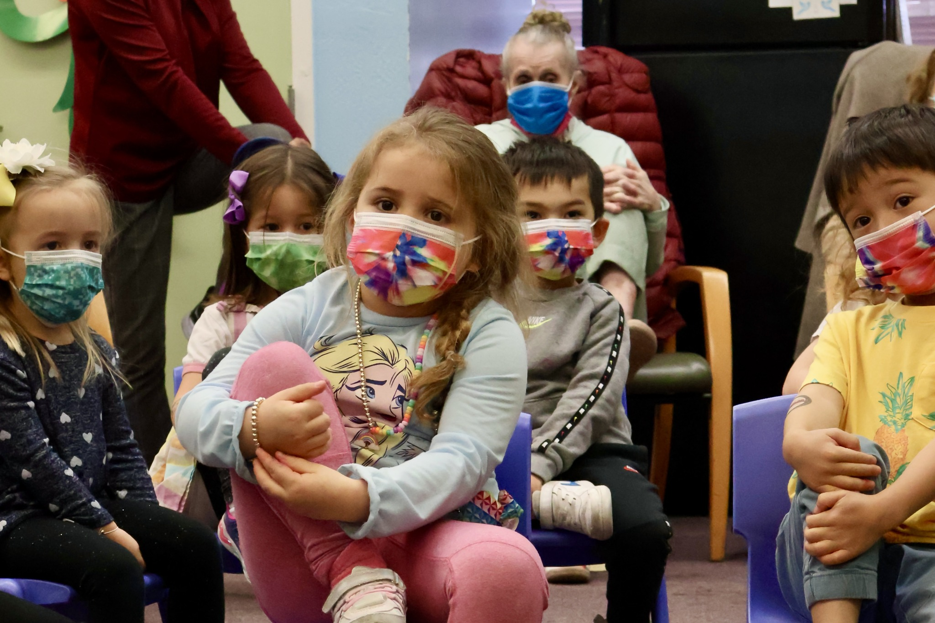
Our mission is to create opportunities where people can learn, grow, and age independently with dignity in community.
TRANSPAC Board Meeting
April 11, 2024
Notes:
Program Overview and Who We Serve
Choice in Aging’s mission is to create opportunities where people can learn, grow, and age independently with dignity in community.
Choice in Aging (CiA) started in 1949 as a rehabilitation facility for children with polio. When polio was eradicated, CiA’s services changed. Today CiA serves more than 600 people with disabilities, multiple health conditions, and Alzheimer’s disease.
CiA was the sixteenth licensed Adult Day Health Care program in California – and one of only two agencies offering state licensed adult day health care in Contra Costa County. CiA has over 40 years of expertise in keeping frail adults living independently. Our Alzheimer’s Day Care Resource Center was one of the first pilot programs of its kind launched in California.
In addition to our day programs which provide nursing, therapy (physical, occupational, recreational), and social programs, CiA has our CCT program: designed to help clients who have been in skilled nursing facilities transition home and our MSSP program to keep our frailest community members living at home and out of institutions.
Several years ago, CiA added the Choice in Learning Montessori preschool to our services and now provides Montessori-based intergenerational programming with our seniors and sprouts.
Transportation We Provide
CiA provides transportation to and from the day program. Transportation is provided via County Connection LINK paratransit service, CiA’s bus, and County Connection/SilverRide that provides door through door service for participants at Mt. Diablo Center (CiA’s adult day health care program in Pleasant Hill).
Service is based on need (medical and/or psychological conditions) and location
We serve Central Contra Costa County – Martinez, Concord, Clayton, Pleasant Hill, and Walnut Creek, M-F
Pre-COVID, CiA also operated a mid-day shopping shuttle in coordination with two low-income senior housing facilities in Concord, The Heritage Senior Apartments in downtown Concord (2020 Grant Street) and the Carlton Senior Living facility (1700 Broadway Street, Concord).
Coming out of the pandemic, we plan to expand to multiple low-income senior housing sites in Central Contra Costa County.

Slide 4
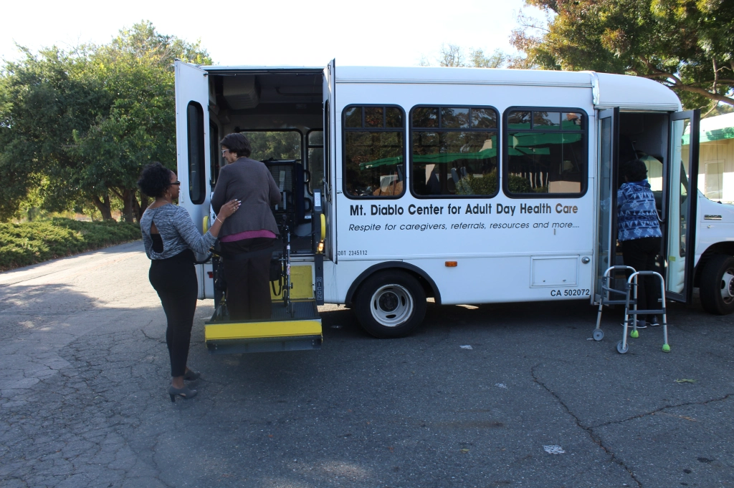
Our Why/History
ADA: The Americans with Disabilities Act created paratransit, but it’s not a one size fits all solution - long ride times, lack of door through door service, no same day service, and mapping to fixed routes makes it unusable for many older adults and people with disabilities.
Advocacy: We began by leading Seniors & Disabled Stakeholders in 2003 to work on Measure J (then C) reauthorization to dramatically increase funding for paratransit and beyond.
Piloted Paratransit Plus: Launched pilot project in 2006 with County Connection to provide one bus - taking 20 ADA trips daily and lowered overall trip times for Choice in Aging, but also the Link riders at large!
Who We Serve
Central County residents who are:
Low-income
Disabled
Elderly with chronic conditions
Refugees/Non-English speaking
Need above and beyond ADA support
TRANSPAC Board Meeting
April 11, 2024
Notes:
Purpose and Need
The Mt. Diablo Mobilizer provides transportation to frail elders and adults with disabilities, customized for special needs so that our clients can continue living independently. We will also be implementing an Accessible Transportation Director position to plan and coordinate our transportation services.
There is a need in Central Contra Costa County for frail elders and adults with disabilities to access health, social, medical, and nutritional service. The Mt. Diablo Mobilizer helps fill this need.
The Mt. Diablo Mobilizer will help implement strategies within the Contra Costa Accessible Transportation Strategic Plan (see below).
Impacts
• The service will help elders participate in CiA’s Adult Day Health Care program which provides needed services such as physical therapy, nursing (including medication management during the day), a healthy meal, and social activities. This allows elders to remain living independently instead of in institutions.
• With the mid-day shuttle service, seniors are provided mobility and independence for local trips to the grocery store, pharmacy, etc.
• Providing transportation to our participants gives the families and caregivers much needed respite time while their loved one attends CiA’s day program. Because this is a door through door program, caregivers can be confident of their loved ones’ safety and security as they will be accompanied throughout their journey.
• Without the Mt. Diablo Mobilizer, CiA participants and residents at senior housing would be isolated at home.
• Seeing the Mt. Diablo Mobilizer driving around in our community heightens the profile of Choice in Aging, hopefully increasing awareness that we serve as a community resource for our frail elders. The additional visibility could also attract additional users of our services.
-------
The Mt. Diablo Mobilizer will meet the following strategies within the Contra Costa Accessible Transportation Strategic Plan:
• Ensure ongoing participation with expertise on frail elder mobility needs on the Implementation Task Force
• Ensure ongoing participation with expertise on frail elder mobility needs, funding streams and institutional/systemic barriers in the development of a consolidated entity
• Ensure ongoing participation with expertise on frail elder mobility needs in the development of partnerships for supportive infrastructure
• Increase options for those needing door through door assistance to and from programs
• Increase options for those needing door through door assistance with shopping
• Expand the circle of services to those living outside the ADA mandated service areas
• Ensure ongoing coordination among providers of services
• Add to the entities which will increase awareness about mobility options.

Slide 5
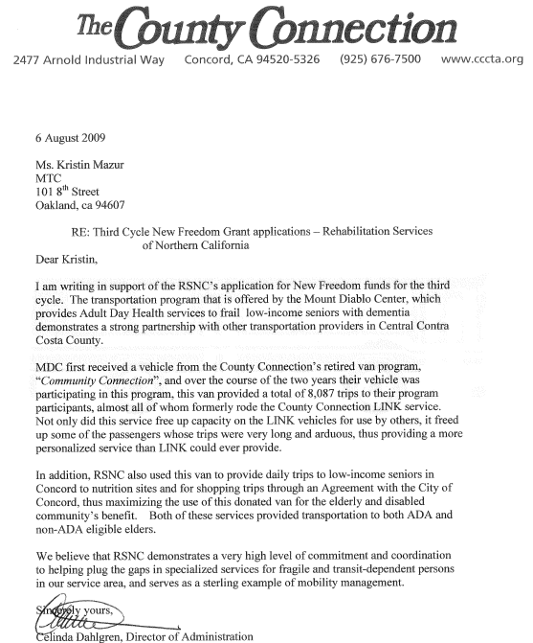
“...over the course of the two years their vehicle was participating in this program, this van provided a total of 8,087 trips to their program participants, almost all of whom formerly rode the County Connection LINK service. Not only did this service free up capacity on the LINK vehicles for use by others, it freed up some of the passengers whose trips were very long and arduous, thus providing a more personalized service than LINK could ever provide.”
TRANSPAC Board Meeting
April 11, 2024

Slide 6
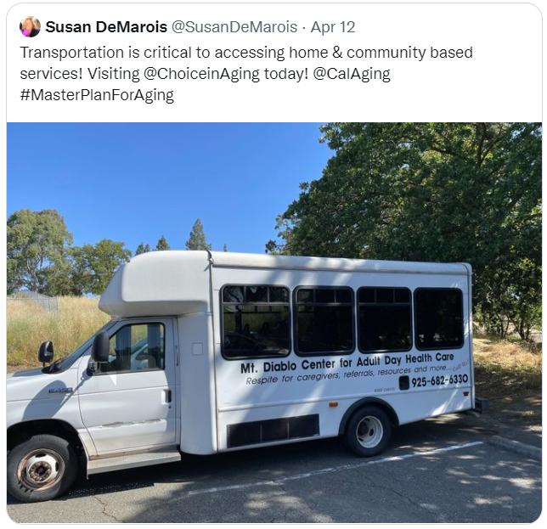
Mt. Diablo Mobilizer
Community: Allows elders and adults with disabilities to engage in day programs, go shopping, make their appointments, all while drastically reducing ride times and providing respite for caregivers
Independence: Ensures our aging and disabled community members are able to get where they need to go quickly and efficiently, supporting dignity and independence
Access: Provides culturally appropriate safe and secure door-through-door access to health, nutritional, and social services, preventing isolation and encouraging socialization
TRANSPAC Board Meeting
April 11, 2024
Notes:
Purpose and Need
The Mt. Diablo Mobilizer provides transportation to frail elders and adults with disabilities, customized for special needs so that our clients can continue living independently. We will also be implementing an Accessible Transportation Director position to plan and coordinate our transportation services.
There is a need in Central Contra Costa County for frail elders and adults with disabilities to access health, social, medical, and nutritional service. The Mt. Diablo Mobilizer helps fill this need.
The Mt. Diablo Mobilizer will help implement strategies within the Contra Costa Accessible Transportation Strategic Plan (see below).
Impacts
• The service will help elders participate in CiA’s Adult Day Health Care program which provides needed services such as physical therapy, nursing (including medication management during the day), a healthy meal, and social activities. This allows elders to remain living independently instead of in institutions.
• With the mid-day shuttle service, seniors are provided mobility and independence for local trips to the grocery store, pharmacy, etc.
• Providing transportation to our participants gives the families and caregivers much needed respite time while their loved one attends CiA’s day program. Because this is a door through door program, caregivers can be confident of their loved ones’ safety and security as they will be accompanied throughout their journey.
• Without the Mt. Diablo Mobilizer, CiA participants and residents at senior housing would be isolated at home.
• Seeing the Mt. Diablo Mobilizer driving around in our community heightens the profile of Choice in Aging, hopefully increasing awareness that we serve as a community resource for our frail elders. The additional visibility could also attract additional users of our services.
-------
The Mt. Diablo Mobilizer will meet the following strategies within the Contra Costa Accessible Transportation Strategic Plan:
• Ensure ongoing participation with expertise on frail elder mobility needs on the Implementation Task Force
• Ensure ongoing participation with expertise on frail elder mobility needs, funding streams and institutional/systemic barriers in the development of a consolidated entity
• Ensure ongoing participation with expertise on frail elder mobility needs in the development of partnerships for supportive infrastructure
• Increase options for those needing door through door assistance to and from programs
• Increase options for those needing door through door assistance with shopping
• Expand the circle of services to those living outside the ADA mandated service areas
• Ensure ongoing coordination among providers of services
• Add to the entities which will increase awareness about mobility options.

Slide 7
Thank you!
TRANSPAC Board Meeting
April 11, 2024

Slide 8
Our mission is to create opportunities where people can learn, grow, and age independently with dignity in community.
TRANSPAC Board Meeting
April 11, 2024
Notes:
Program Overview and Who We Serve
Choice in Aging’s mission is to create opportunities where people can learn, grow, and age independently with dignity in community.
Choice in Aging (CiA) started in 1949 as a rehabilitation facility for children with polio. When polio was eradicated, CiA’s services changed. Today CiA serves more than 600 people with disabilities, multiple health conditions, and Alzheimer’s disease.
CiA was the sixteenth licensed Adult Day Health Care program in California – and one of only two agencies offering state licensed adult day health care in Contra Costa County. CiA has over 40 years of expertise in keeping frail adults living independently. Our Alzheimer’s Day Care Resource Center was one of the first pilot programs of its kind launched in California.
In addition to our day programs which provide nursing, therapy (physical, occupational, recreational), and social programs, CiA has our CCT program: designed to help clients who have been in skilled nursing facilities transition home and our MSSP program to keep our frailest community members living at home and out of institutions.
Several years ago, CiA added the Choice in Learning Montessori preschool to our services and now provides Montessori-based intergenerational programming with our seniors and sprouts.
Transportation We Provide
CiA provides transportation to and from the day program. Transportation is provided via County Connection LINK paratransit service, CiA’s bus, and County Connection/SilverRide that provides door through door service for participants at Mt. Diablo Center (CiA’s adult day health care program in Pleasant Hill).
Service is based on need (medical and/or psychological conditions) and location
We serve Central Contra Costa County – Martinez, Concord, Clayton, Pleasant Hill, and Walnut Creek, M-F
Pre-COVID, CiA also operated a mid-day shopping shuttle in coordination with two low-income senior housing facilities in Concord, The Heritage Senior Apartments in downtown Concord (2020 Grant Street) and the Carlton Senior Living facility (1700 Broadway Street, Concord).
Coming out of the pandemic, we plan to expand to multiple low-income senior housing sites in Central Contra Costa County.

Slide 9
Our Why/History
ADA: The Americans with Disabilities Act created paratransit, but it’s not a one size fits all solution - long ride times, lack of door through door service, no same day service, and mapping to fixed routes makes it unusable for many older adults and people with disabilities.
Advocacy: We began by leading Seniors & Disabled Stakeholders in 2003 to work on Measure J (then C) reauthorization to dramatically increase funding for paratransit and beyond.
Piloted Paratransit Plus: Launched pilot project in 2006 with County Connection to provide one bus - taking 20 ADA trips daily and lowered overall trip times for Choice in Aging, but also the Link riders at large!
Who We Serve
Central County residents who are:
Low-income
Disabled
Elderly with chronic conditions
Refugees/Non-English speaking
Need above and beyond ADA support
TRANSPAC Board Meeting
April 11, 2024
Notes:
Purpose and Need
The Mt. Diablo Mobilizer provides transportation to frail elders and adults with disabilities, customized for special needs so that our clients can continue living independently. We will also be implementing an Accessible Transportation Director position to plan and coordinate our transportation services.
There is a need in Central Contra Costa County for frail elders and adults with disabilities to access health, social, medical, and nutritional service. The Mt. Diablo Mobilizer helps fill this need.
The Mt. Diablo Mobilizer will help implement strategies within the Contra Costa Accessible Transportation Strategic Plan (see below).
Impacts
• The service will help elders participate in CiA’s Adult Day Health Care program which provides needed services such as physical therapy, nursing (including medication management during the day), a healthy meal, and social activities. This allows elders to remain living independently instead of in institutions.
• With the mid-day shuttle service, seniors are provided mobility and independence for local trips to the grocery store, pharmacy, etc.
• Providing transportation to our participants gives the families and caregivers much needed respite time while their loved one attends CiA’s day program. Because this is a door through door program, caregivers can be confident of their loved ones’ safety and security as they will be accompanied throughout their journey.
• Without the Mt. Diablo Mobilizer, CiA participants and residents at senior housing would be isolated at home.
• Seeing the Mt. Diablo Mobilizer driving around in our community heightens the profile of Choice in Aging, hopefully increasing awareness that we serve as a community resource for our frail elders. The additional visibility could also attract additional users of our services.
-------
The Mt. Diablo Mobilizer will meet the following strategies within the Contra Costa Accessible Transportation Strategic Plan:
• Ensure ongoing participation with expertise on frail elder mobility needs on the Implementation Task Force
• Ensure ongoing participation with expertise on frail elder mobility needs, funding streams and institutional/systemic barriers in the development of a consolidated entity
• Ensure ongoing participation with expertise on frail elder mobility needs in the development of partnerships for supportive infrastructure
• Increase options for those needing door through door assistance to and from programs
• Increase options for those needing door through door assistance with shopping
• Expand the circle of services to those living outside the ADA mandated service areas
• Ensure ongoing coordination among providers of services
• Add to the entities which will increase awareness about mobility options.

Slide 10
“...over the course of the two years their vehicle was participating in this program, this van provided a total of 8,087 trips to their program participants, almost all of whom formerly rode the County Connection LINK service. Not only did this service free up capacity on the LINK vehicles for use by others, it freed up some of the passengers whose trips were very long and arduous, thus providing a more personalized service than LINK could ever provide.”
TRANSPAC Board Meeting
April 11, 2024

Slide 11
Mt. Diablo Mobilizer
Community: Allows elders and adults with disabilities to engage in day programs, go shopping, make their appointments, all while drastically reducing ride times and providing respite for caregivers
Independence: Ensures our aging and disabled community members are able to get where they need to go quickly and efficiently, supporting dignity and independence
Access: Provides culturally appropriate safe and secure door-through-door access to health, nutritional, and social services, preventing isolation and encouraging socialization
TRANSPAC Board Meeting
April 11, 2024
Notes:
Purpose and Need
The Mt. Diablo Mobilizer provides transportation to frail elders and adults with disabilities, customized for special needs so that our clients can continue living independently. We will also be implementing an Accessible Transportation Director position to plan and coordinate our transportation services.
There is a need in Central Contra Costa County for frail elders and adults with disabilities to access health, social, medical, and nutritional service. The Mt. Diablo Mobilizer helps fill this need.
The Mt. Diablo Mobilizer will help implement strategies within the Contra Costa Accessible Transportation Strategic Plan (see below).
Impacts
• The service will help elders participate in CiA’s Adult Day Health Care program which provides needed services such as physical therapy, nursing (including medication management during the day), a healthy meal, and social activities. This allows elders to remain living independently instead of in institutions.
• With the mid-day shuttle service, seniors are provided mobility and independence for local trips to the grocery store, pharmacy, etc.
• Providing transportation to our participants gives the families and caregivers much needed respite time while their loved one attends CiA’s day program. Because this is a door through door program, caregivers can be confident of their loved ones’ safety and security as they will be accompanied throughout their journey.
• Without the Mt. Diablo Mobilizer, CiA participants and residents at senior housing would be isolated at home.
• Seeing the Mt. Diablo Mobilizer driving around in our community heightens the profile of Choice in Aging, hopefully increasing awareness that we serve as a community resource for our frail elders. The additional visibility could also attract additional users of our services.
-------
The Mt. Diablo Mobilizer will meet the following strategies within the Contra Costa Accessible Transportation Strategic Plan:
• Ensure ongoing participation with expertise on frail elder mobility needs on the Implementation Task Force
• Ensure ongoing participation with expertise on frail elder mobility needs, funding streams and institutional/systemic barriers in the development of a consolidated entity
• Ensure ongoing participation with expertise on frail elder mobility needs in the development of partnerships for supportive infrastructure
• Increase options for those needing door through door assistance to and from programs
• Increase options for those needing door through door assistance with shopping
• Expand the circle of services to those living outside the ADA mandated service areas
• Ensure ongoing coordination among providers of services
• Add to the entities which will increase awareness about mobility options.

Slide 12
Thank you!
TRANSPAC Board Meeting
April 11, 2024

