Slide 1
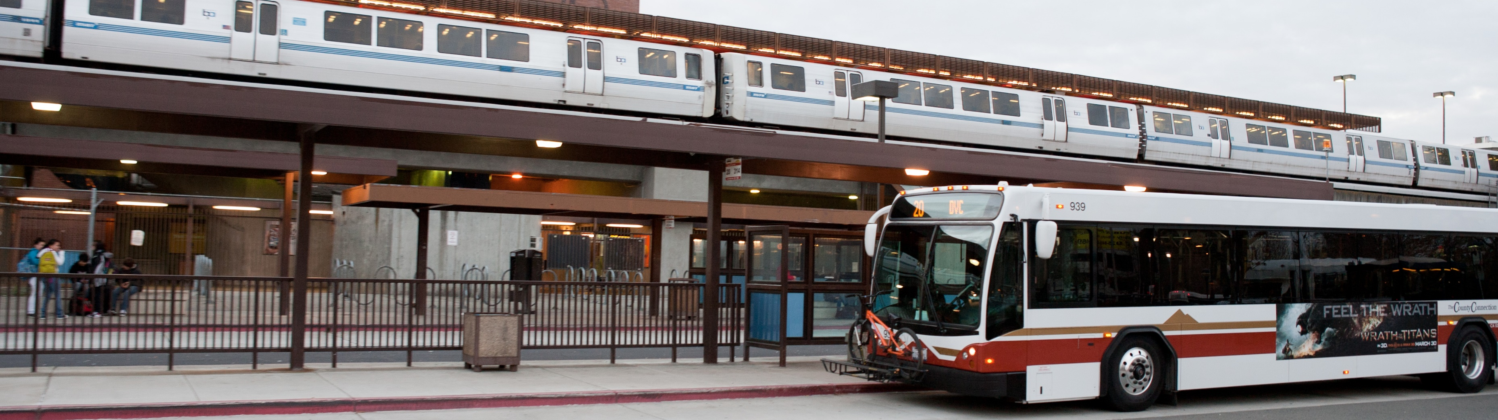

Midday Free - Measure J Line 20a
TRANSPAC – March 14, 2024

Slide 2
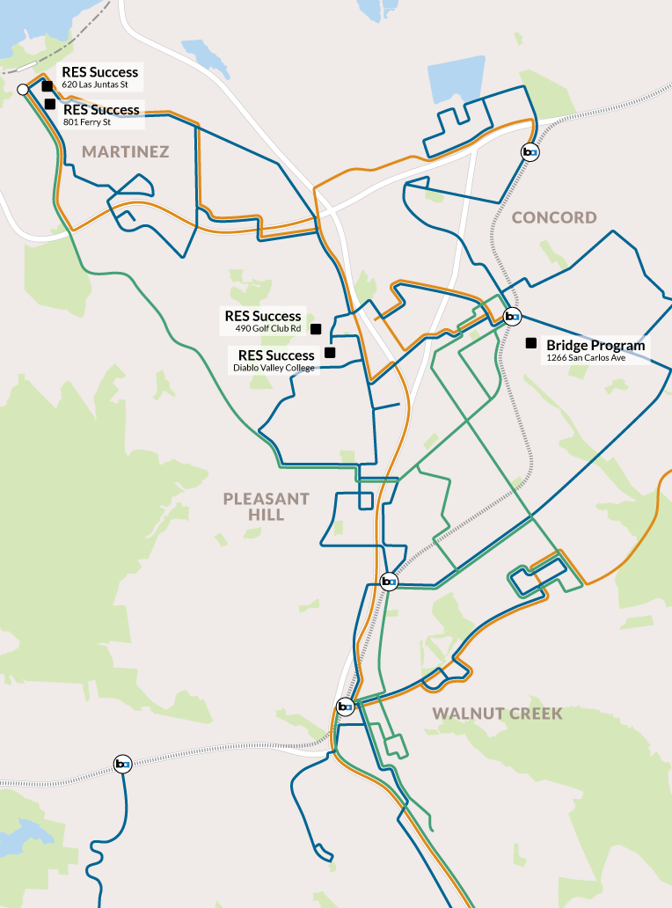
Midday Free Rides:
Overview
Continuation of existing program currently funded by Measure J Line 20a
Free rides on County Connection fixed-route buses to facilitate travel training for students with disabilities
Limited to off-peak hours (10am–2pm) when capacity is already available
Participating transition programs:
  Mt. Diablo Unified School District’s Bridge Program (Concord)
  RES Success (Pleasant Hill, Martinez)

Slide 3
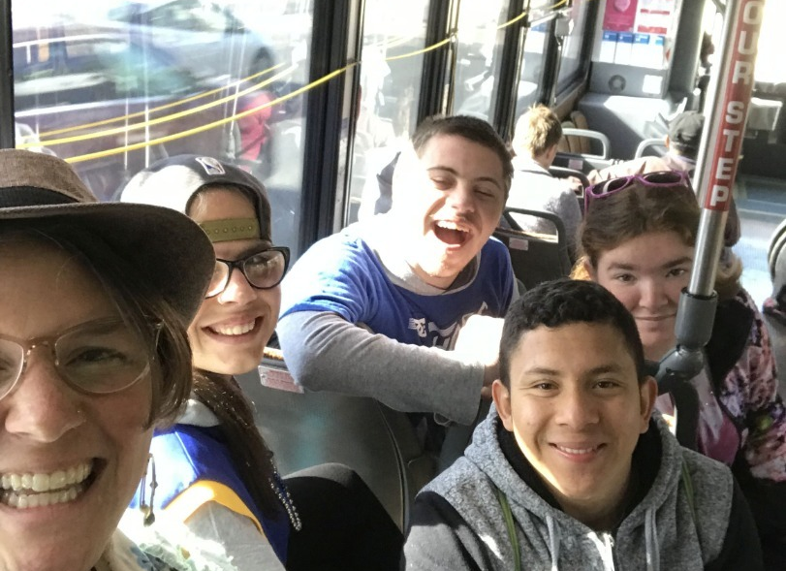
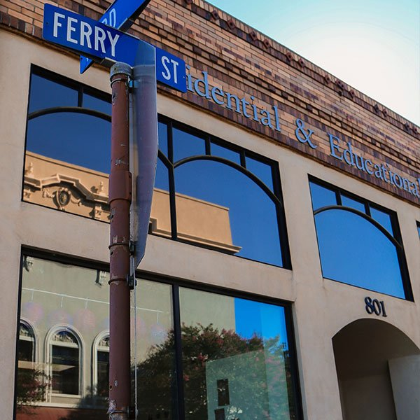
Midday Free Rides
Source: Mt. Diablo Unified School District
Source: RES – Martinez Website
Mt. Diablo unified school District
RES Success

Slide 4
Program Impact
“Being able to ride County Connection buses is the perfect bridge to help our students get to the next level in their lives. They use it to be part of their community, get to their part-time jobs, and support local businesses. The entire process of riding the bus independently is daunting, so being able to focus on logistics and safety rather than payment allows our students to build skills that will help them become lifelong transit riders."
          Chloe Page, Education Specialist, Mt Diablo Unified Bridge Program

Slide 5
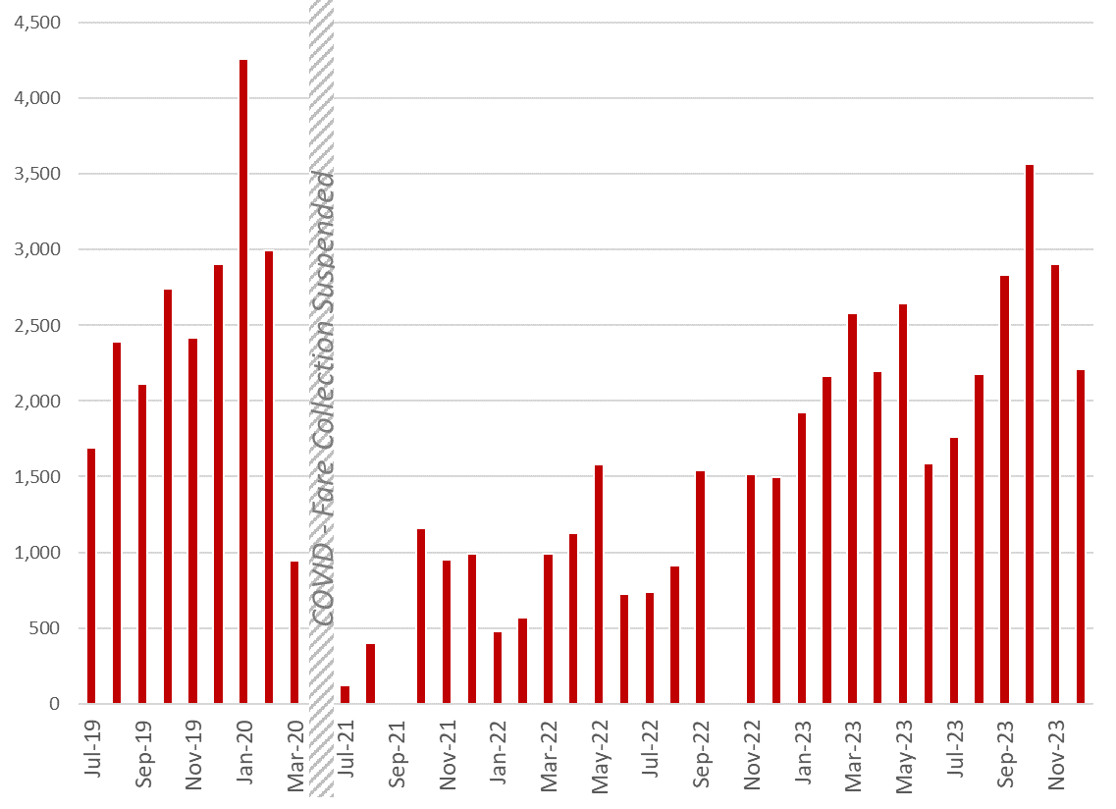
Midday Free Rides:
Ridership & Usage
190 participants across two programs
Total of 43,851 rides from July 2021 – Dec 2023
Steady increase across FY 22, FY 23.
  Pre-COVID: 2,700 monthly trips
  FY 2023: 1,755 monthly trips

Slide 6
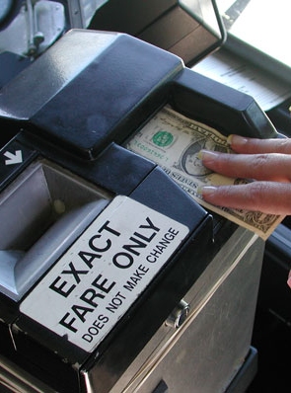
Midday Free Rides:
Costs & Funding
Projected ridership of 3,000 trips per month for FY 2024-25 & FY 2025-26
Estimated cost of $79,200 over two years
  Fare revenue loss: $1.00 per trip
  Program administration: 10% ($0.10 per trip)
Reimbursement requests to be based on actual usage
Could be expanded to additional transition programs depending on usage and available funding

Slide 7
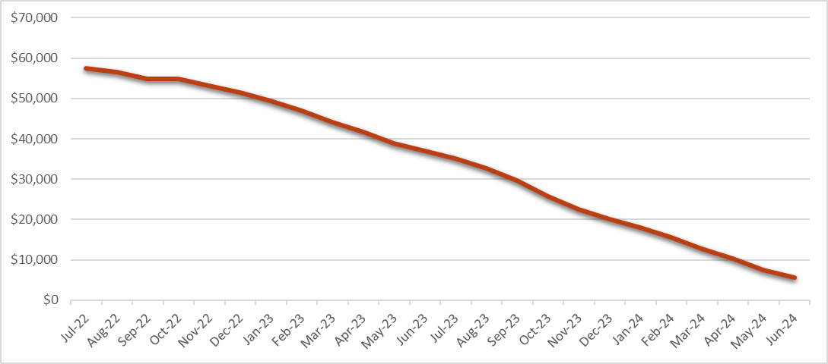
Midday Free Rides:
Historic Spend of Funds
Projected

Slide 8
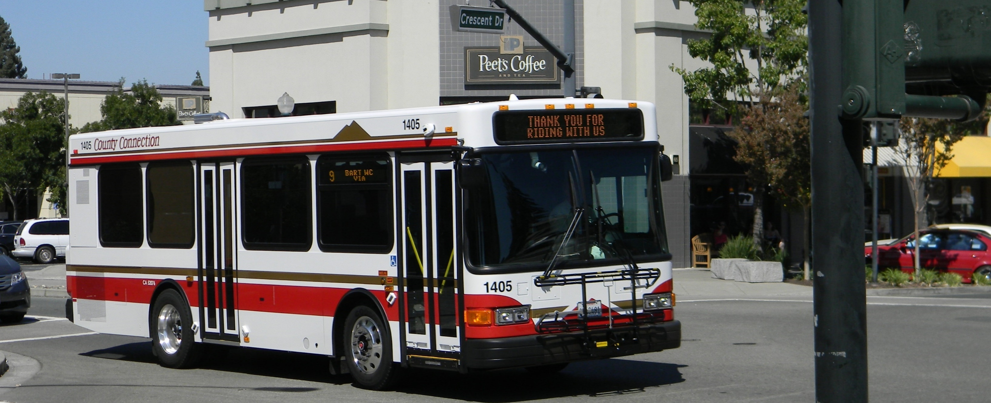
Thank you!
Melody Reebs
Director of Planning, Marketing, & Innovation
Kyle Boehm
Grants Administrator

