Slide 1


Contra Costa Transportation Authority Automated Driving Systems (ADS) Program Update
Prepared for
TRANSPAC
April 11, 2024

Slide 2
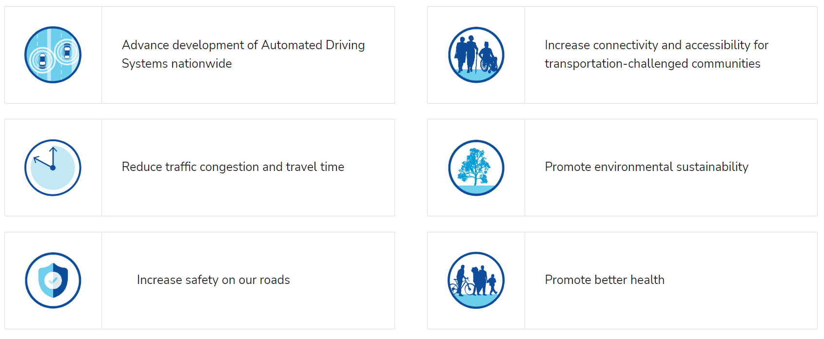
Automated Driving System (ADS) Demonstration Program Goals
Demonstrations will facilitate data collection to support rulemaking and development of ADS safety performance standards
Advance Safety of Automated Driving Systems nationwide
Increase connectivity and accessibility for transportation-challenged communities
Reduce traffic congestion and travel time
Promote environmental sustainability
Increase safety on our roads
Promote better health
Notes:
The CCTA ADS Demonstration Project goals defined based on Innovative Operational Strategies, First Mile and Last Mile Connections, and Prepare the Corridor for the future strategies are:
Advance safety of Automated Driving Systems
Facilitate data collection to support rulemaking and development of ADS safety performance standards
Provide unprecedented mobility choices to transportation-challenged, underserved communities
Expand shared mobility options

Slide 3
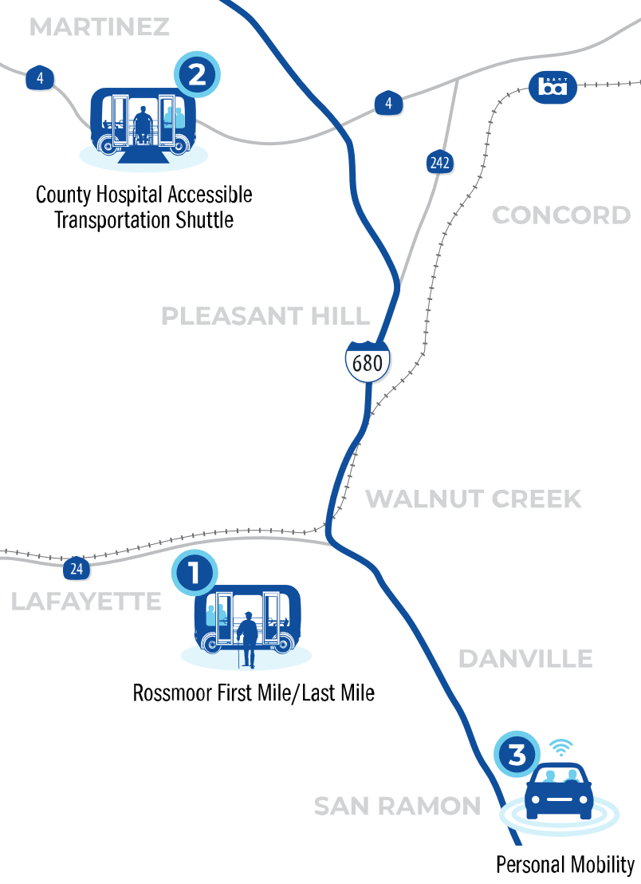
ADS Projects
PROJECT 1: Rossmoor Senior Community First Mile / Last Mile Shuttles, Walnut Creek, CA
Shared AV trial that will connect seniors with essential goods and services, providing greater transit accessibility and independence for Rossmoor residents.
PROJECT 2: County Hospital Accessible Transportation Shuttles, Martinez, CA
On-demand, wheelchair accessible AV shuttle service for people who don’t have reliable transportation to medical appointments and hospital services.
PROJECT 3: Personal Mobility on I-680 Corridor, San Ramon, CA
Install necessary technologies along a two-mile stretch of I-680 to prepare for the future of connected and automated vehicles (CAVs). This pilot project will allow testing of a range of AVs for safe integration onto the roadway alongside traditional vehicles.

Slide 4






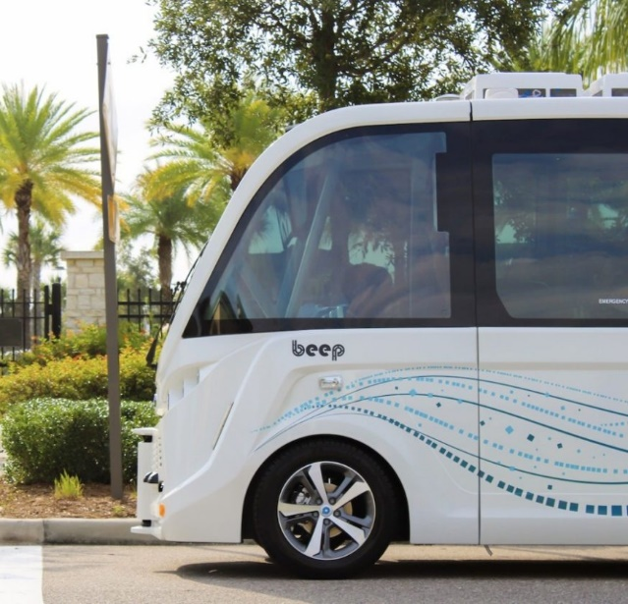

Rossmoor First Mile/Last Mile Shared Autonomous Vehicles
Walnut Creek, California
AV provider Local Motors went out of business early 2022
A replacement SAV vendor contract awarded to Beep in July 2022
Execution of Access Agreement with Rossmoor, Beep, and CCTA to deploy SAV, provide storage and charging station at Rossmoor
Testing started at beep facility late 2023
CCTA authorized shipment of vehicles March 2024
Target for Deployment May 2024
Stakeholders
Rossmoor
City of Walnut Creek
Partners
Beep
Telegra
UC Berkeley PATH
Heex
Notes:
Increase transit accessibility for the elderly community using shared autonomous vehicles (SAVs)
Data gathered will be used to develop safety performance measures
Project will utilize Level 4 low-speed SAV shuttles (up to 25mph)
Demo Type: Fixed route SAV service with multiple stop locations along a predetermined path to load and unload passengers
HMI: User interface is able to identify desired stop, Q’STRAINT automated securement and restraint systems
Partners Roles:
Beep– Shared Autonomous Vehicle Technology
Telegra – Data Integration for Highways
UCB PATH – Program Evaluation
Heex Data processing and visualization
CCTA facilitates access to GoMentum Testbed including V2X Signal Lab

Slide 5
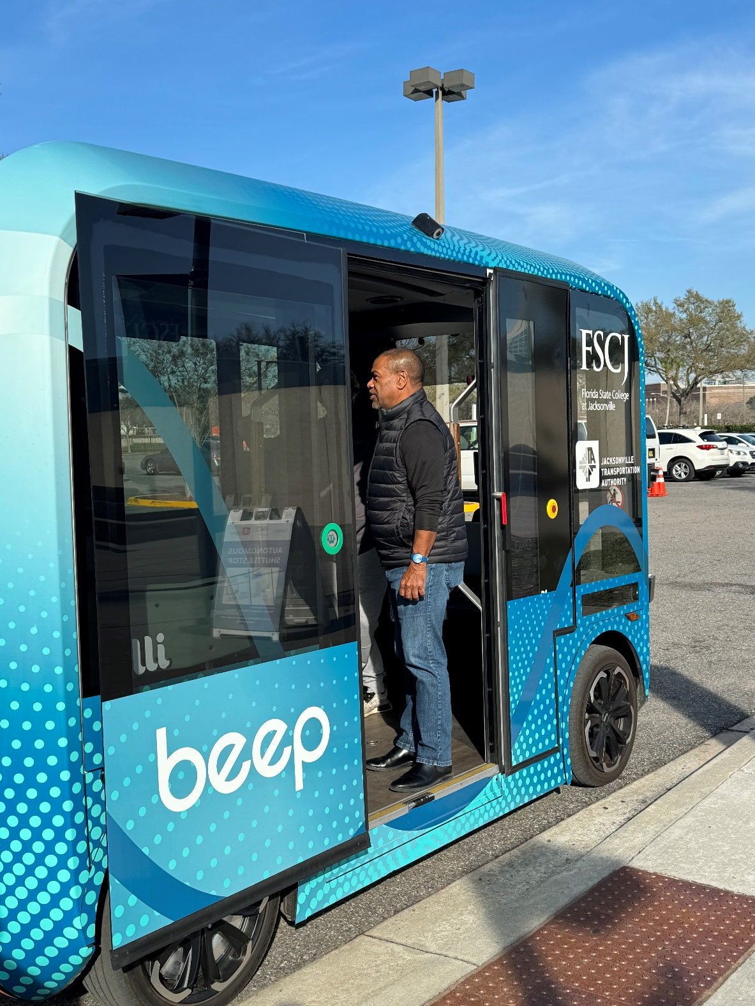
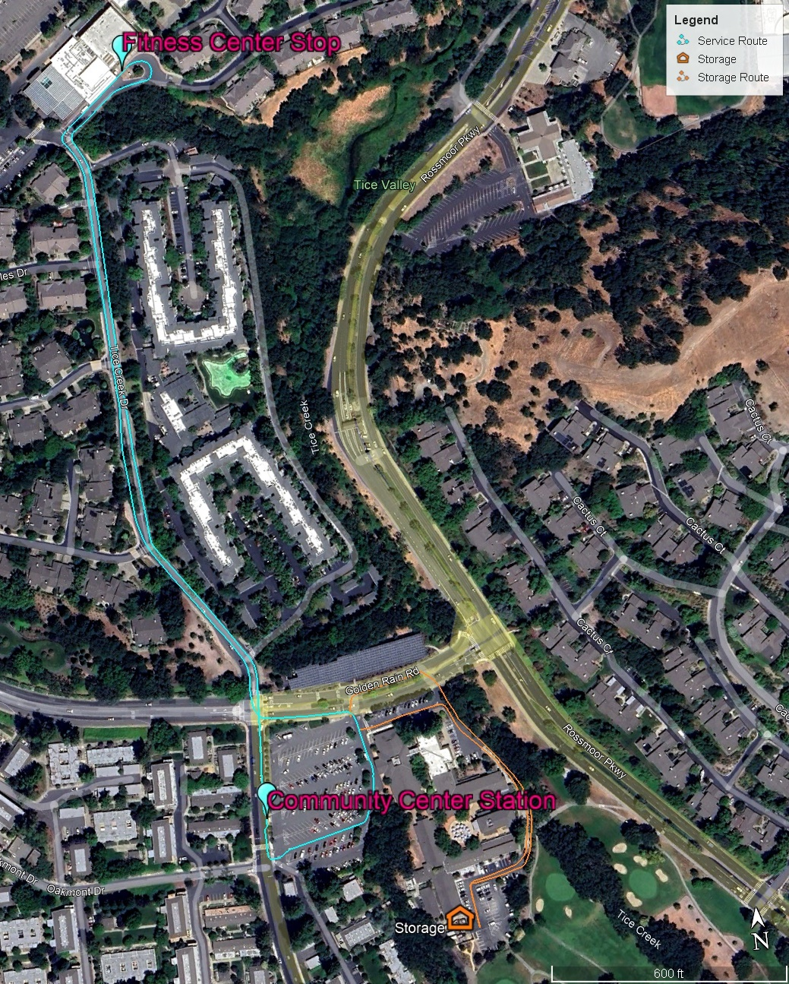
Project 1: Rossmoor Deployment
Service Location: Rossmoor Senior Community
Launch Date: Targeted May 2024
# of Shuttles: 2 Shared Autonomous Vehicle Suttles. Ollie vehicles with Oxa robotics package
Service Hours: 9-5
Proprietary and confidential. Property of May Mobility. Do not distribute or forward.

Slide 6


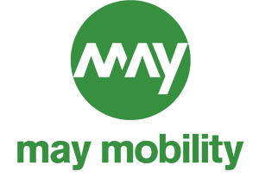





County Hospital Accessible Transportation
Martinez, California
New AV solution was identified, May Mobility AV contract executed in July 2023
Update Use Cases with County Hospital, and County Connection
Compliance with County Connection route(s), labor requirements, hours of service (undergoing)
Agreement with County Connection to provide operators and route services.
Mapping and Testing in Q1 2024
Deployment late spring/early summer 2024
Stakeholders
FTA
CCTA
County Connection
Contra Costa County
City of Martinez
County Hospital
First Responders
TRANSPAC
Partners
AMG
May Mobility
Telegra
UC Berkeley PATH
Heex
Notes:
On-demand, wheelchair accessible, autonomous vehicle (AV) shuttle service
Provide accessible transportation to public health facility to improve quality of life and medical appointment absenteeism
Gather data to help develop safety performance measures
Level 3, Level 4 medium speed shuttles (up to 50mph)
Smartphone app and dial-a-ride service, Q’STRAINT automated securement and restraint systems, and optional wearable device such as a bracelet especially designed for seniors and minimally ambulatory individuals
Future expansion of service area to include on-demand services in Concord, Pleasant Hill, and Walnut Creek
Partners Roles:
May Mobility– Shared Autonomous Vehicle Technology
Telegra – Data Integration for Highways
UCB PATH – Program Evaluation
Heex Data processing and visualization
CCTA facilitates access to GoMentum Testbed including V2X Signal Lab

Slide 7
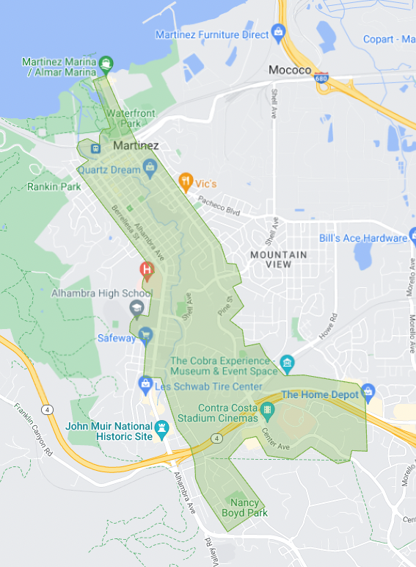
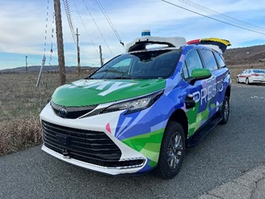
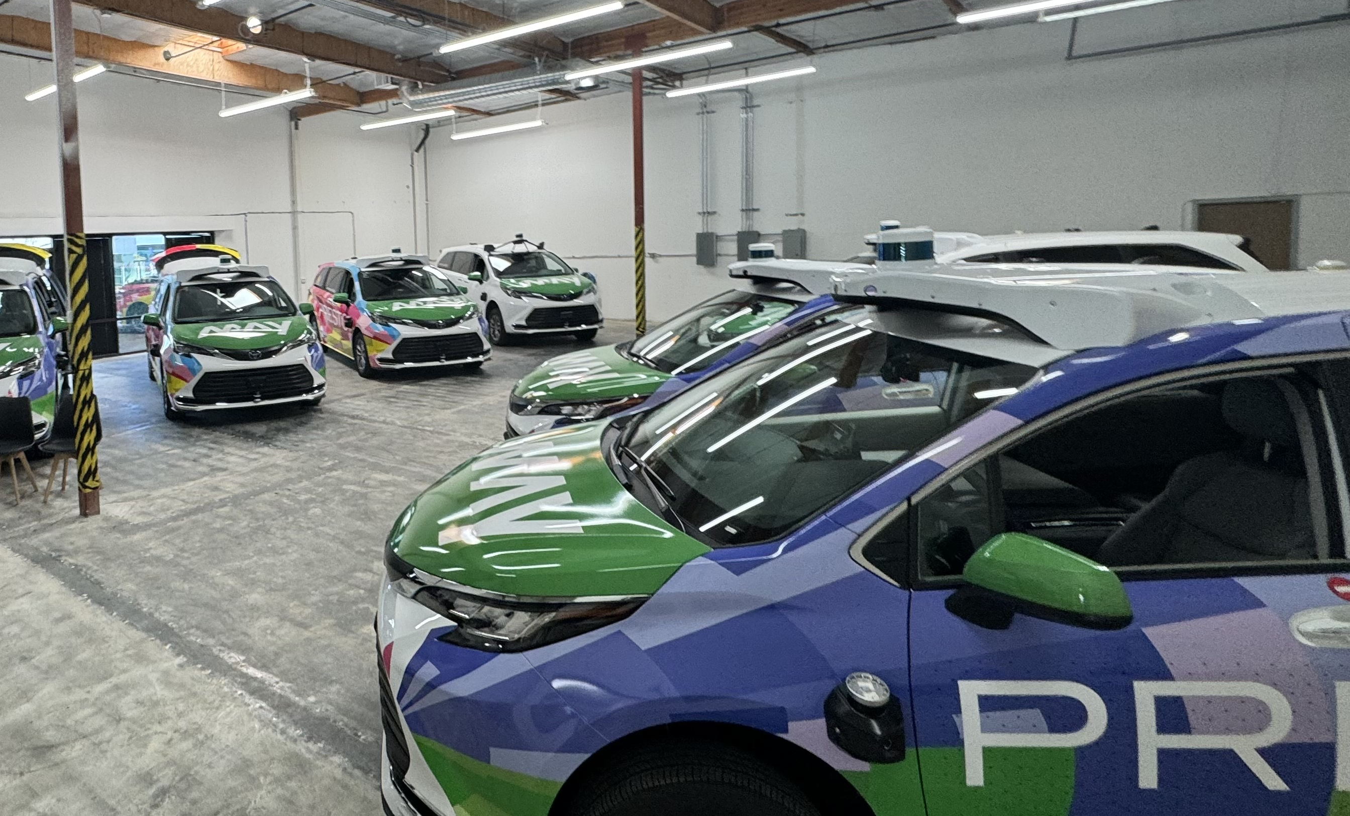
Project 2: Medical Services Deployment
Core Service Locations: City of Martinez, Amtrak Station, Contra Costa Regional Medical Center
Launch Date: late spring/early summer 2024
# of Shuttles: Seven (7) Total (6 operational, 1 reserve)
Four (4) standard Sienna’s
Three (3) accessible Sienna’s
Service Hours: Targeting M-F 6pm-10pm with potential hospital service (AM) outside of that window in designated zone. 932
Proprietary and confidential. Property of May Mobility. Do not distribute or forward.

Slide 8
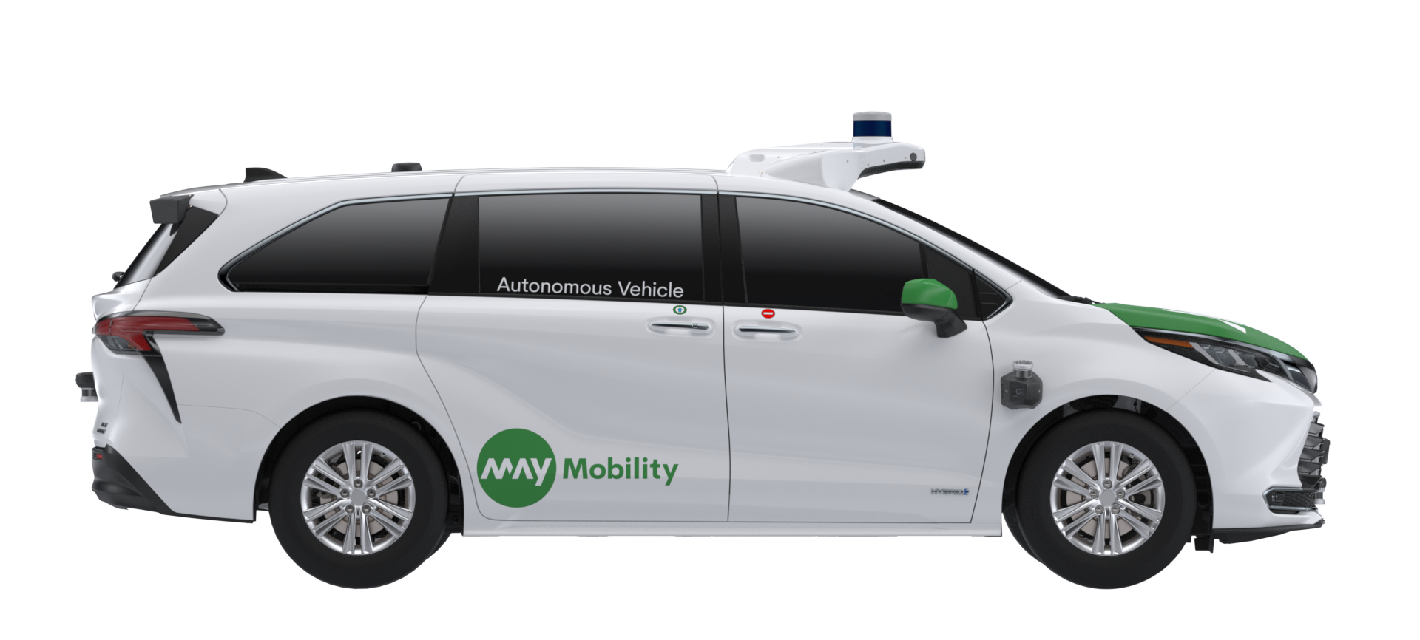

Sienna Autono-MaaS
(Mobility as a Service) Platform
New and emerging safety and customer experience features
Cabin awareness
Comfortable ride
MPDM integration with carefully tuned ride feel
Open feel
• Open view - no front passenger seat
• Ambient lighting
Connectivity
Rider wifi hotspot,
USB charging
Configurability
• Low power tablet displays
• App based GUI
Fuel Efficiency
Hybrid - 35 mpg
Easy ingress/egress
Sliding doors, captain seats
Rider capacity
Comfortable seating for 4
(max 5)
Accessibility
Wheelchair accessible with 2 additional passengers; accommodates service animal & attendant. passenger screens, audio queues
Space for storage
Large and small
(Scooter, stroller, groceries)
Specs: 17’3” Length | 7’7” Width | 6’7” Height | ~4,800 lbs GVWR

Slide 9
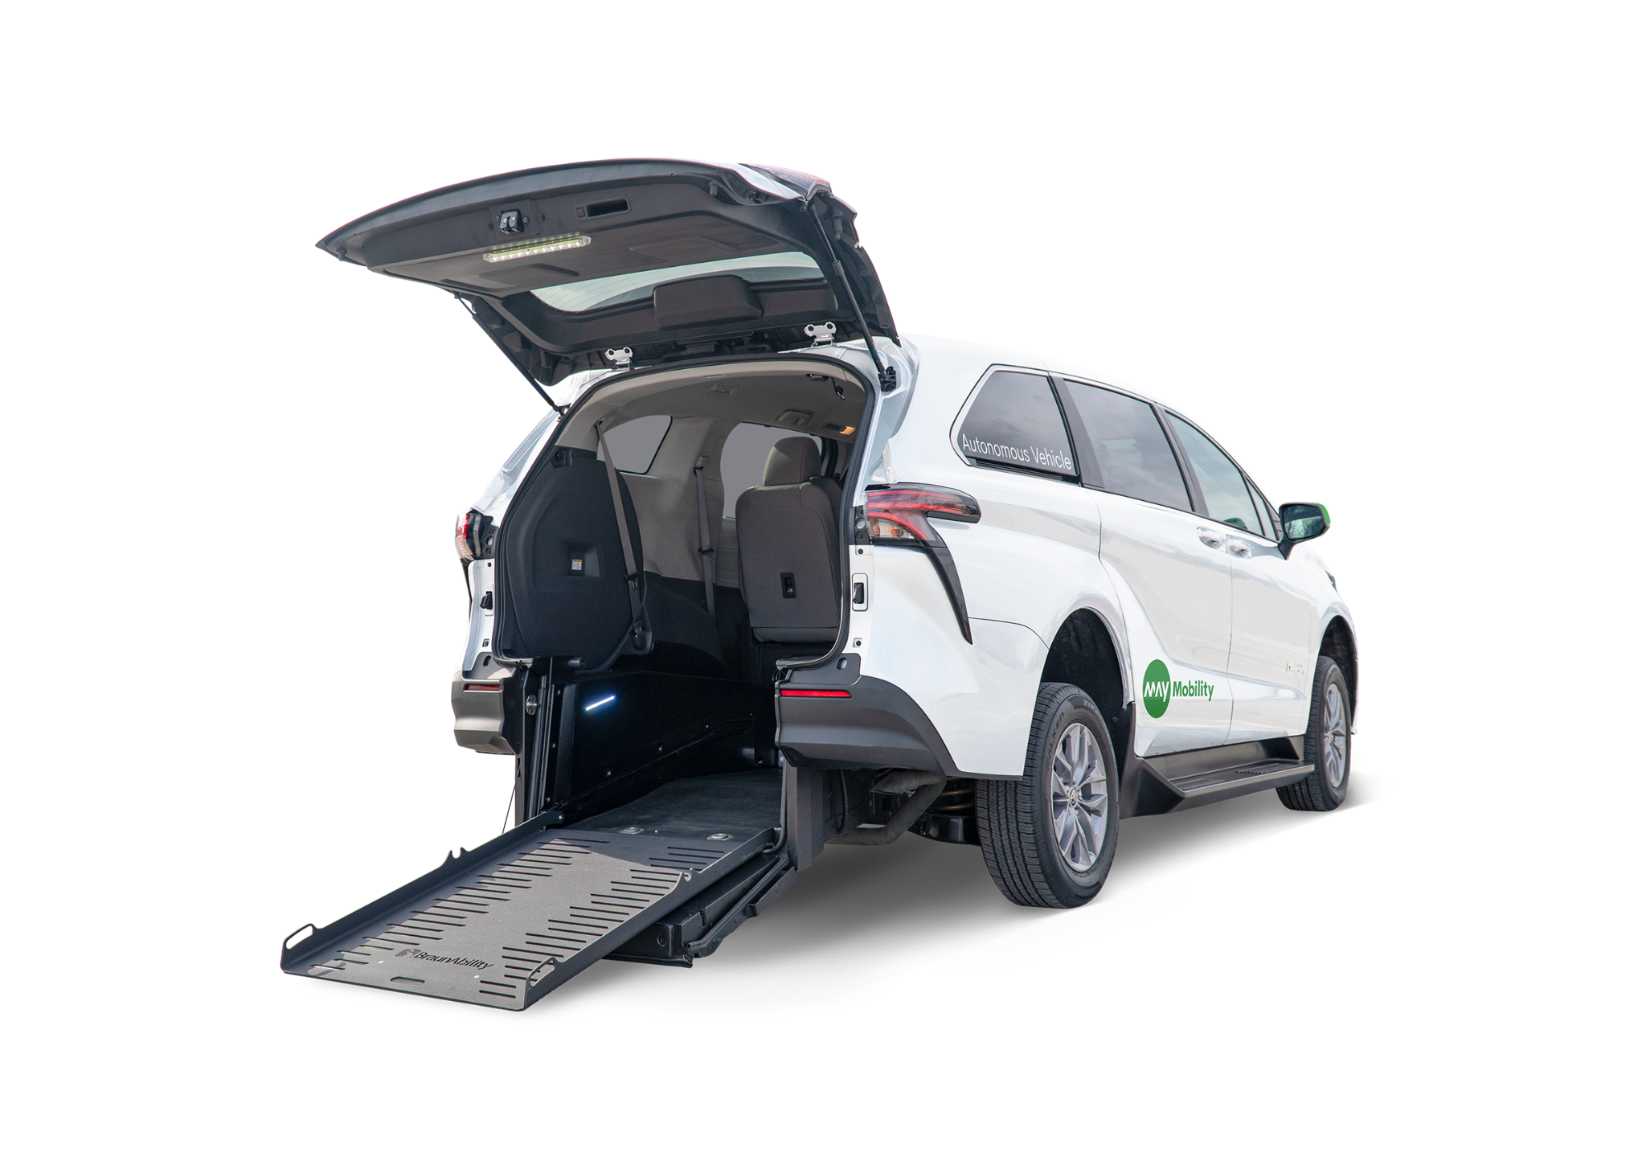
Accessibility For All
Accessibility
  Wheelchair accessible with 2 additional passengers
  Accommodates service animal & attendant
  Passenger screens and audio queues included
Space for storage
  Large and small
  Luggage, scooter, stroller, groceries, etc.
The Toyota Sienna Autono-MaaS

Slide 10







Personal Mobility on I-680 Corridor,
San Ramon, California
Data successfully transferred from Nissan vehicle to Verizon, to Telegra (testing at GoMentum)
Data collection is on-going
Nissan is implementing a cooperative congestion management on I-680 in Town of Danville (demonstration is July 2024)
Verizon video system obsolete, Verizon to provide a replacement system acceptable to stakeholders
Agreement with City of San Ramon to procure and install monitoring and data gathering equipment, and charging stations.
Deployment anticipated summer 2024
Stakeholders
City of San Ramon
Caltrans
CHP
First Responders
Partners
Nissan
Verizon
Telegra
UC Berkeley PATH
Heex
Notes:
Integrate and operate highly-automated CAVs on a two-mile segment of the I-680 freeway and adjacent arterials
Prepare a portion of the I-680 Corridor for future CAVs
V2I, V2V, and 4G/5G communications
Gather data to help develop safety performance measures
Level 3, Level 4 high speed CAVs (up to 65mph)
HD dynamic mapping and ADAS technologies
HMI: Touch screens with maps to enable the user to identify a destination and preferred route.
Partners Roles:
Nissan – State of the art Seamless Autonomous Mobility (SAM) software + AV Cars
Verizon – Communication system infrastructure 4G/5G demonstration
Telegra – Data Integration for Highways
UCB PATH – Program Evaluation
Heex Data processing and visualization
CCTA facilitates access to GoMentum Testbed including V2X Signal Lab

Slide 11
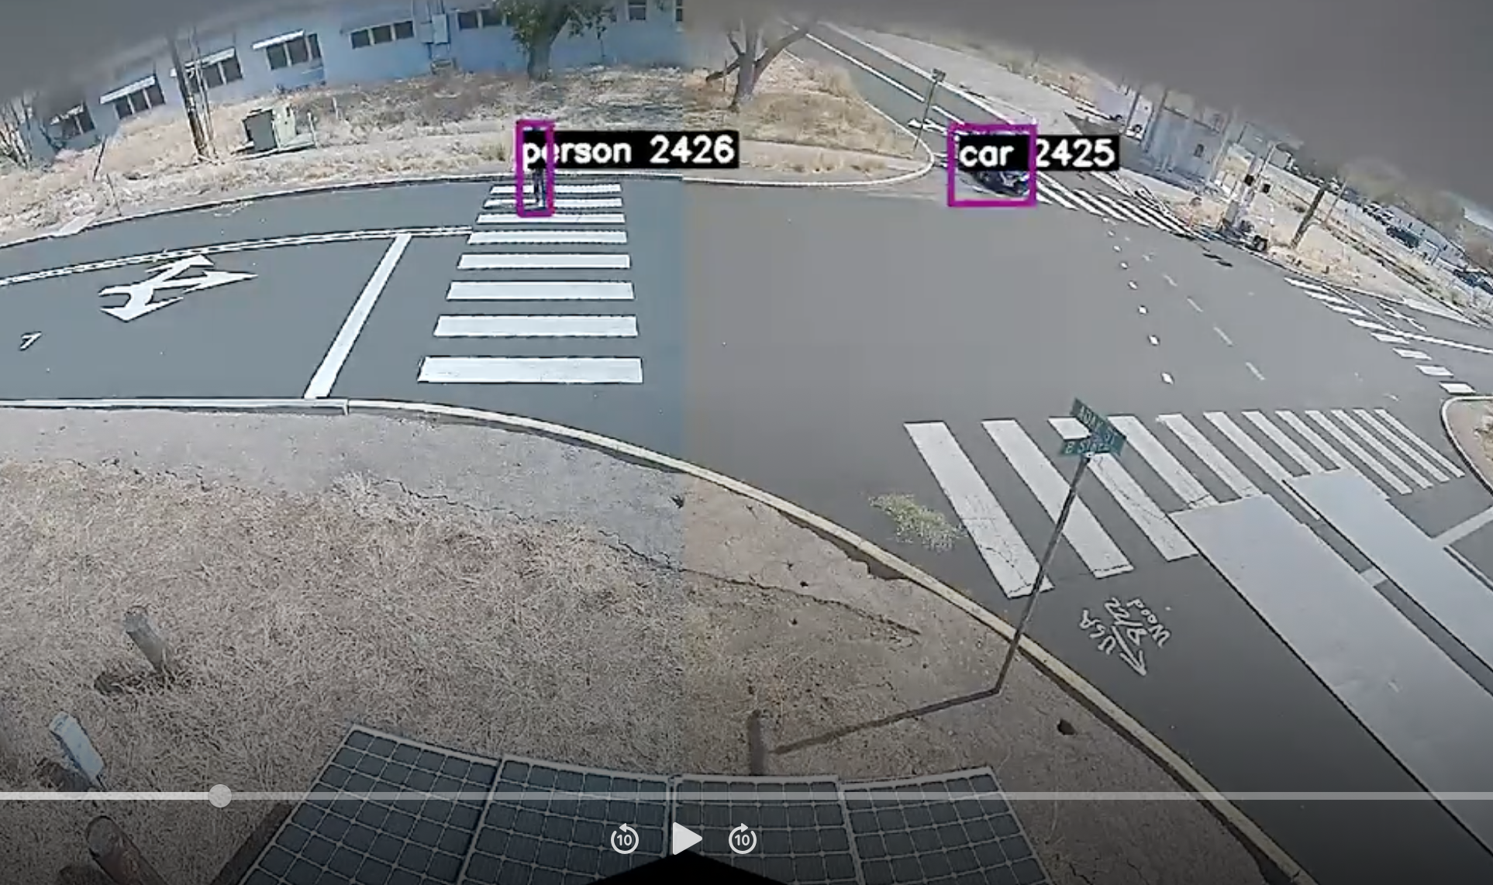
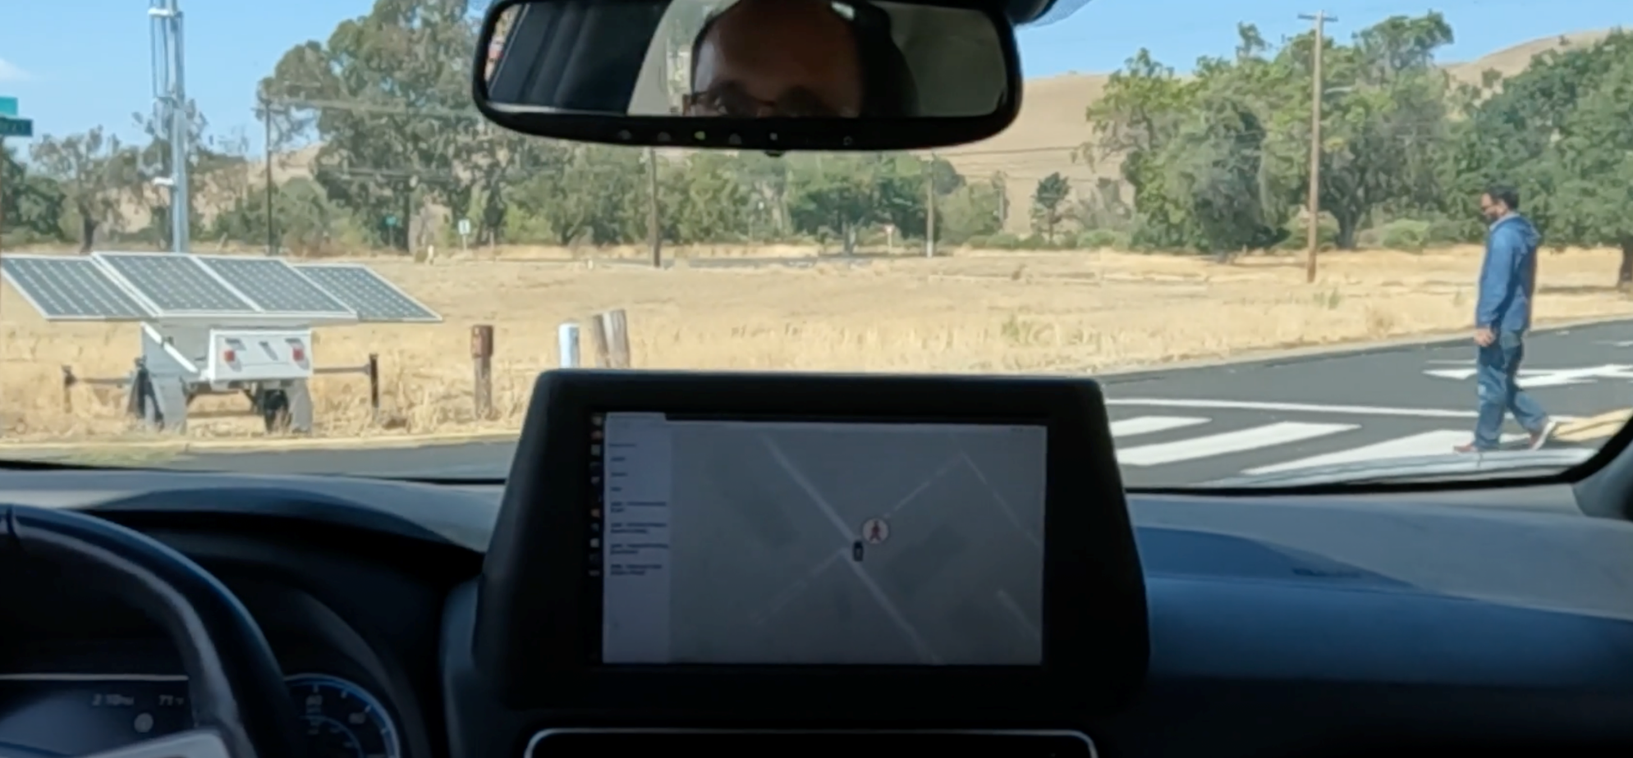
Personal Mobility on I-680 Corridor,
San Ramon, California
Nissan testing at GoMentum Station – Data Collection

Slide 12
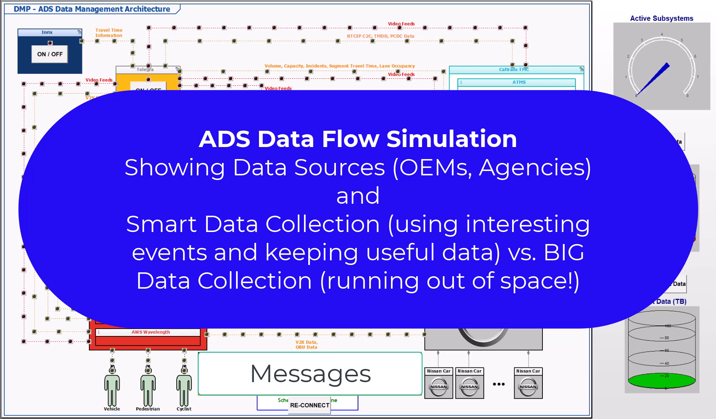

Slide 13
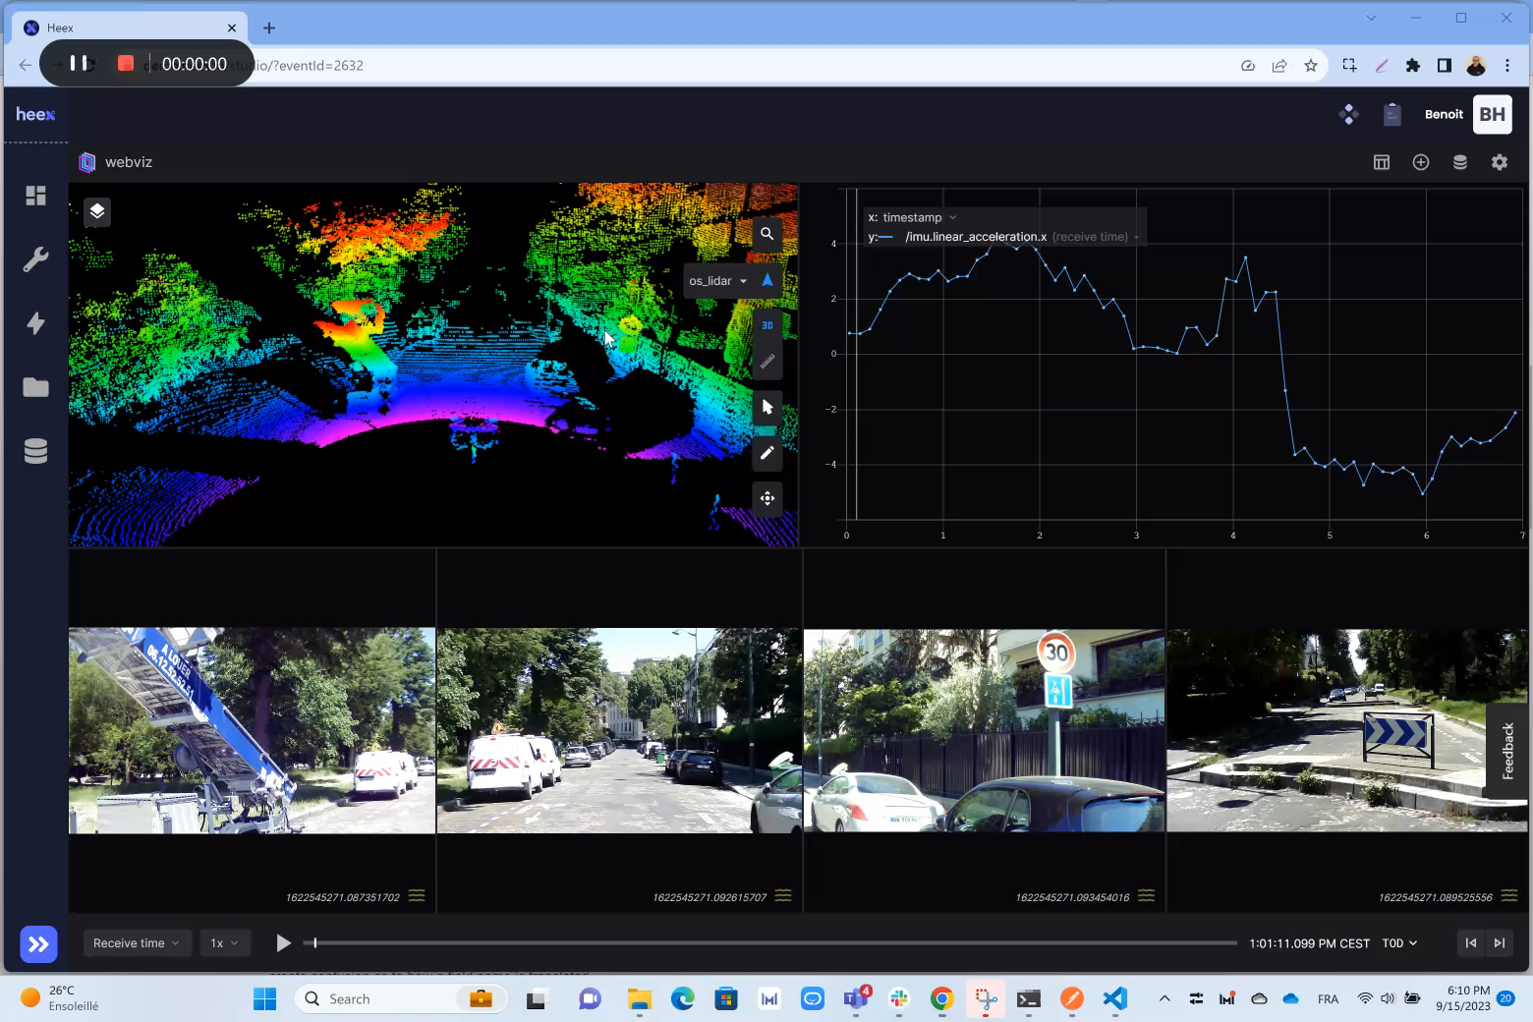

Slide 14
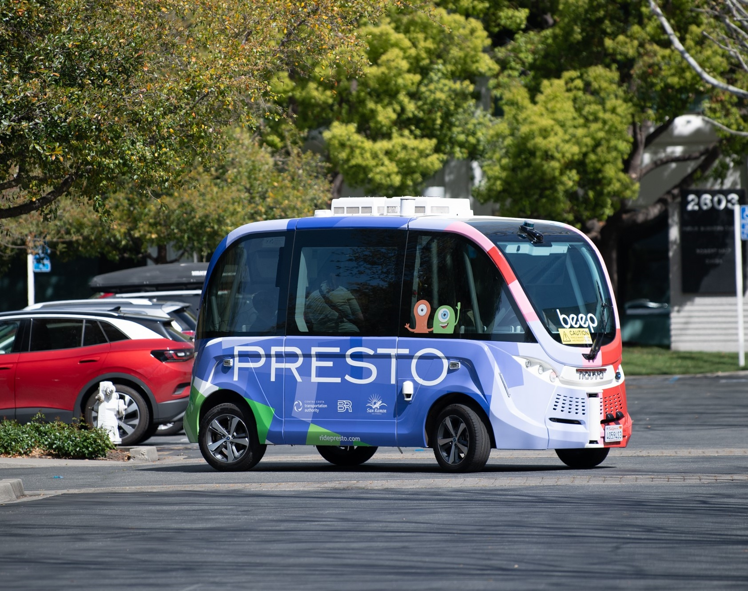
Presto Autonomous Shuttle Service
Complimentary SAV shuttle service for Bishop Ranch Business Park tenant’s and employees
For travel between the business park’s transit hub, BR1 and BR3 buildings, and City Center
Service Began on April 24, 2023
Partnership with the City of San Ramon, Sunset Development, and Beep Inc. funded by Contra Costa Transportation Authority

Slide 15
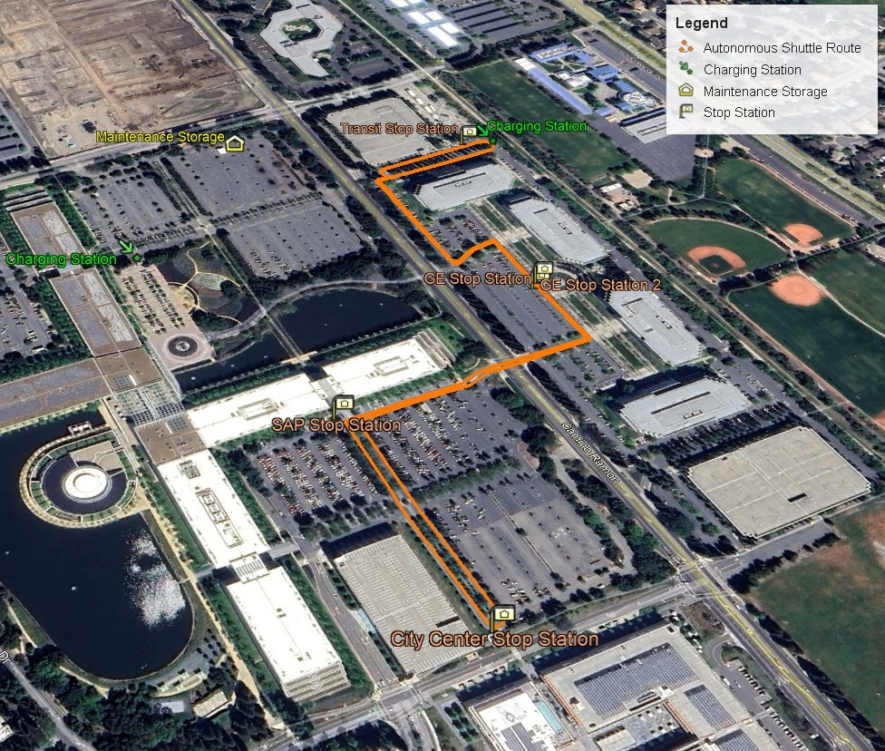
Service Location and Hours
1.2-mile loop in Bishop Ranch Business Park in San Ramon, CA
  Stops at transit hub, BR1 and BR3 buildings, and City Center
One shuttle operates weekdays from 7:30 am to 5:30 pm
Two shuttles run during lunch hours between 11 am - 2 pm

Slide 16
Questions + Answers

