Slide 1
Walnut Creek Transportation Program
Arts + Recreation Department
Recreation - Social Services Division
Kat Reisinger | Program Manager
Civic Park Community Center
1375 Civic Drive | Walnut Creek

Slide 2
THE BASICS
ELIGIBILITY
"The Lyft program has been very helpful for my husband and I. He cannot drive and I cannot drive at night. There are times where our schedules conflict, so the program helps us both get to where we need to be.
Open to ALL residents of TRANSPAC neighborhoods (Clayton, Concord, Martinez, Pleasant Hill, Walnut Creek, and the unincorporated area of Central Contra Costa County)
Be 60+ years of age and no longer able to drive a vehicle
Be 18+ years of age with adaptive needs and be unable to drive a vehicle
Be comfortable boarding vehicles with minimal assistance
NOTE – Program is NOT equipped with wheelchair access but does provide some assistance with boarding and disembarking. Walkers and canes are permitted.
I am grateful for the services that it provides. I plan myself to join the program in the following years." - Elaine Y.

Slide 3
PROGRAM BASICS
Transportation Coordinator
Physical office is located at the Civic Park Community Center in downtown Walnut Creek
Administrative staff are part of the City of Walnut Creek Arts + Recreation Department | Social Services Division
Vannessa Cendejas, M.S.W.
"For the past 8 years of my City of Walnut Creek career, I have worked with our transportation program in different capacities, whether booking a ride, subbing as a driver for a last-minute cancellation, or providing outreach in our community.
Transportation Specialist
Dominik Ambriz
“This role has been truly rewarding in so many ways. The goal of the program is to foster independence by facilitating access to crucial medical appointments, essential errands, and social engagement. I have created wonderful connections with riders a part of the program, and I have learned so much about the positive impact our transportation program has made for the City of Walnut Creek. The smiles and compliments from riders encourage me to continue to make the transportation program the best that it can be. I plan to continue to grow with the program and form a foundation that can flourish for many years to come.”
I am excited to have the privilege of supporting this vital program as the new Transportation Coordinator and plan to continue to bring my passion for ensuring accessible and reliable transportation options to our central Contra Costa County community members.”

Slide 4
GAP PROGRAMMING
Mix of on-demand & prescheduled Lyft rides, and Shared Rides in the Minibus
24 Hour On-Demand Lyft Rides available in emergency (not 911) instances.
Minibus scheduled routes for MOW or Sea Serpent practice (Special Olympics)
Rides to essential services such as medical, dental, grocery, educational, AND social and recreational engagements.
Program is used in addition to other services such as LINK or Vivalon.
By providing reliable and accessible transportation options, gap transportation programming helps seniors and adults with adaptive needs remain active, engaged, and connected to their communities. Transportation also provides support for the ancillary participants who traditionally provide the rides. Transportation Program is to enrich the mobility, independence, and overall life satisfaction of Walnut Creek's senior and disabled community by facilitating access to affordable and accessible transportation. Our commitment is to connect individuals with vital aging services, ensuring they have convenient and frequent access to transportation.

Slide 5
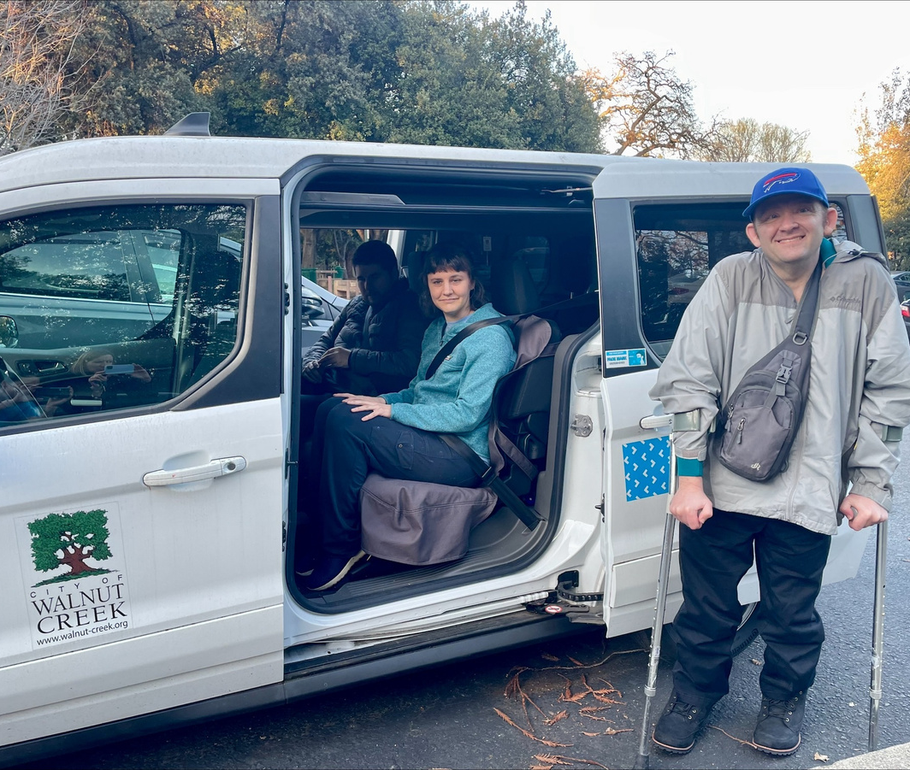
PROGRAM PURPOSE
Purposeful low threshold of acceptance
Rides are provided in conjunction with other beneficial programs such as MOW, Aquatics Therapy, Resource Presentations, etc.
Reduces challenges of having to park and walk for individuals with mobility challenges
What makes us different?
Phone # with the same real person to connect with
Personal connection = memory care support
Physical address to get support
Communicate directly with care providers
Trained staff for adaptive riders
Mix of Lyft & group rides

Slide 6
PROGRAM SAFETY
TRANSPORTATION SPECIALISTS & DRIVERS
Hourly Staff or Volunteers
FBI & CA Background Check
Mandated Reporter Training & Elder Abuse Prevention Training
Anti-Harassment Training
Diversity, Equity & Inclusion Training
CA DMV Record & Driver Background Screening & Ongoing Monitoring
Driver evaluations to
maintain the safety and
integrity of the Mini Bus
program
“Unique to the transportation program with the City (of Walnut Creek), Dominik actually knows my name and calls me back when I call. I never feel rushed when I’m talking to him and he makes me feel I’m not bothering him. Without this program I would be a burden on my family and wouldn’t be able to still get around Walnut Creek to do my shopping.”
Barbara W.

Slide 7
DEMOGRAPHICS OF RIDERS
Residency | 2023 | 2024
NonWalnut Creek Residents | 8% | 32%
Walnut Creek Residents | 92% | 68%
 | 100% | 100%
Age Breakdown | 2023 | 2024
18-59 yrs | 5% | 11%
60-69 yrs | 14% | 9%
70-79 yrs | 32% | 27%
80-89 yrs | 37% | 46%
90+ yrs | 12% | 7%
 | 100% | 100%
Language | 2023 | 2024
English as Primary Language | 84% | 86%
Other* | 16% | 14%
* Main secondary langauges include Spanish, Japanese, Veitnamese & German | 100% | 100%
Gender | 2024
Male | 33%
Female | 61%
Not Indicated | 6%
*Not asked prior to 2024 | 100%
 | 2023 | 2024
ADA Participants | 54% | 42%
Non-ADA Participants | 46% | 58%
 | 100% | 100%

Slide 8
FUNDING
A version of the City of Walnut Creek Transportation Program has been funded by the Line 20A TRANSPAC funding since 2017.
Since 2019, many significant program changes have been made to accommodate feedback from TAC members and Gray Bowen Scott with a focus on:
1. leveraging existing services and programs to combine and streamline offerings,
2. keep the cost per ride as minimal as possible,
3. open program eligibility to all TRANSPAC communities.
Multiple-year grant recipients of $10K for Community Grants thru John Muir Hospital
Scholarships for riders are provided by the Walnut Creek Seniors Club & general A+R scholarship fund.
Riders pay a nominal fee ($0 - $50) to enroll in program.
City of Walnut Creek General Fund supports the transportation program with varying levels of support by quarter (~4K - $15K)

Slide 9
GOALS FOR UPCOMING PROGRAM YEAR
In addition to ongoing operations, specific goals include:
Expand partnerships with local senior centers to provide route rides with the minibus for groups of seniors to attend programs and services as a whole.
Deliver transportation information presentations to neighboring senior centers and assisted living facilities.
In partnership with Kyra Dixon, Program Coordinator | Adaptive Recreation & Community Outreach, increase free presentations and drop-in programs for adaptive needs participants including transportation to/from programs
Target ridership growth in Equity Priority Communities (Martinez and Concord)

Slide 10
Thank You

