Slide 1
Measure J Program 13 Request: TRANSPAC TAC Feedback and Funding Recommendation to TRANSPAC Board for the Iron Horse Rehabilitation Project
Katy Hornbeck, Grants Manager
TRANSPAC TAC Meeting | October 31, 2024

Slide 2
Measure J Program 13: Pedestrian, Bicycle or Trail Facilities (PBFT)
$30 million for Program 13
“One third of the funds are to be allocated to the East Bay Regional Park District (EBRPD) for the development and rehabilitation of paved regional trails. EBRPD is to spend its allocation equally in each subregion, subject to the review and approval of the applicable subregional committee, prior to funding allocation by the Authority.”
Last TRANSPAC project approval was in 2016
To date, approximately $910,000 of Measure J, Program 13 funds have been spent in the TRANSPAC subregion

Slide 3
2025 TRANSPAC Project
Request up to $500,000 for Contra Costa County trail project in TRANSPAC region
Rehabilitate two sections of the Iron Horse Regional Trail (approx. 1.5-miles)
EBRPD staff time for contract administration is in-kind
BUDGET
# | Description | Square Feet | Miles | Estimate
1 | Iron Horse Trail: Concord Ave to Diamond Blvd Remove and replace asphalt concrete, including slurry seal | 48,576 sq. ft. | .8-mile | $350,000
2 | Iron Horse Trail: Walden Rd to Ygnacio Valley Rd Remove and replace asphalt concrete | 44,352 sq. ft. | .7-mile | $450,000

Slide 4
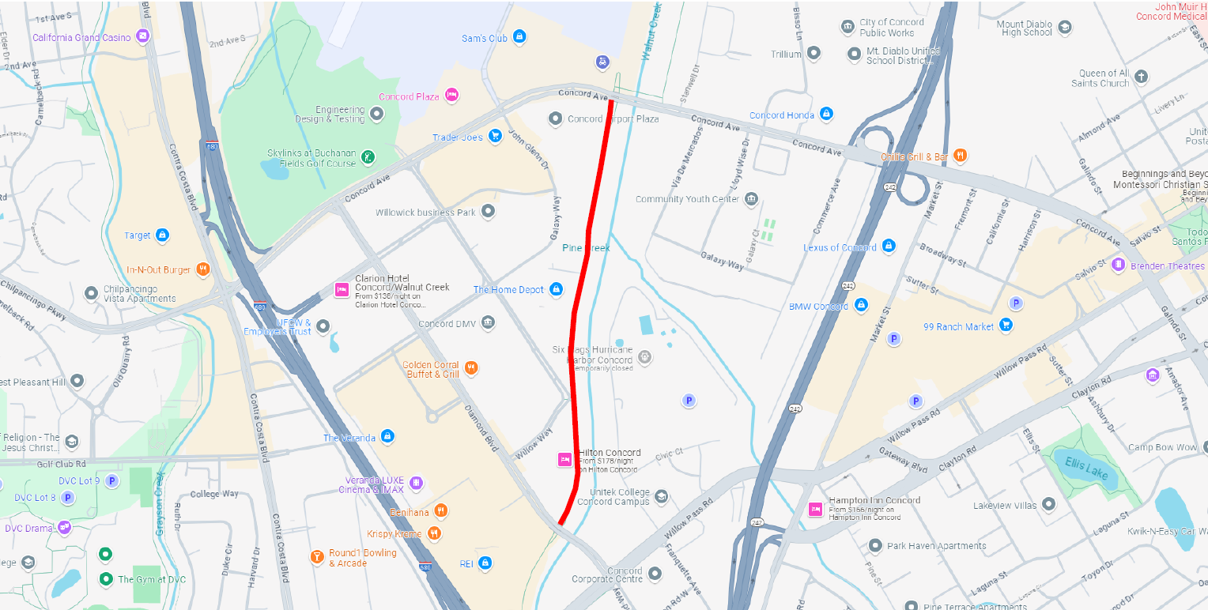
Project Map – IHT Concord to Diamond

Slide 5
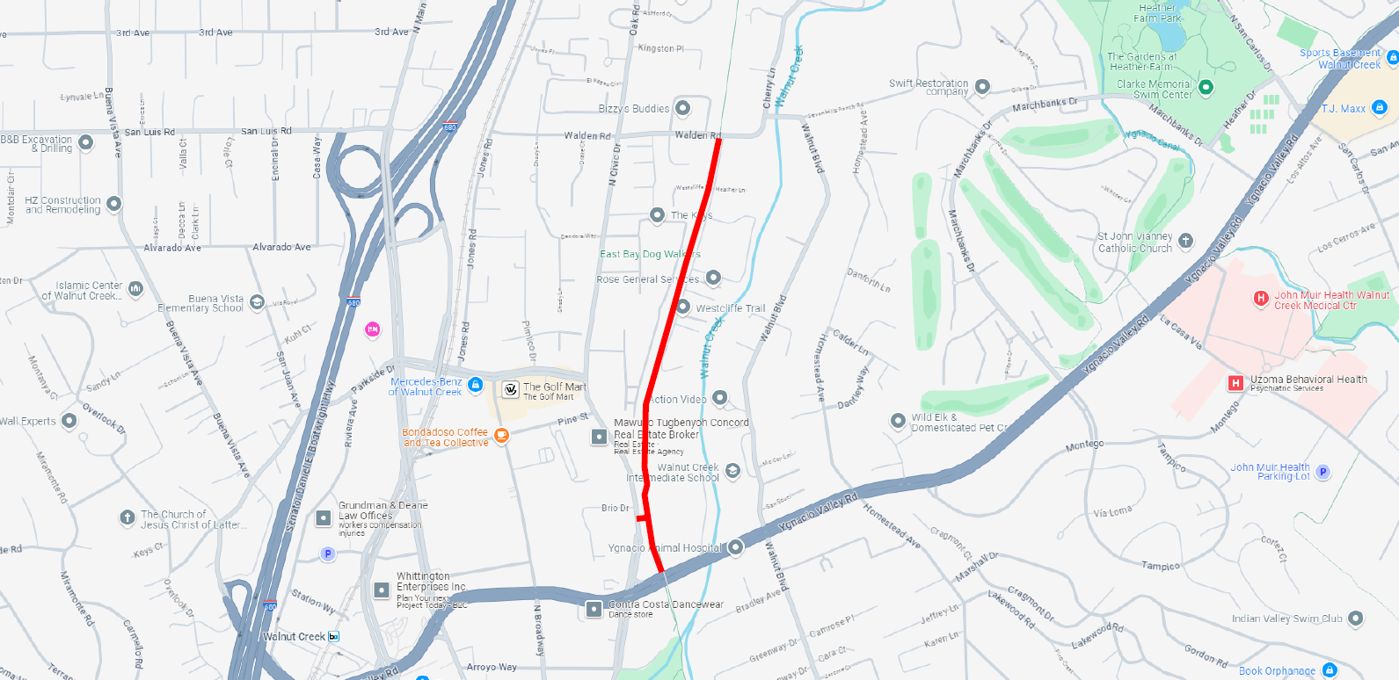
Project Map – IHT Walden to Ygnacio Valley

Slide 6
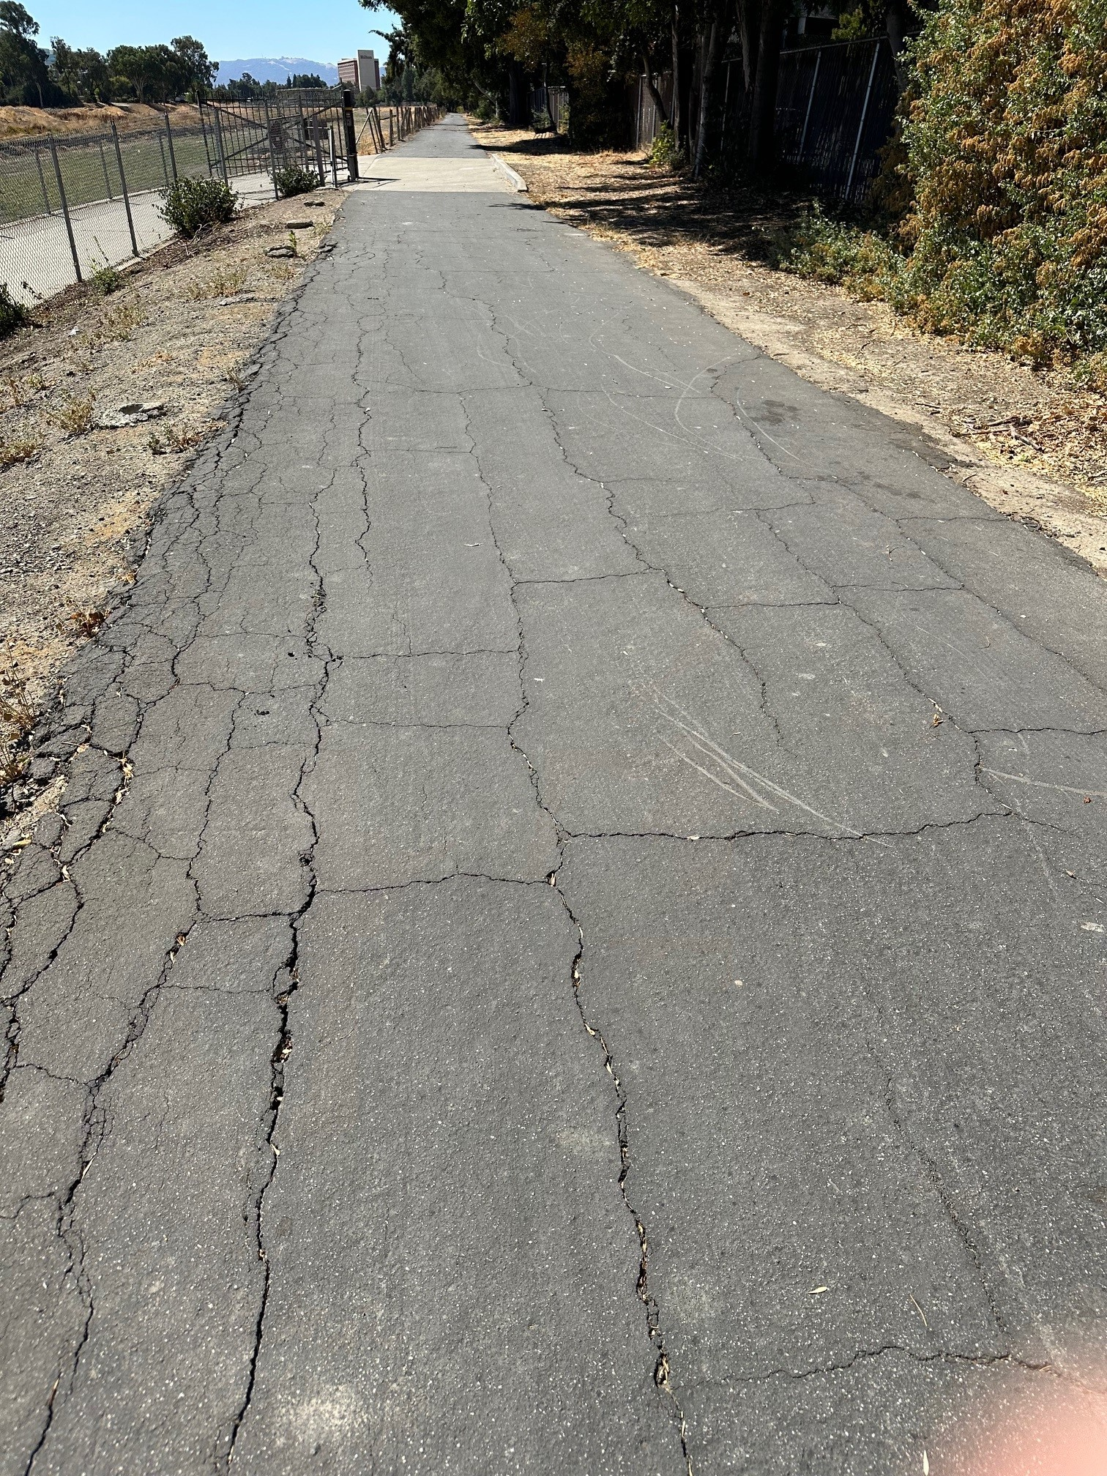
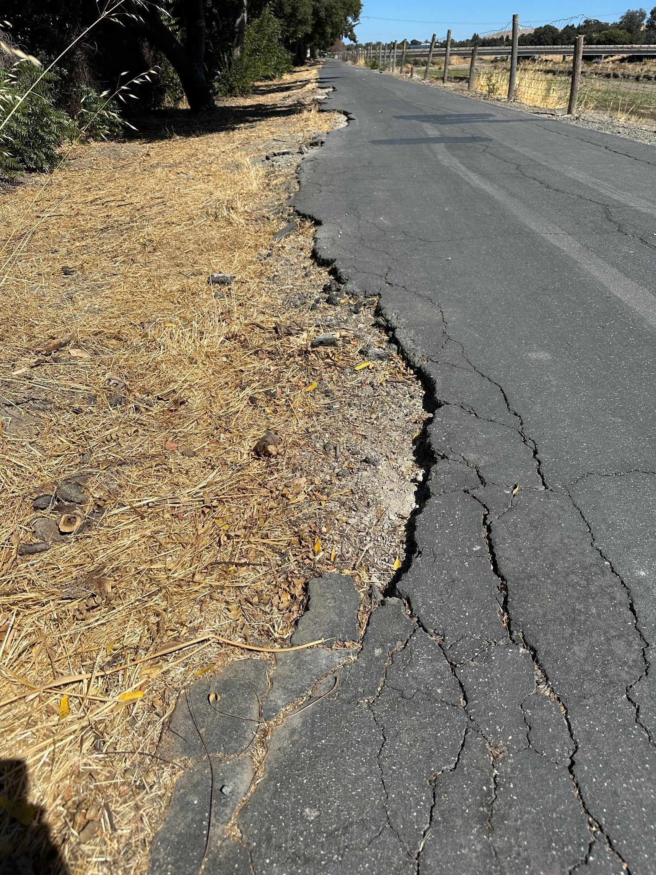
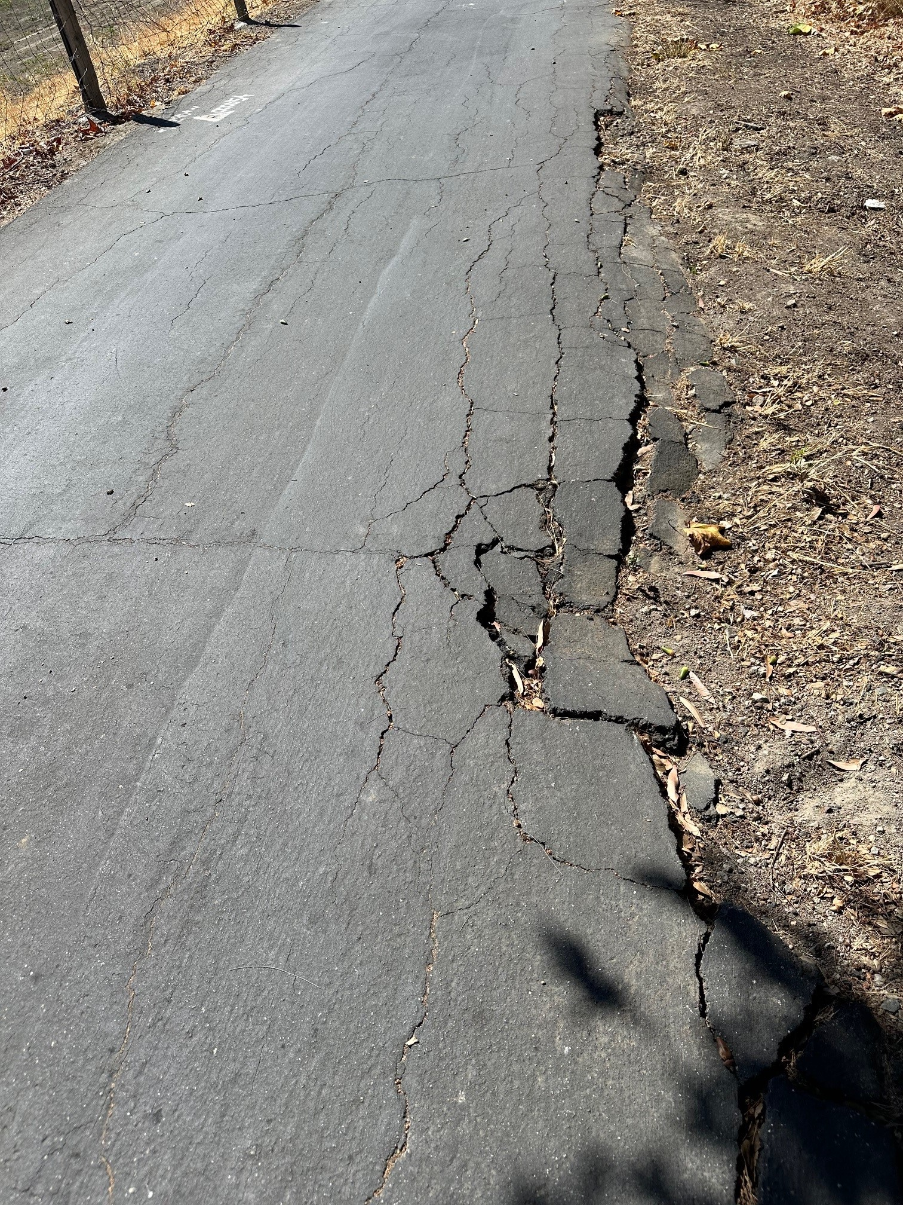
Photos of Current Conditions –
IHT near Concord Ave

Slide 7
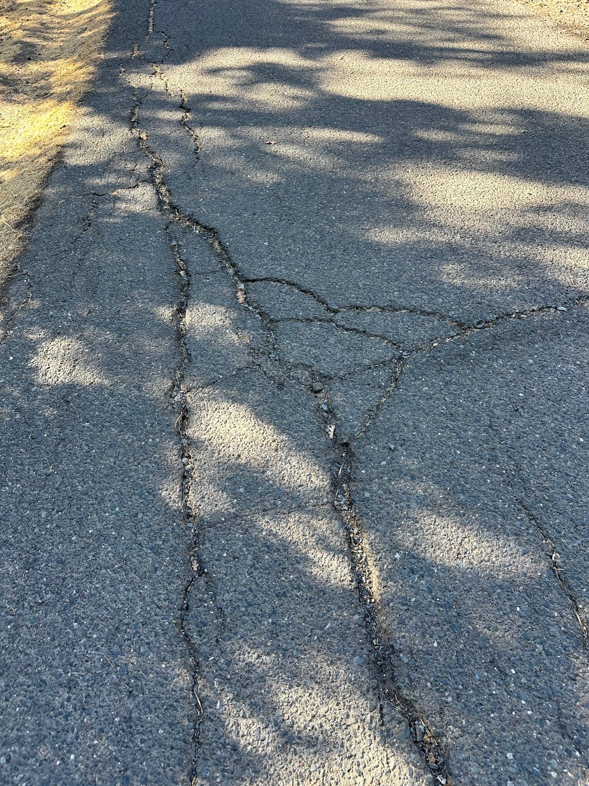
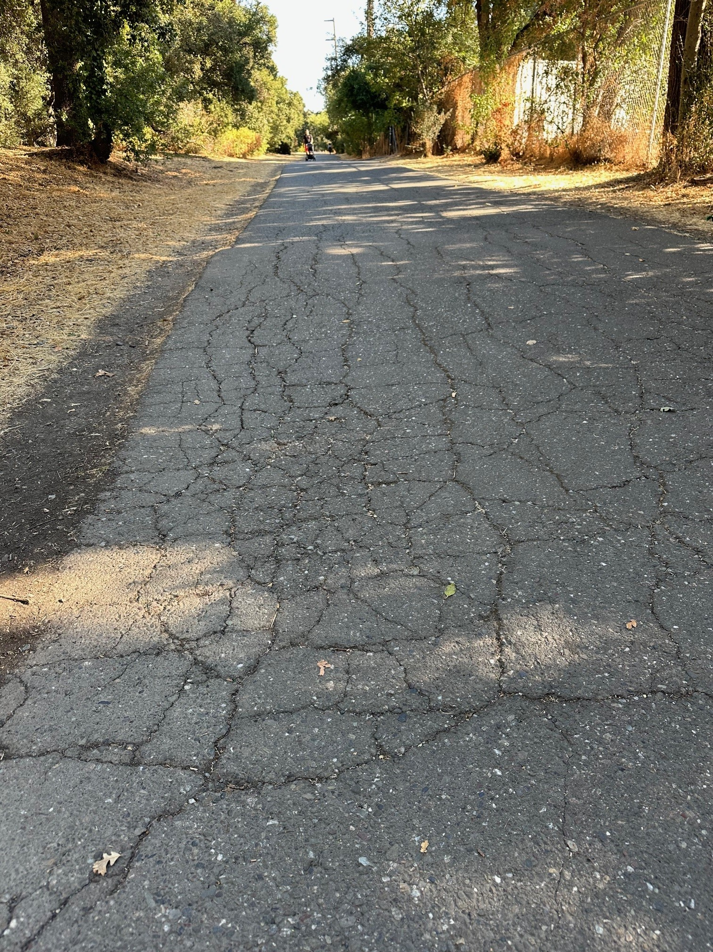
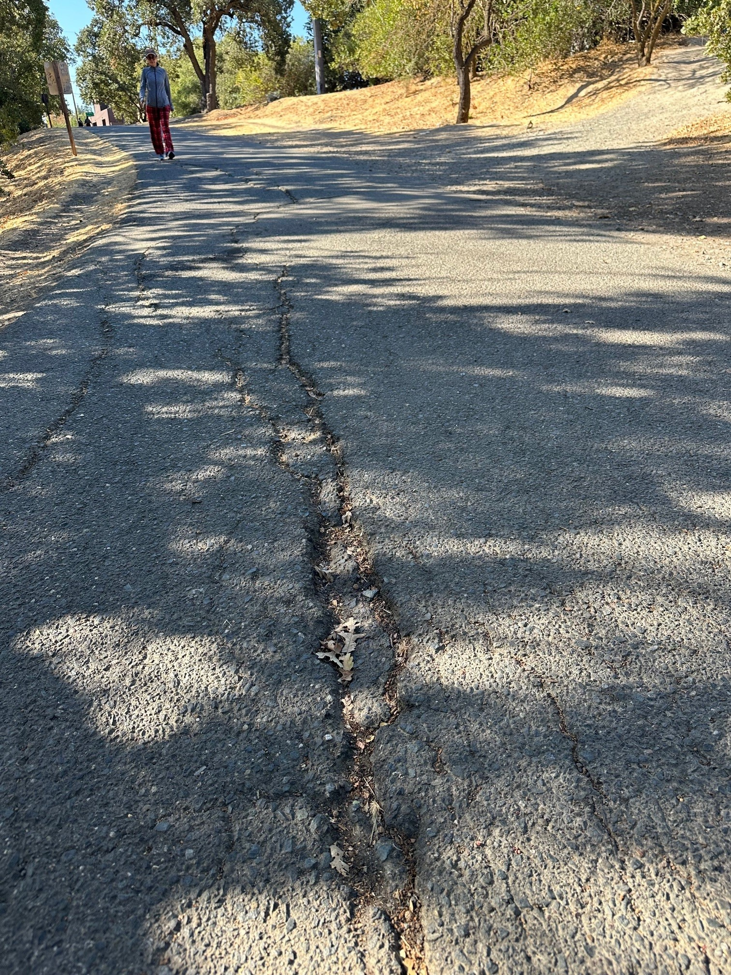
Photos of Current Conditions –
IHT between Ygnacio Valley to Walden

Slide 8
Project Details, Planning & Schedule
Trail work consists of removal and replacing asphalt concrete
Use Best Management Practices (hours of work, noise, dust, etc.)
Project Manager will develop an outreach and notification plan with the local jurisdictions.
Schedule: June 2025 – August 2025. Construction scheduled to avoid impacts to school commuters.
Notes:
Areas of north and south have been recently
Pavement conditions are poor
High impact from students commuting to school
About to do a PCI assessment District-wide and will include a report; est. by Spring 2025
Limited in boundaries/agreements in terms of widening trails

Slide 9
Questions?

