Slide 1
Weekly Scanning Program

Slide 2
Introductions: Cara De Jong
Parent of 3 children
Masters in Public Health at Erasmus University in Rotterdam, NL
Creator of BikePHE-pilot program for Walk ‘n Roll
New to the 511 Contra Costa team (Aug 2024)

Slide 3
Street Smarts Educational outreach for schools
‘Mr Beeps’ and ‘Heads Up’ assemblies
31 elementary schools
Blender Bike Walk ‘n Roll
3 middle schools
Community Outreach
3 events
National Walk to School Day-October
15 schools

Slide 4
Street Smarts Educational outreach for schools
School trip reduction program
Notes:
I was brought on to implement this program as the creator, and I’m excited to share with you our progress in the last 2.5 months! Using your subregional TFCA money to get more in the community cycling to schools in teh TRANSPAC cities.

Slide 5
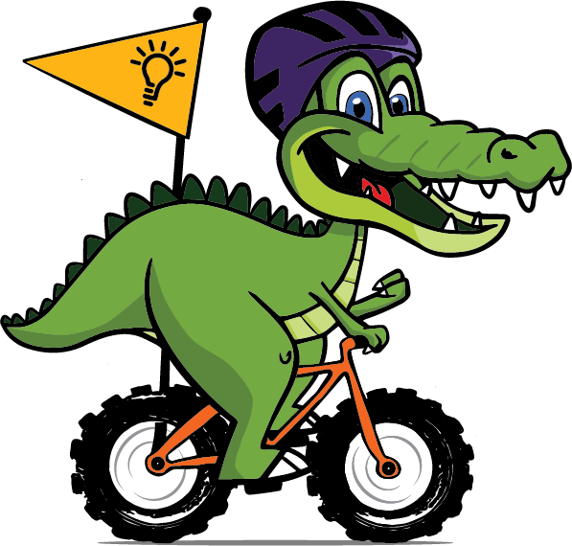
What is the program?
A customized encouragement program to reduce school trips through active transportation and carpool

Slide 6
Who is enrolling?
Pleasant Hill: Pleasant Hill Elementary School (began 9/21/2022)
Pleasant Hill: Strandwood Elementary School (began 5/3/2024)
Pleasant Hill: Gregory Gardens Elementary School (to launch 11/6/24)
Martinez: John Muir Elementary School (to launch 11/22/24)
Concord: Silverwood Elementary School (to launch 12/5/24)
Concord: Meadow Homes Elementary School (to launch 12/5/24)
Walnut Creek: Walnut Heights Elementary School (in process)
Concord: Ayers Elementary School (in process)
Funded by:

Slide 7
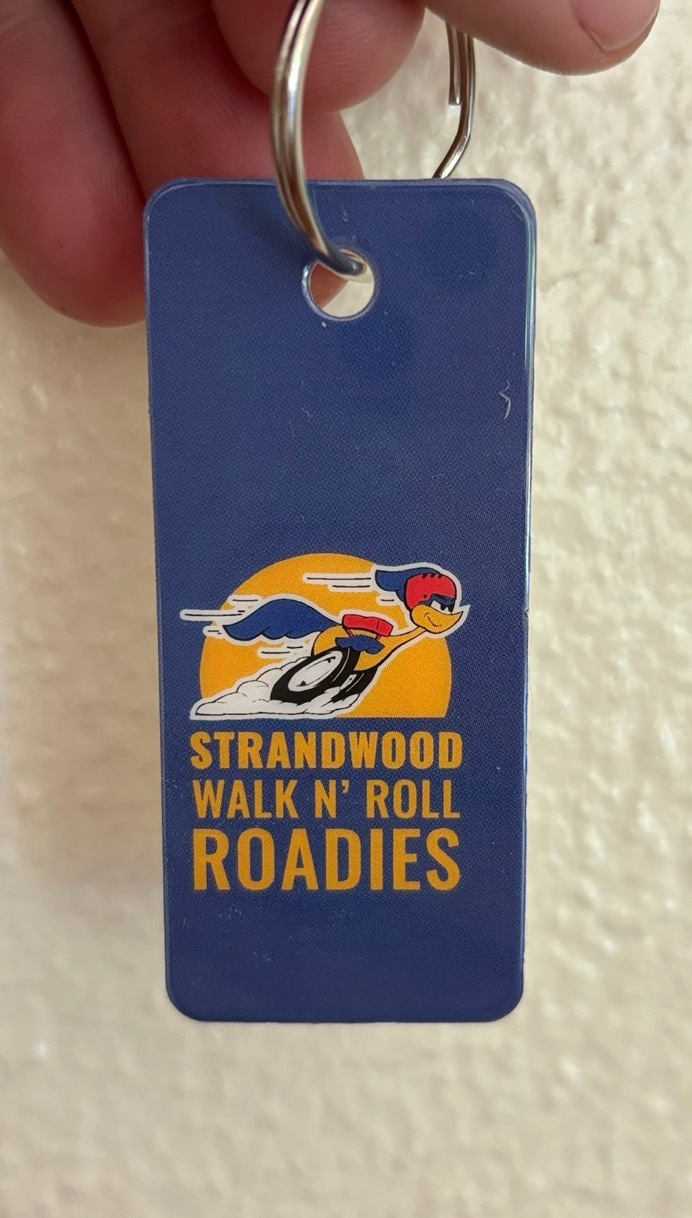
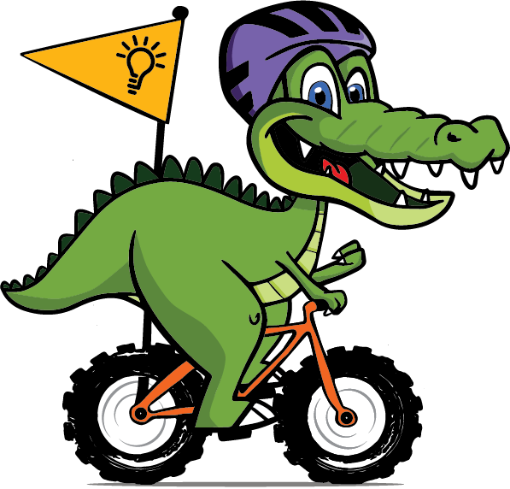
How does it work?
1.
All students receive a Scan Tag that affixes to a backpack

Slide 8
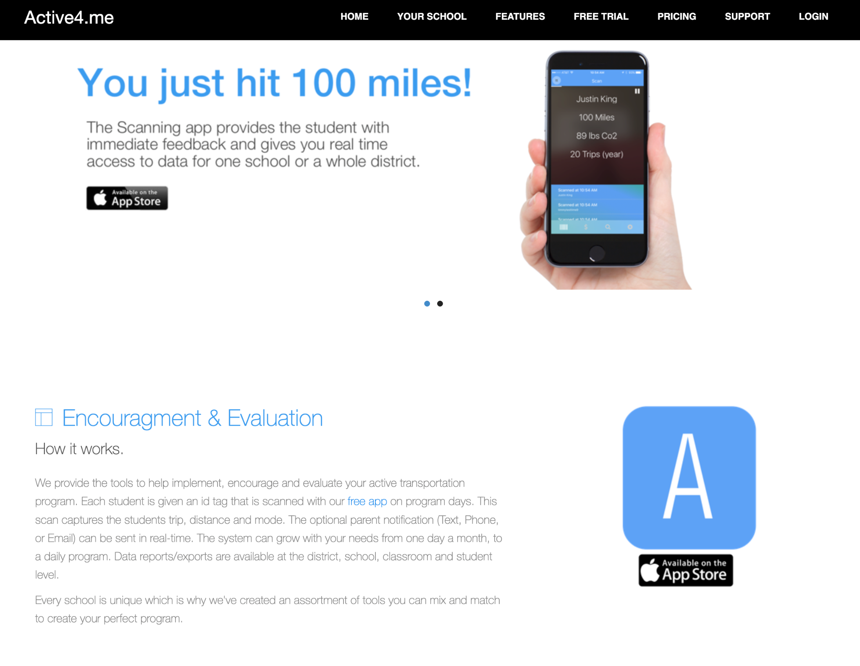
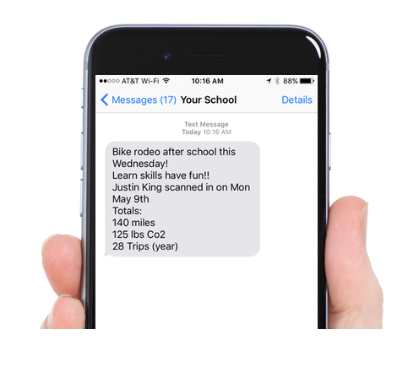
How does it work?
2.
Parents can choose to individualize their student’s Scan Tag

Slide 9
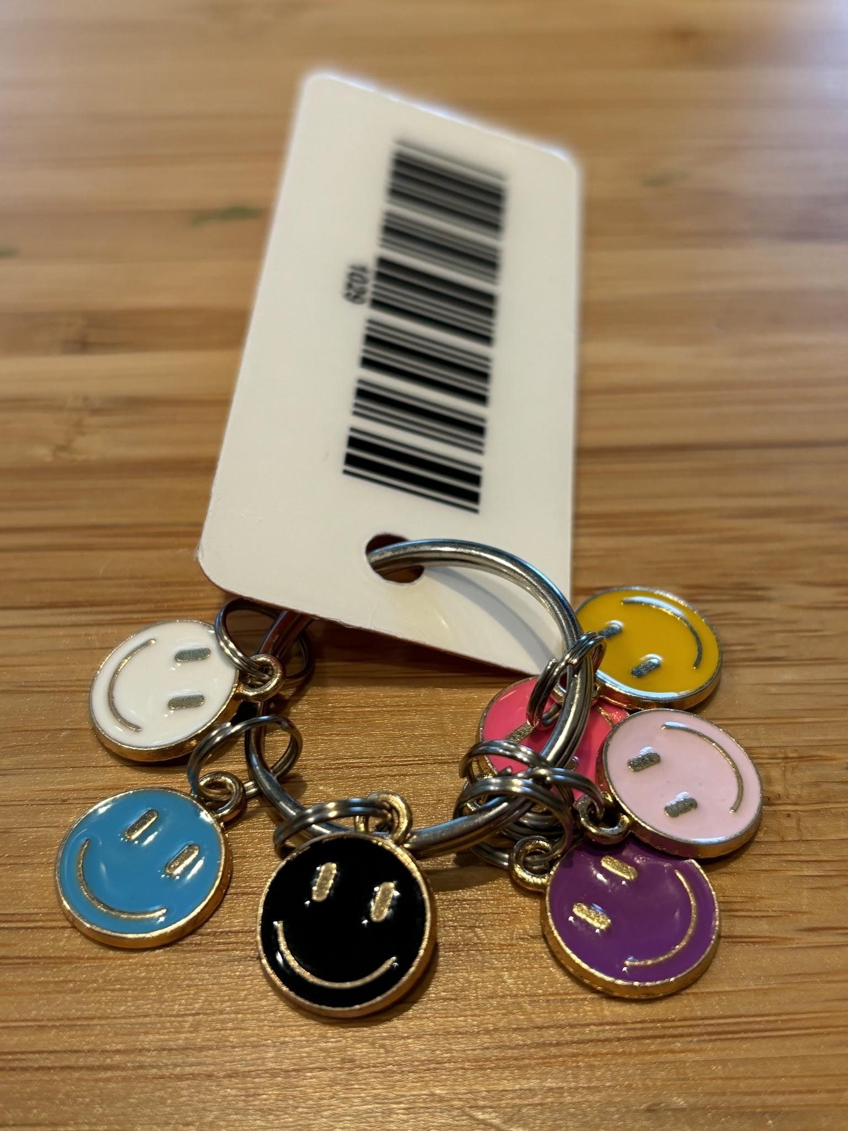
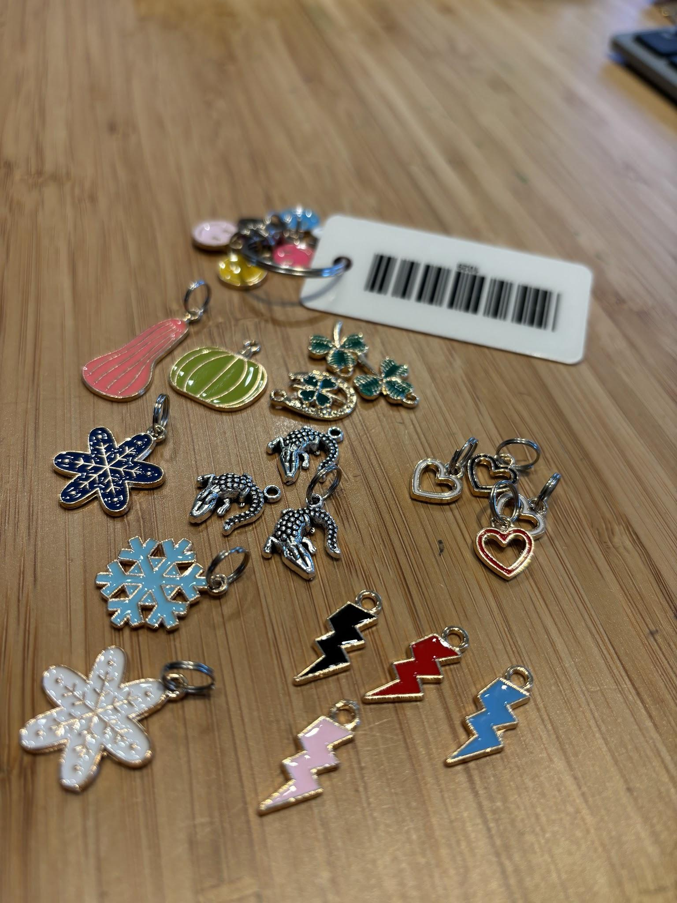
How does it work?
3.
Trip charms for every 4th trip, special charms and weather charms

Slide 10
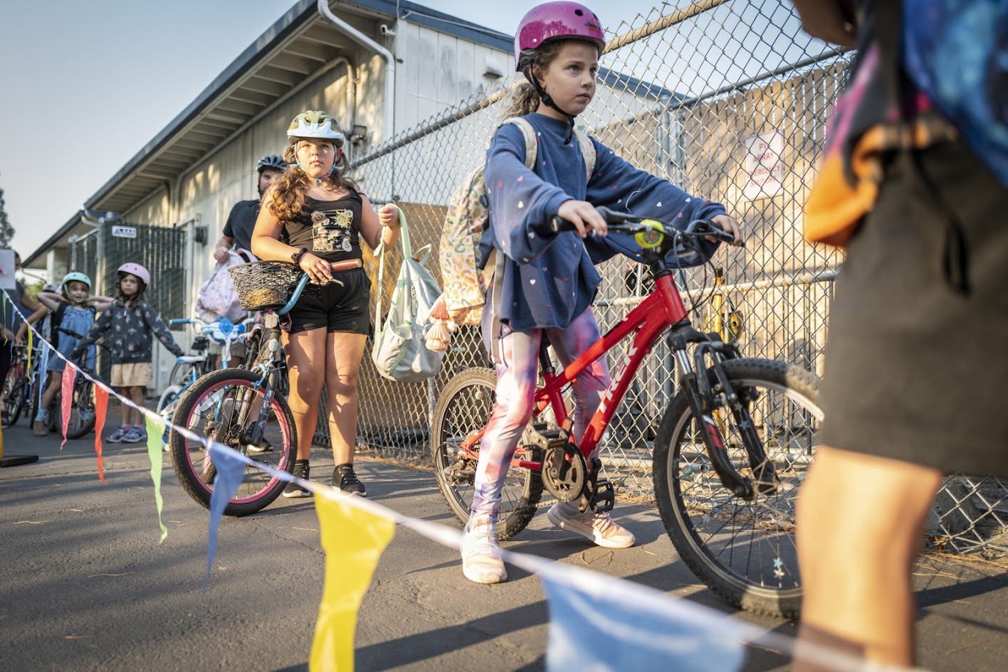
Start the program
4.
Walk ‘n Roll Wednesdays rolls out every week rain or shine
Notes:
Simple and effective-a partnership between Street Smarts and the schools

Slide 11
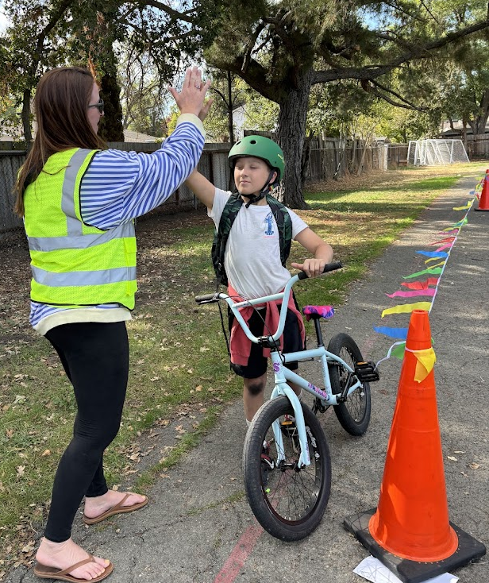
Our Part: funding
All the supplies to make the program one and done
Active4me subscription
Incentives
Individualized Walk ‘n Roll mascot
Equipment (cones, vests, flags, etc)
Advertising
Templates
Training

Slide 12
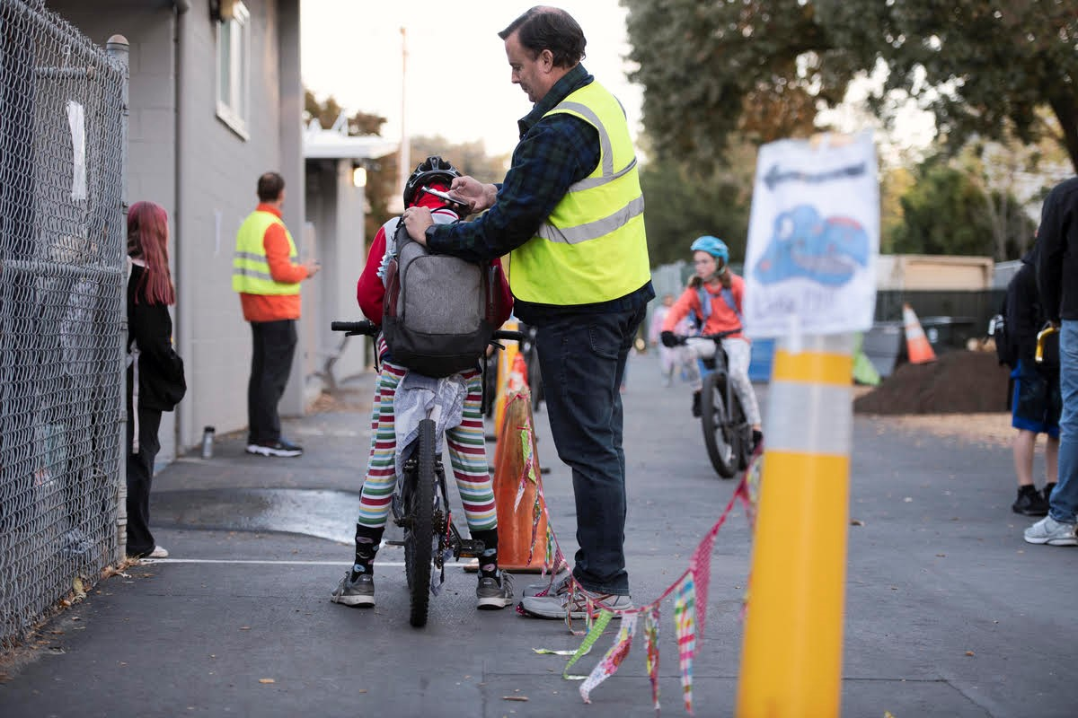
School’s part: collect volunteers
Need 1 coordinator and 2 scanners to begin
We offer guidance and best practice advice

Slide 13
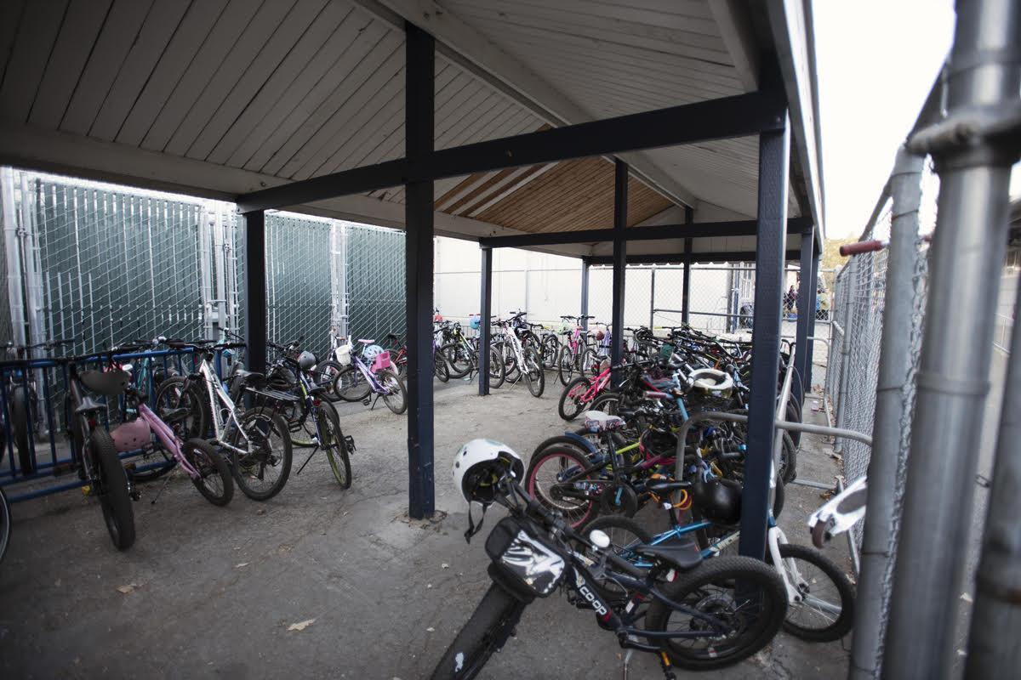
School’s part: count bikes

Slide 14
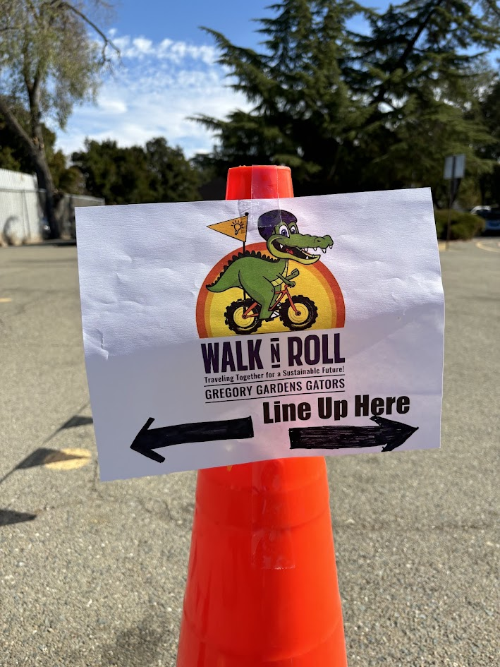
School’s part: promote

Slide 15
6.
Results
Notes:
Your school takes measurable climate change action, students get active, and traffic safety improves.

Slide 16
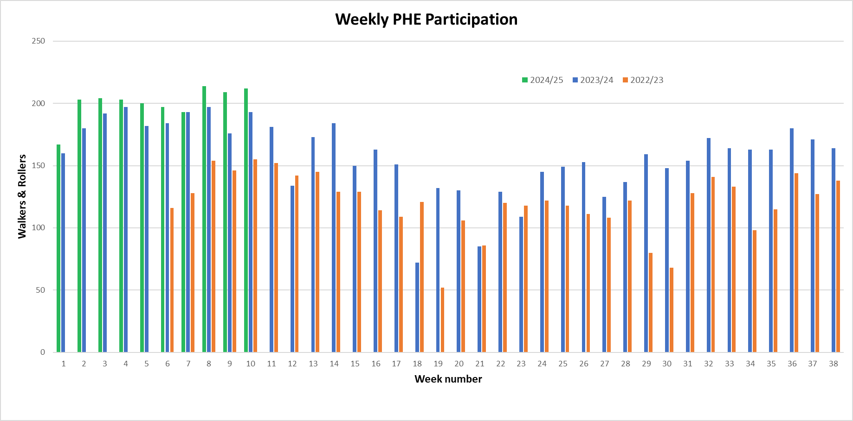
Results

Slide 17
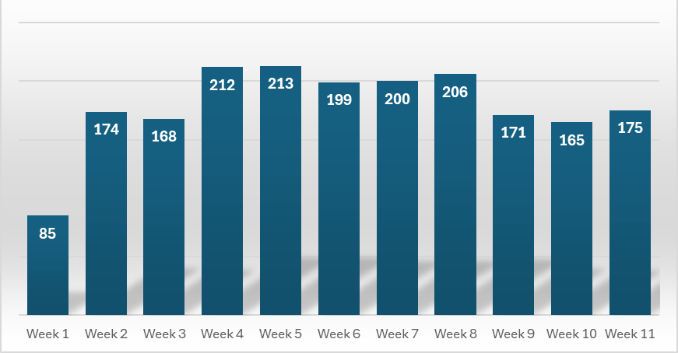
Results
2024/25 Weekly Participation at Strandwood

Slide 18
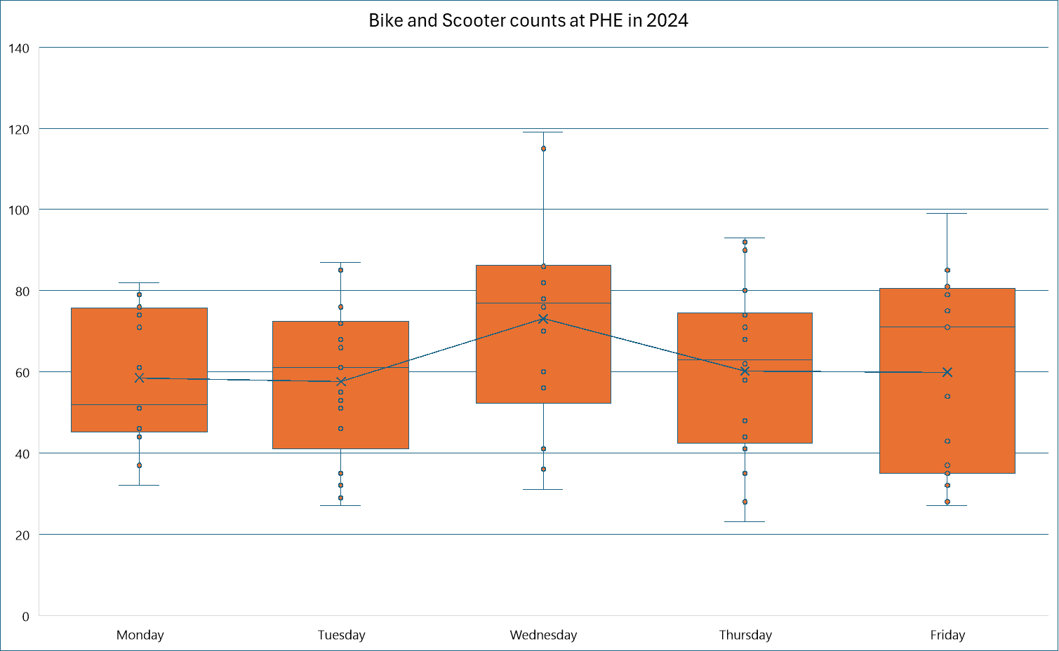
Results

Slide 19
What does it take to start a school?
School interest through a contact
Meet with PTA, board, principal and identify coordinator
Sign school agreement
Customize school materials, purchase items, train volunteers, help with advertising
Launch date ~1 month after signed agreement
More streamlined with each school who signs on

Slide 20
High School Volunteers
We’ve partnered with College Park High School freshman leadership class
Help with scanning and charms
Visit class once per month
Active transportation presentation

Slide 21
Weekly Scanning Program
cara@streetsmartsdiablo.org

