Slide 1
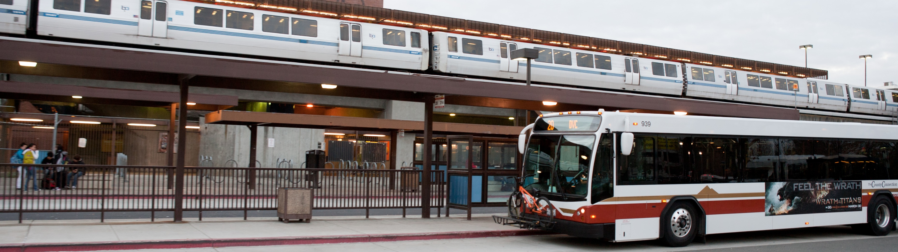

Midday Free Rides &
Monument Free Paratransit
Measure J Line 20a - TRANSPAC – March 12, 2026

Slide 2
Midday Free Rides

Slide 3
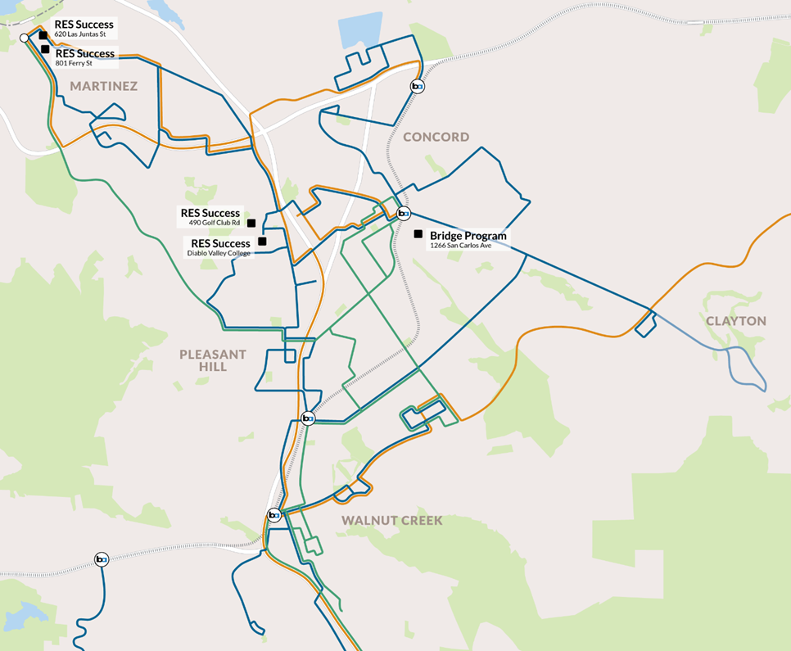
Midday Free Rides:
Overview
Continuation of existing program currently funded by Measure J Line 20a
Free rides on County Connection fixed-route buses to facilitate travel training for students with disabilities
Limited to off-peak hours (10am–2pm) when capacity is already available
Participating transition programs:
  Mt. Diablo Unified School District’s Bridge Program (Concord)
  RES Success (Pleasant Hill, Martinez)
  Newly Added: Clayton Valley Charter High School (Concord)
Clayton Valley Charter High School
1101 Alberta Way

Slide 4
Program Impact
“Being able to ride County Connection buses is the perfect bridge to help our students get to the next level in their lives. They use it to be part of their community, get to their part-time jobs, and support local businesses. The entire process of riding the bus independently is daunting, so being able to focus on logistics and safety rather than payment allows our students to build skills that will help them become lifelong transit riders."
          Chloe Page, Education Specialist, Mt Diablo Unified Bridge Program

Slide 5
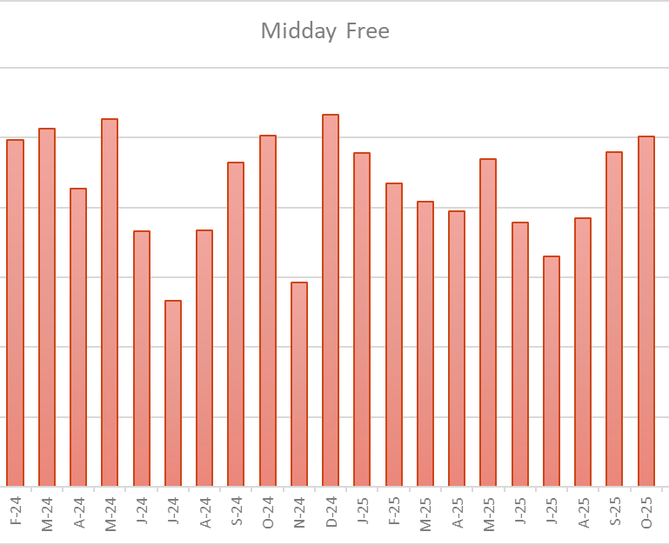
Midday Free Rides:
Ridership & Usage
163 participants across two programs
Total of 51,244 rides from Jan 2024 – Dec 2025
Ridership Remains Steady
  FY 2023: 1,755 monthly trips
  FY 2024: 2,203 monthly trips
  FY 2025: 2,067 monthly trips

Slide 6
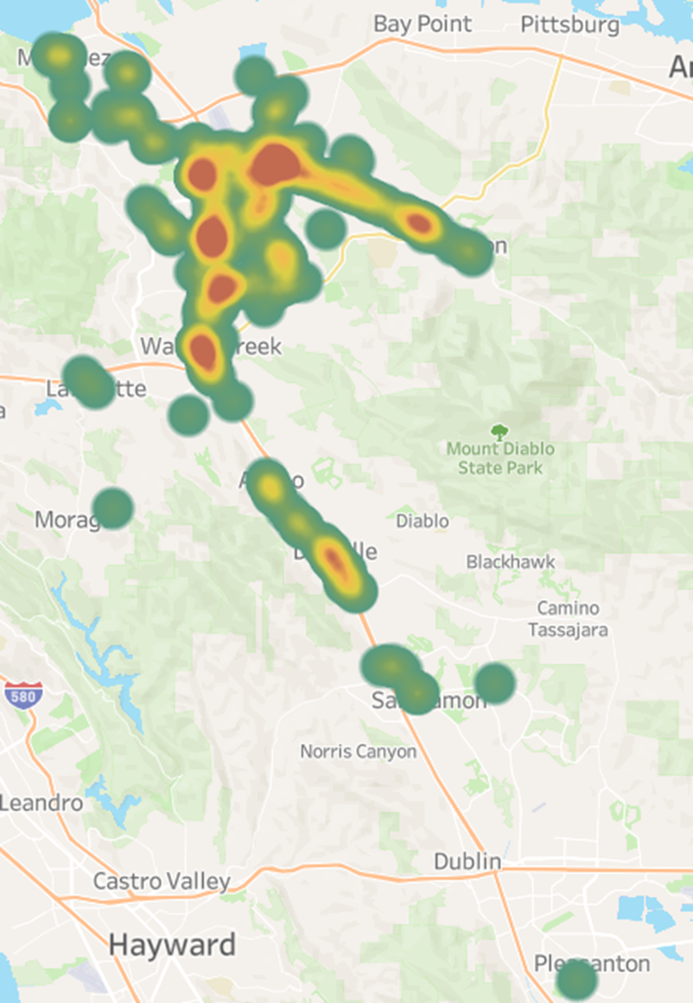
Ride Distribution
January 1 to December 31, 2025
99.7% of trips originate on route within or serving TRANSPAC
89% of trips are entirely within TRANSPAC
10.9% of trips originate on a route outside of TRANSPAC on a route that serves the TRANSPAC area
0.3% of trips originate outside of TRANSPAC and do not travel with TRANSPAC area

Slide 7
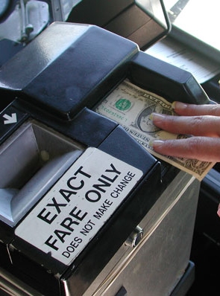
Midday Free Rides:
Costs & Funding
Projected ridership of 2,500 trips per month for FY 2026-27 & FY 2027-28
Estimated cost of $66,000 over two years
  Fare revenue loss: $1.00 per trip
  Program administration: 10% ($0.10 per trip)
Reimbursement requests to be based on actual usage
Could be expanded to additional transition programs depending on usage and available funding. Recently expanded includes Clayton Valley Charter High School

Slide 8
Monument Free Paratransit

Slide 9
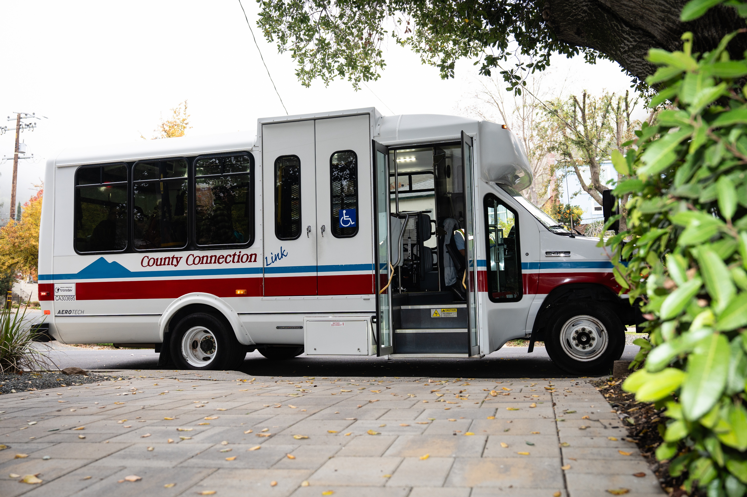
Monument Free Paratransit:
Background
County Connection uses Low Carbon Transit Operations Program (LCTOP) funds to provide free fares on fixed routes 11, 14, 16, 311, 314, and 316.
Recent FTA direction requires County Connection to provide free paratransit fares for trips that begin and end with the ¾ mile catchment area of fare free routes due to fare free fixed route subsidy.
Clayton Valley Charter High School
1101 Alberta Way

Slide 10
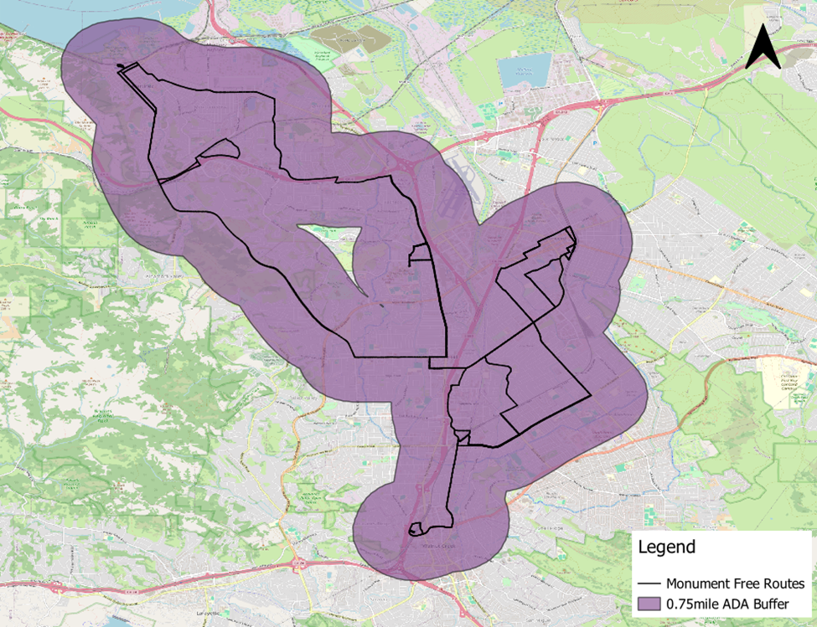
Monument Free Paratransit:
Overview
Covers $5 LINK paratransit fare for paratransit trips originating in the ¾ mile catchment area along the routes 11, 14, 16, 311, 314, and 316, and ending within the ¾ mile catchment area of any other connection fare-free fixed route.
Eligibility: Certified LINK Paratransit Riders
Preserves Free Fares on Fixed Routes along Monument Corridor
Clayton Valley Charter High School
1101 Alberta Way

Slide 11
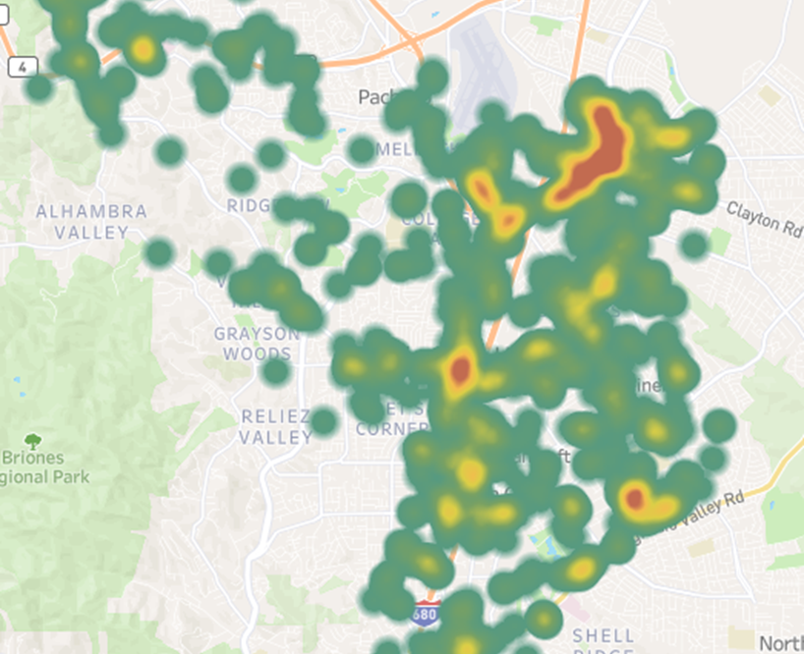
Monument Free Paratransit:
Projections/Ridership
Last 12 months: 17,362 existing paratransit trips with paid fares in proposed service area
Projection: 19,100 rides for FY 26/27.
$19,100 x $5 x 10% Admin = $105,050 Annually

Slide 12
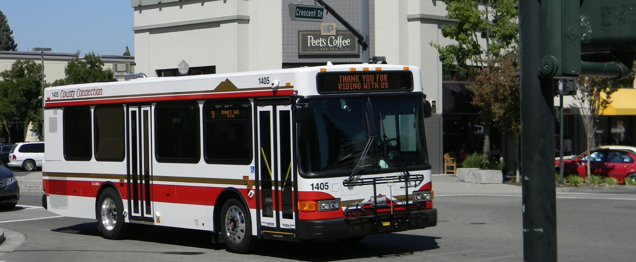
Thank you!
Andy Smith
Director of Planning and Marketing
Kyle Boehm
Grants Administrator

