Slide 1
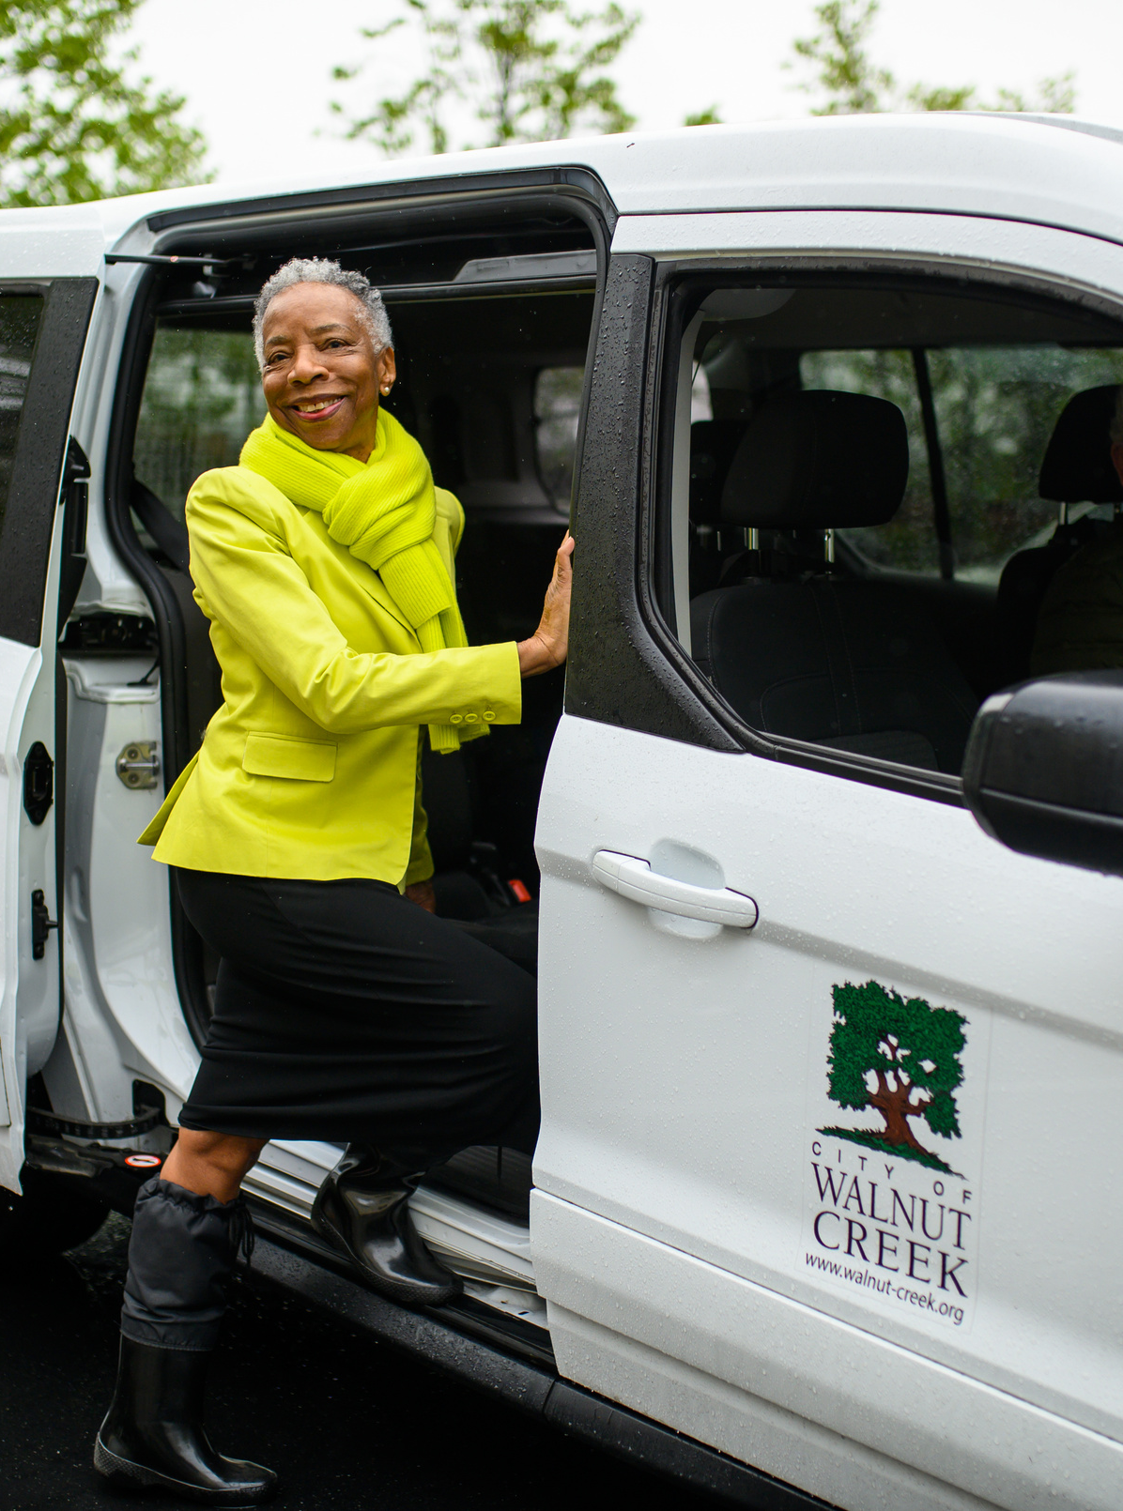


Walnut Creek Transportation Program
Arts + Recreation Department
Recreation - Social Services Division
Vannessa Cendejas | Program Supervisor
Civic Park Community Center
1375 Civic Drive | Walnut Creek

Slide 2
Program description
The City of Walnut Creek offers a robust transportation program, managed by the Social Services Division, that provides accessible transportation for seniors and adults with developmental or intellectual disabilities within the TRANSPAC region. Through a combination of Lyft TNC and Minibus services, the program offers a range of ride options to meet varying needs and abilities. This program reflects the City's commitment to inclusivity and independence by delivering transportation that is easy to access, fills gaps left by other service providers, and offers high-quality customer service that empowers community members to get where they need to go.

Slide 3

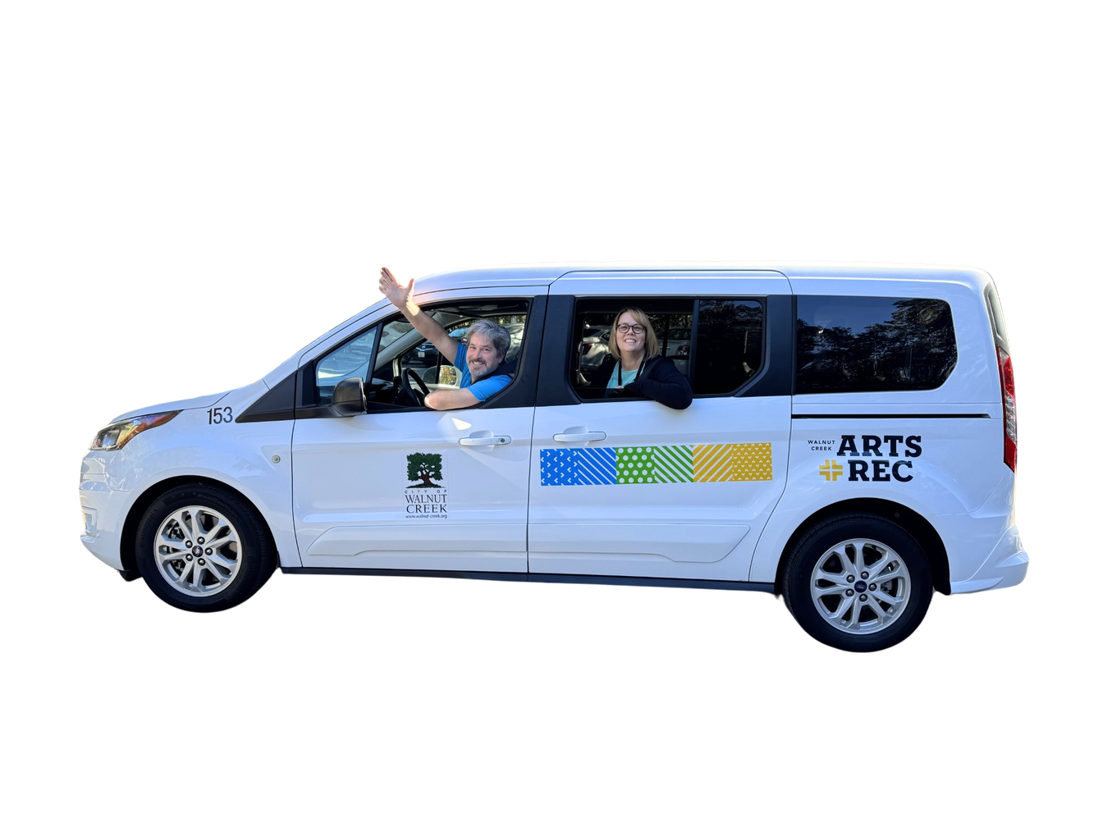
PROGRAM BASICS
Physical office is located at the Civic Park Community Center in downtown Walnut Creek
Transportation team members are part of the City of Walnut Creek Arts + Recreation Department, Social Services Division
Transportation Coordinator
Kyra Dixon, CTRS
“Transportation is a vital piece of every day life. It connects people to their jobs, essential services, education, and social networks. It’s deeply rewarding to provide the opportunity for our riders to engage with others and participate in their community”.
Transportation Specialist
Christine Klein
“Ensuring that our senior and disabled community have reliable access to transportation is more than a job, it’s an opportunity to support their independence and overall well‑being. I truly love our riders, and it’s deeply rewarding to know that a friendly hello and a dependable ride can make such a positive difference in their daily lives”.
Transportation Driver
Tad Lambrook

Slide 4
transportation program
Self access pass
concierge pass
mini-bus service

Slide 5

Self access pass
Program basics
Hours of operation:
7 days a week between 8 am - 9 pm
How to schedule a ride:
Download the Lyft app to your smart phone and sign up for a Lyft account with your cell phone number.
We provide Lyft app tutorials for participants utilizing the service.

Slide 6

Self access pass
What does the pass include?
Eligibility
10 one-way rides per month (total of 5 round trips) to Walnut Creek, Concord, Clayton, Pleasant Hill and Martinez
Resident of Walnut Creek, Concord, Clayton, Pleasant Hill and Martinez
Seniors 60+ or adults 18+ with disabilities or a health condition that prevents using regular transportation options
Rider pays the first $5 of the ride. The program covers up to $10 per ride; rider pays for any amount over $15
Must have a smart phone with the Lyft app to schedule your own rides, & email address
Lyft Self Access flexibility to book your own rides on-demand within our service cities and hours.
“I am writing in gratitude for the Walnut Creek Arts and Rec Special Transportation Program. We have utilized its services for at least 3 years, if not longer, for our son who is 30, with special needs. He is unable to drive, and he has used both the Lyft Access & the Minibus service. He has taken them both to work and to appointments and activities. He sometimes uses Lyft to meet friends at the movies. Zackary lives on his own, and we are not always available to drive him to work or to his activities. This program has been a lifesaver, and it has given Zackary the added independence he needs. Christine the Transportation Specialist is always kind, thorough, and responds quickly to any needs or requests. The Minibus driver is always prompt and caring. We have told so many families about this wonderful program! I am not sure very many towns have a similar program.”
-JM (Zackary MacDonald uses Minius and Access)
Rider Fee: Rider pays a portion of each ride, prices shown in the Lyft app.

Slide 7
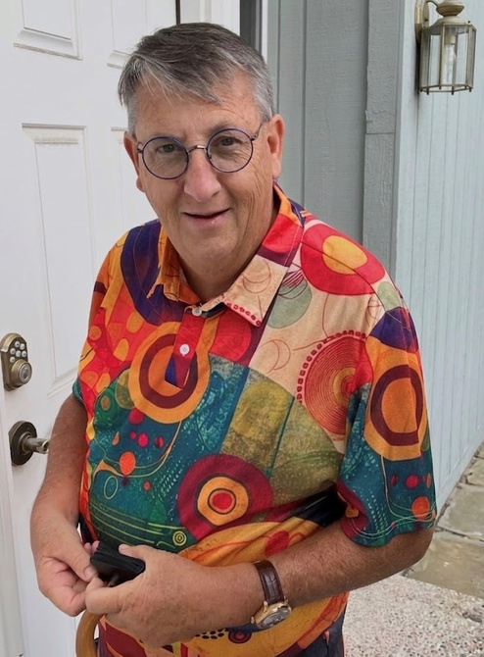
concierge pass
program basics
Hours of operation:
7 days a week between 8 am - 9 pm
How to schedule a ride:
Call dispatch at (925) 256-3533, Monday - Friday, 9AM-10AM. You can schedule rides 2 to 7 business days in advance.

Slide 8

concierge pass
What does the pass include?
eligibility
10 one-way rides per month (total of 5 round trips) to Walnut Creek, Concord, Clayton, Pleasant Hill and Martinez.
Resident of Walnut Creek, Concord, Clayton, Pleasant Hill and Martinez
Rider Fee:
$5 per ride - same origin and destination city
$10 per ride - different origin and destination city
Seniors 70+ or adults 18+ with disabilities or a health condition that prevents using regular transportation options
Must have a cellular phone & email address
This service is designed for individuals who need extra support
scheduling transportation through the Lyft ride share system due to a disability or does not own a smart phone.

Slide 9
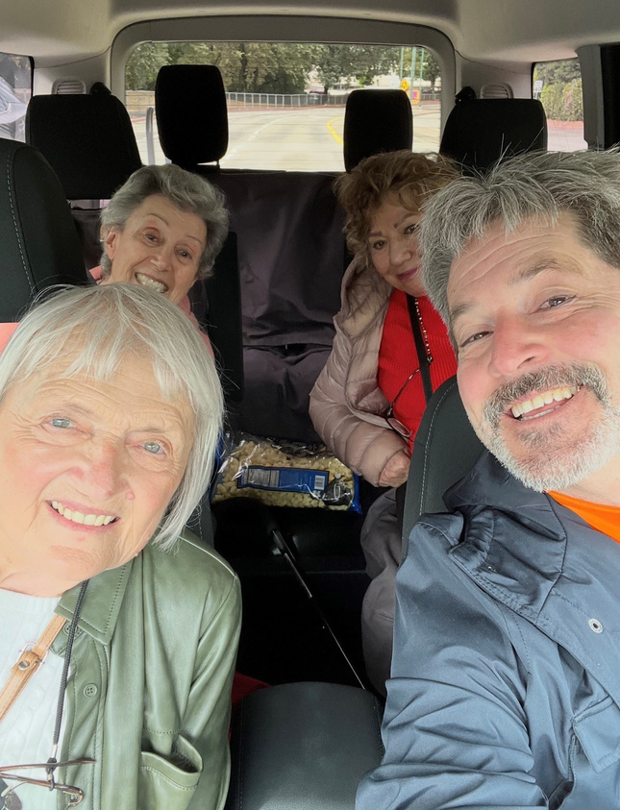
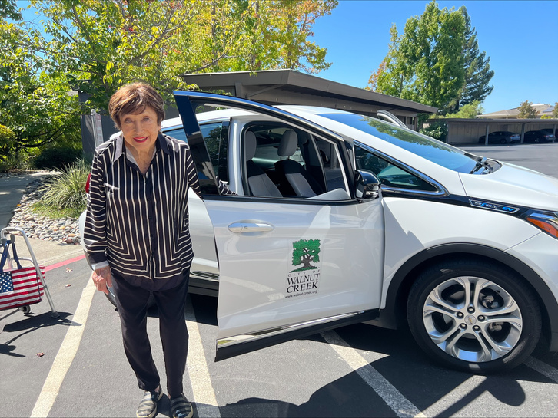
Minibus service
program basics
"This program makes a huge difference for my Mom. She is in her 80's, lives alone, and doesn't speak a lot of English. Lyft (Concierge) has been a godsend, and the support we get is amazing - responsive, care & concern for my mom and both Christine and Tad feel like an extension of our family”.
Ride Fee: $2 per ride ($4 round trip)
- Maryam A
The Minibus is helpful for people who do not use rideshare services, such as Lyft, however, passengers may share trips with other riders.

Slide 10
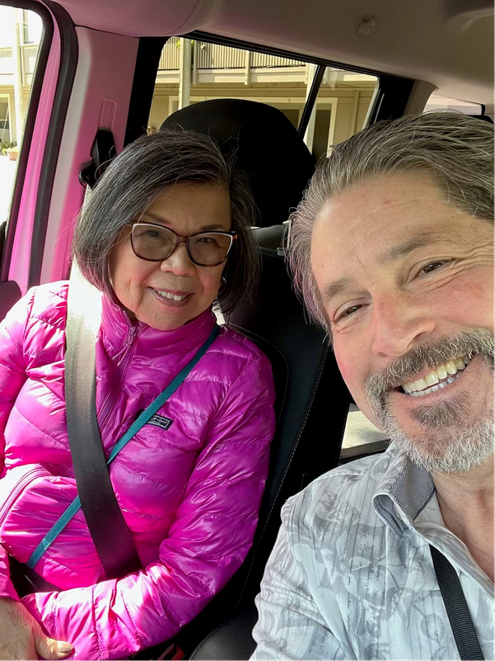
Minibus service
What does the pass include?
Our Minibus program provides 1-round trip per day on Tuesday, Wednesday, and Thursday.
The Minibus program utilizes either a 5 or 6 passenger city vehicle and provides rides only within Walnut Creek city limits.
eligibility
Open to Walnut Creek residents
"Pleased and thankful for this program. It’s been a godsend to not be stuck at home and get groceries. Love talking to Christine to get my rides booked and Tad is sweet and kind driver."
- Patti Eisner
Be 60+ years of age or an adult 18+ with disabilities or a health condition that prevents using regular transportation options

Slide 11
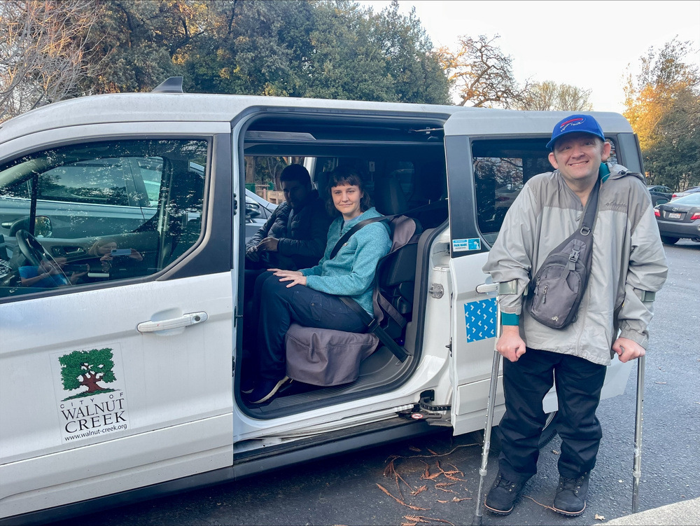
PROGRAM PURPOSE: GAP SERVICE
Rides are provided in conjunction with other beneficial programs such as Cafe Costa (Meals on Wheels), aquatics therapy, resource presentations, etc.
Reduces challenges of having to park and walk for individuals with mobility challenges
Rides to essential services such as medical, dental, grocery, educational, AND social and recreational engagements.
Program is used in addition to other services such as LINK or Mobility Matters.
Speak with a live person
Personal connection with riders provides wellness checks
Communicate directly with care providers (adult children, aides, social workers, etc.)
Trained staff on how to best support riders with disabilities
Mix of Lyft, Minibus & shared rides + meeting new friends
“This is for Matthew Basset, a testimonial to how wonderful Lyft has been for him. It's gotten him to the places he needs to be, like the dentist or to the Civic Center when he has a Walnut Creek activity. It's been a really big help knowing that is available, because sometimes there’s just NO other way he was going get there. So thank you so much for having Lyft available.”
-Carol Basset (Matthew Bassett‘s mother)

Slide 12
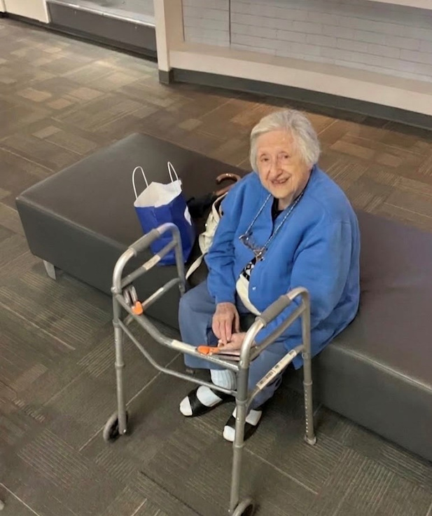
PROGRAM SAFETY
TRANSPORTATION SPECIALISTS & DRIVERS
Hourly Staff
FBI & CA Background Check
Mandated Reporter Training & Elder Abuse Prevention Training
Anti-Harassment Training
Diversity, Equity & Inclusion Training
CA DMV Record & Driver Background Screening & Ongoing Monitoring
Driver evaluations to maintain the safety and integrity of the MiniBus
program
“The Minibus and Lyft program is a Godsend for seniors who do not drive and need to go to appointments, grocery shopping or errands around town. The bus service here is very slow and unreliable. The Minibus program helps seniors who need to go to appointments and to get out of the house. It enables me to get out to Choir practice and to socialize with others. Thank you for continuing this program."
- Penny L

Slide 13
Community Outreach Highlights:
Tabled Events:
Oct 16, 2024: Pedestrian Safety Awareness Month Event at Rossmoor
Feb 21, 2025: City of Martinez Senior Center “Healthy Hearts, Healthy Lives” Community Resource Fair
Mar 13, 2025: Walnut Creek Senior Resource Fair at St. Mathews – Sensational Seniors Sponsorship
Mar 29, 2025: IDD Resource Fair – Developmental Disabilities Awareness Month
Sep 14, 2025: Concord Senior Center Transportation Expo
Nov 6, 2025: Rossmoor Health Fair
Conferences:
Senior Forum of Central Contra Costa County
July 14, 2025: Older Americans Act 60th Birthday Bash.
Presentations & Trainings:
Transportation Program presentations for Walnut Creek Arts & Recreation
Program reviews and training courses for City of Concord’s transportation team.
Individuals with Disabilities Support:
The transportation program team took a strategic approach through targeted marketing and active participation in community outreach events.
This has directly contributed to a 17% average increase (this past year) in ridership among riders with disabilities or health conditions, underscoring the critical need and positive impact of this program within the community.

Slide 14
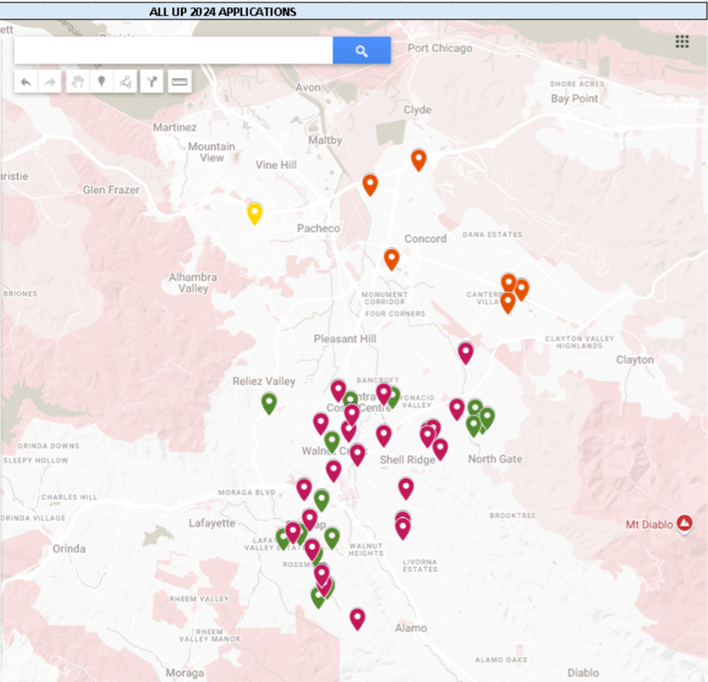
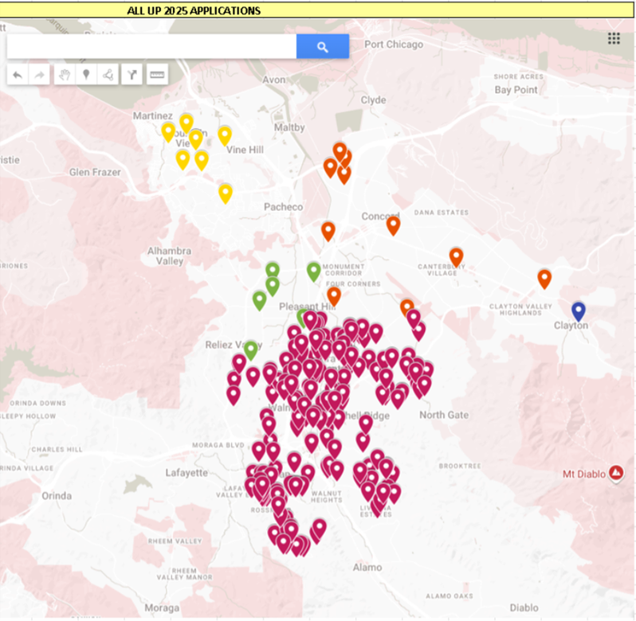
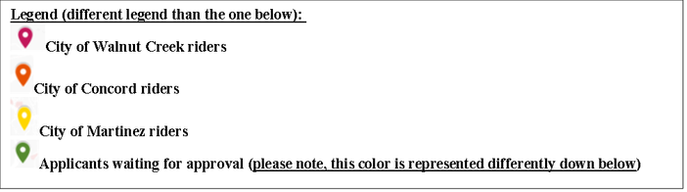
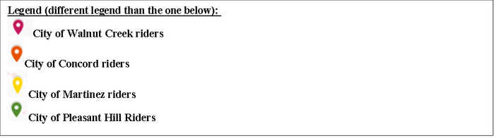
2024/2025 - 2025/2026 snapshot
Snapshot map above shows the expansion of ridership across all three programs in the TRANSPAC area from the last FY 24/25 (above) to our FY 25/26 cycle (below).
Snapshot map above shows the expansion of ridership across all three programs in the TRANSPAC area from the last FY 24/25 to our FY 25/26 cycle.

Slide 15
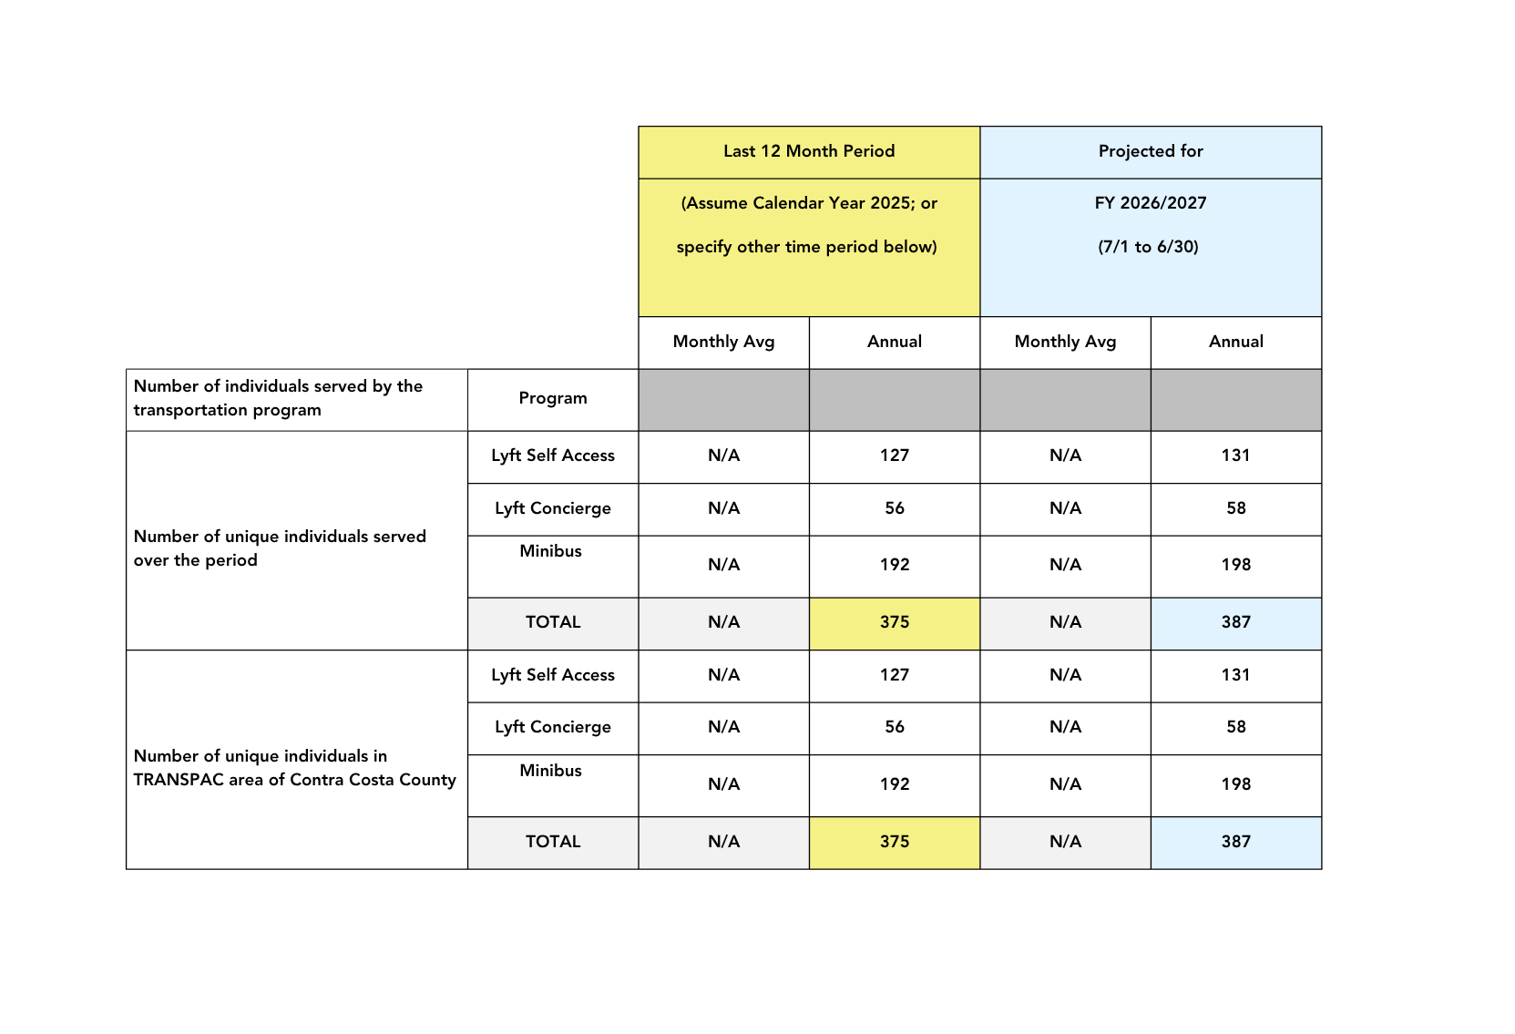
2025 calendar year + 26/27 projections

Slide 16
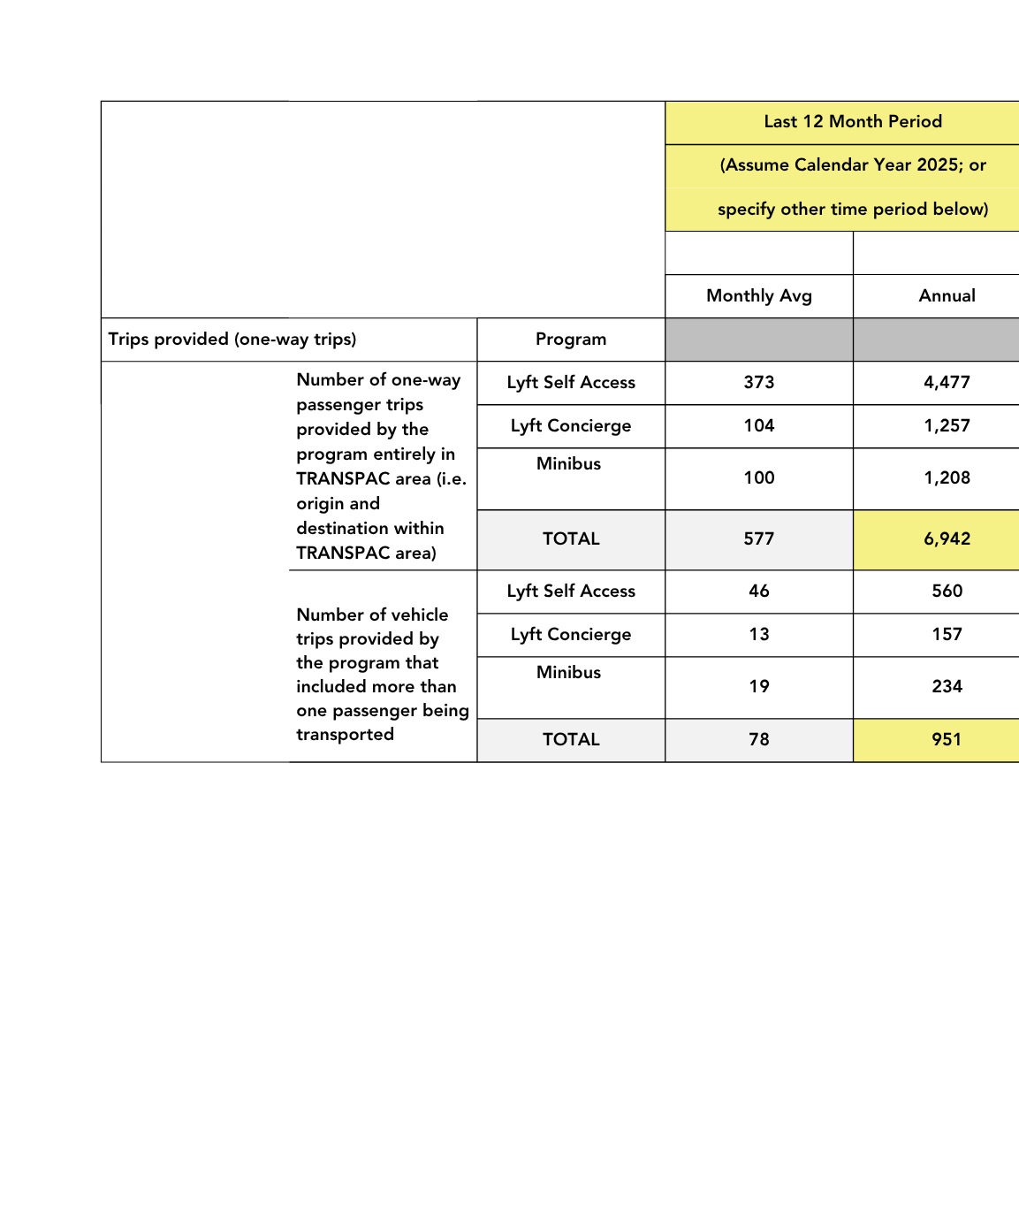
2025 calendar year + 26/27 projections

Slide 17
DEMOGRAPHICS OF RIDERS
Age Breakdown | 2024 | 2025
18-59 yrs | 5% | 8%
60-69 yrs | 12% | 14%
70-79 yrs | 30% | 28%
80-89 yrs | 40% | 37%
90+ yrs | 13% | 13%
Total | 100% | 100%
Language | 2024 | 2025
English as Primary Language | 86% | 91%
Other* | 14% | 9%
* Main secondary languages include Spanish, Farsi, Mandarin, Russian, Japanese, and Vietnamese. | 100% | 100%
Gender | 2024 | 2025
Male | 22% | 20%
Female | 73% | 77%
Other | 4% | 2%
Prefer not to say | 1% | 1%
Total | 100% | 100%
Residency | 2024 | 2025
Walnut Creek Residents | 89% | 91%
Non-Walnut Creek Residents | 11% | 9%
Total: | 100% | 100%

Slide 18
FUNDING
A version of the City of Walnut Creek Transportation Program has been funded by the Line 20A TRANSPAC funding since 2007.
Currently, Line 20A TRANSPAC funds ~82% of the Walnut Creek Transportation program. The remainder ~18% is from the City of Walnut Creek general fund and the Arts and Recreation scholarship fund.
A portion of the scholarships for riders are subsidized by the Walnut Creek Seniors Club, general Arts + Recreation scholarship fund.

Slide 19
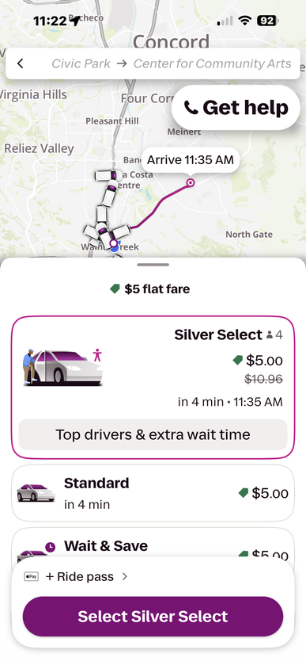
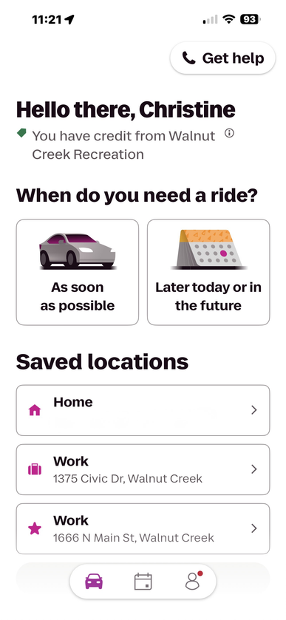
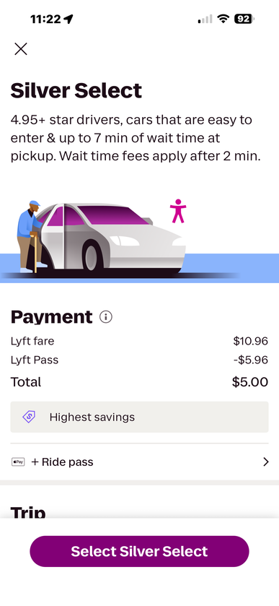
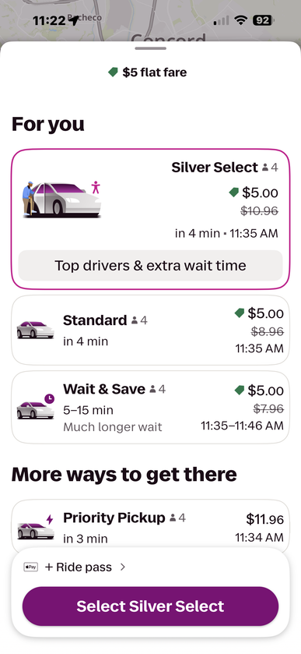
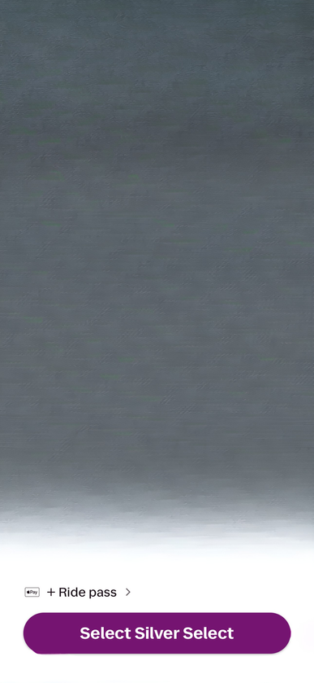
PROGRAM YEAR goals & Priorities
In addition to ongoing operations, specific goals include:
Accessing and launching Lyft Silver:
A simplified design of the Lyft app for easier navigation
Cars with easy entry and exit
Live phone support available during your rides
Continue to deliver transportation information presentations to neighboring senior centers and assisted living facilities.
Partner with CCTA to host Travel Training Program opportunities for our older adults and community members with disabilities.
Expand scholarship program to support Minibus participants.

Slide 20
Thank You

