Slide 1
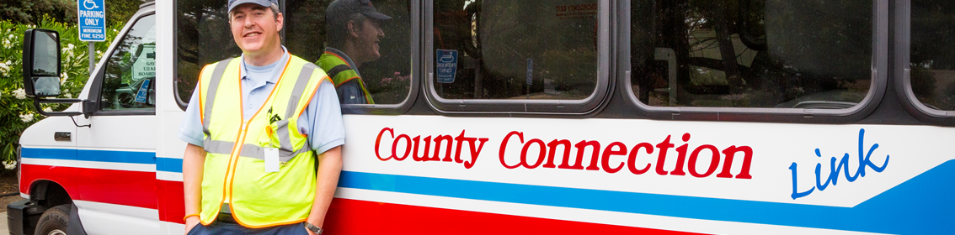

Measure J Line 20a TRANSPAC Presentation
Thursday, March 12, 2026

Slide 2
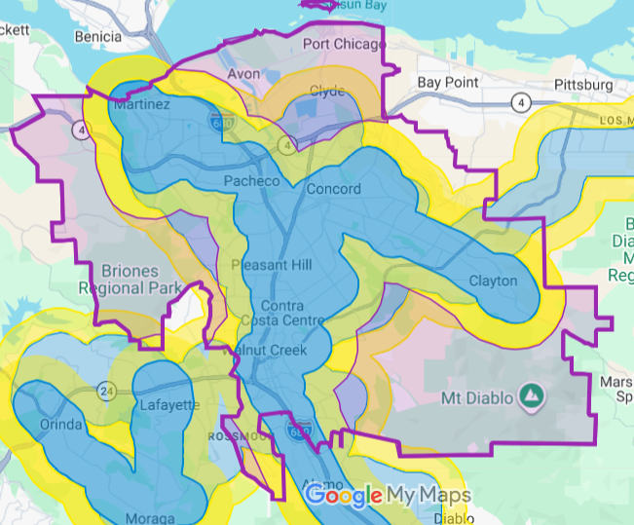
County Connection LINK Extended Service Area & Rural Lifeline Transportation Program
County Connection LINK provides service well beyond the ADA-mandated service area
Provides a critical lifeline for users who often have no other accessible transportation options
Builds on the success of the FY2024-26 Rural Lifeline program
Will support County Connection LINK’s continued service in program areas

Slide 3

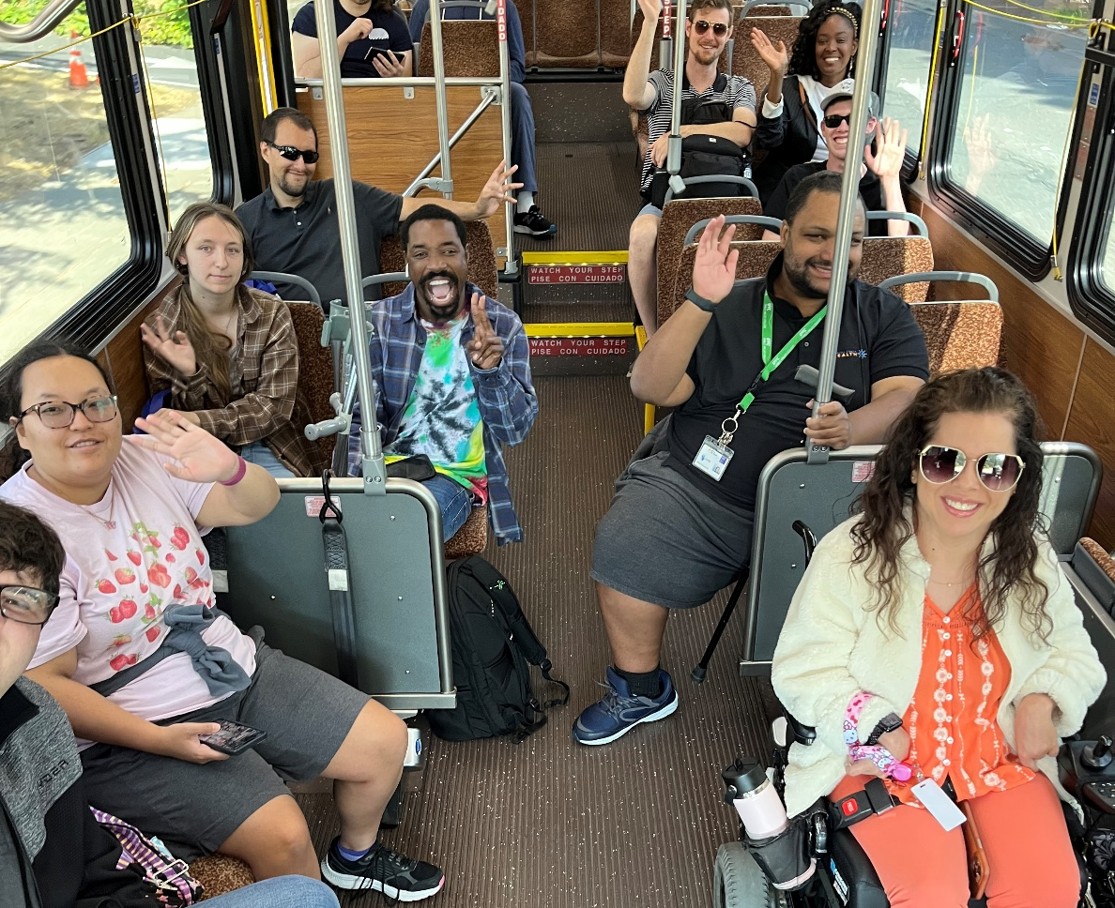
Travel Training:
Teaches skills needed to ride fixed route transit independently, including:
Planning trips, Boarding & paying fare, How to read a map, Using app-based ride-hailing services like Uber or Lyft
Builds on lessons learned from the 2022-25 program
Starts with a 2-year Program Development phase
Will be operated primarily by in-house County Connection Staff (Accessible Services & Customer Service departments)
Notes:
Through TRANSPAC: new call for projects

Slide 4
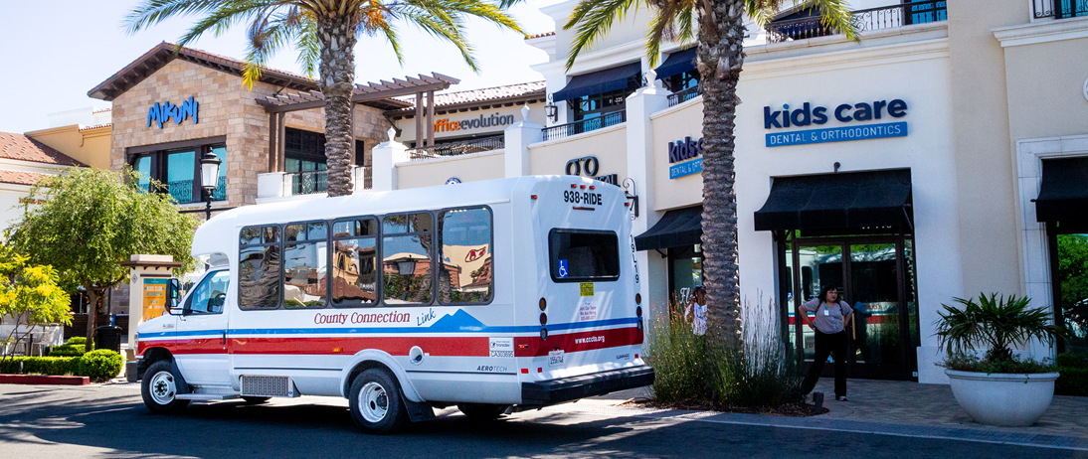
Thank You!
John Sanderson
Director of ADA & Specialized Services
jsanderson@cccta.org

