Slide 1
Summer Youth Transit Pilot

Slide 2
Program Development
TRANSPAC (Nov)
Transit GM Meeting (Oct)
SWAT (Dec)
Funding approved
Transit GM Meeting (Dec)
Funding inquiry with Tri Delta and WestCAT
Transit GM Meeting (June/July)
Transit GM Meeting (March)
Funding approved
Measure J Line 21A funds in the amount of ($41,000) to fund the TRANSPAC portion of the countywide summer youth transit
Measure J Line 17 funding for youth transit rides for up to $5,933.00
Transit GM Meeting (April)
Marketing & program launch
Countywide coordination
County Connection Board Meeting (Sept)
Early discussions
South
East
Notes:
From TRANSPAC: CCTA is coordinating a countywide four-month youth transit pilot that combines two components: a two-month summer program (June-July 2026) the existing Pass2Class school-year program (August-September 2026) providing free passes to enrolled students.
From SWAT: This countywide, four-month youth transit pilot is a combination and coordination of two consecutive programs: a two-month summer program where youth ages 6-18 can ride free without passes, and the existing Pass2Class school-year program providing free passes to enrolled students. While the Pass2Class component is funded through Transportation Fund for Clean Air (TFCA), the summer component requires separate subregional funding of $5,933

Slide 3
TRANSPAC: CCTA is coordinating a countywide four-month youth transit pilot that combines two components: a two-month summer program (June-July 2026) the existing Pass2Class school-year program (August-September 2026) providing free passes to enrolled students. ​
SWAT: This countywide, four-month youth transit pilot is a combination and coordination of two consecutive programs: a two-month summer program where youth ages 6-18 can ride free without passes, and the existing Pass2Class school-year program providing free passes to enrolled students. While the Pass2Class component is funded through Transportation Fund for Clean Air (TFCA), the summer component requires separate subregional funding of $5,933
West
Central
South
East

Slide 4
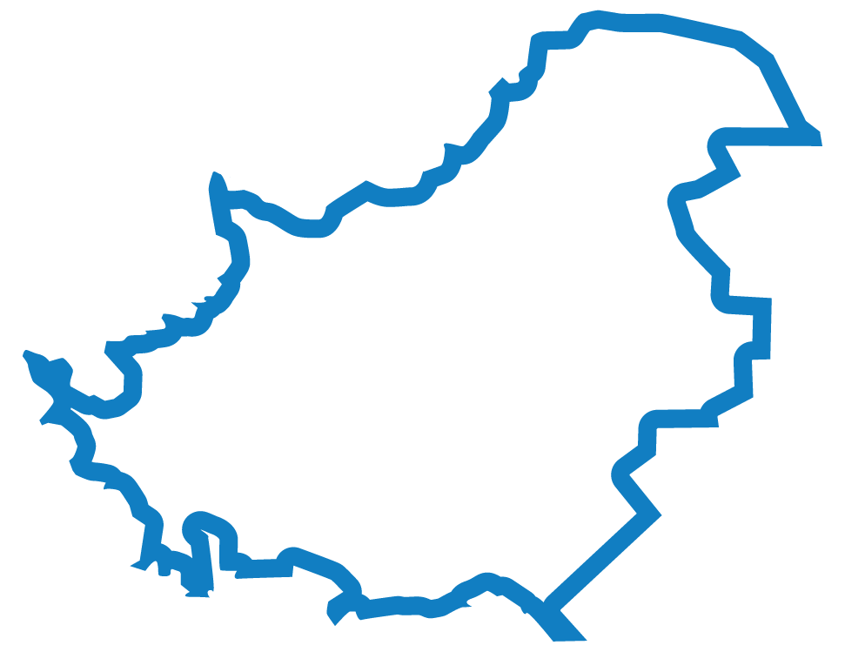
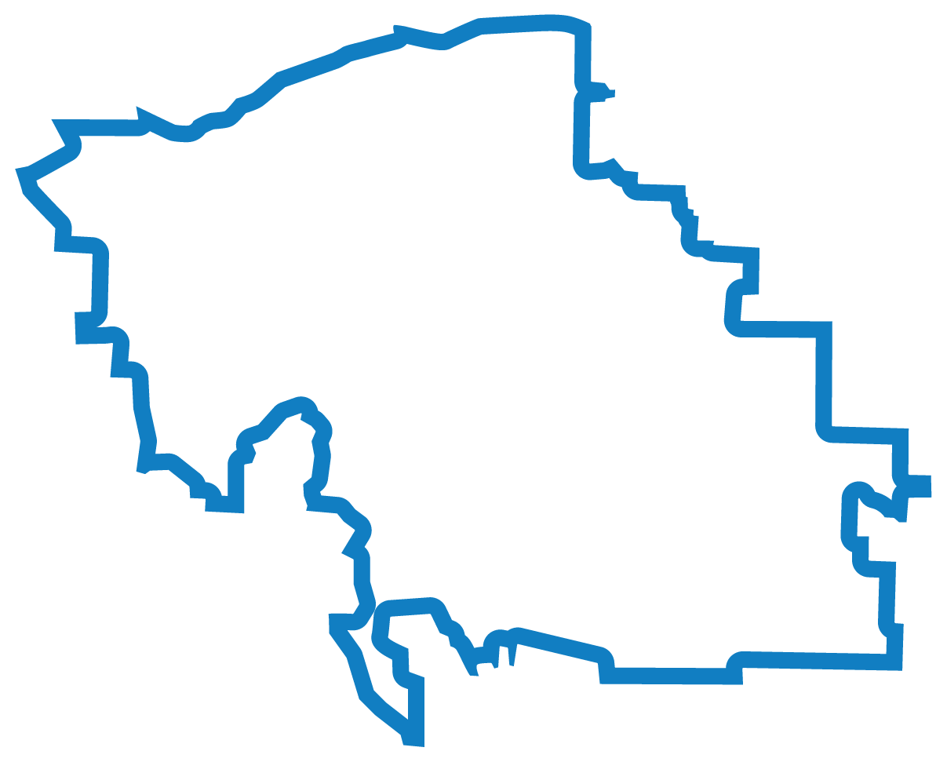
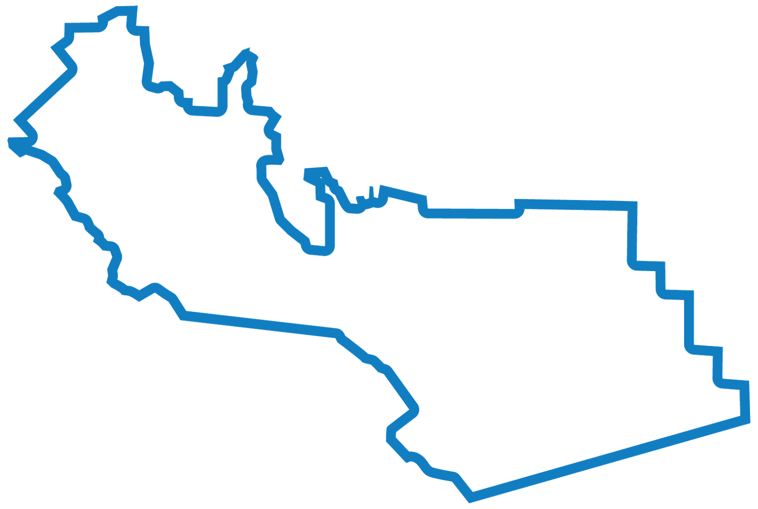
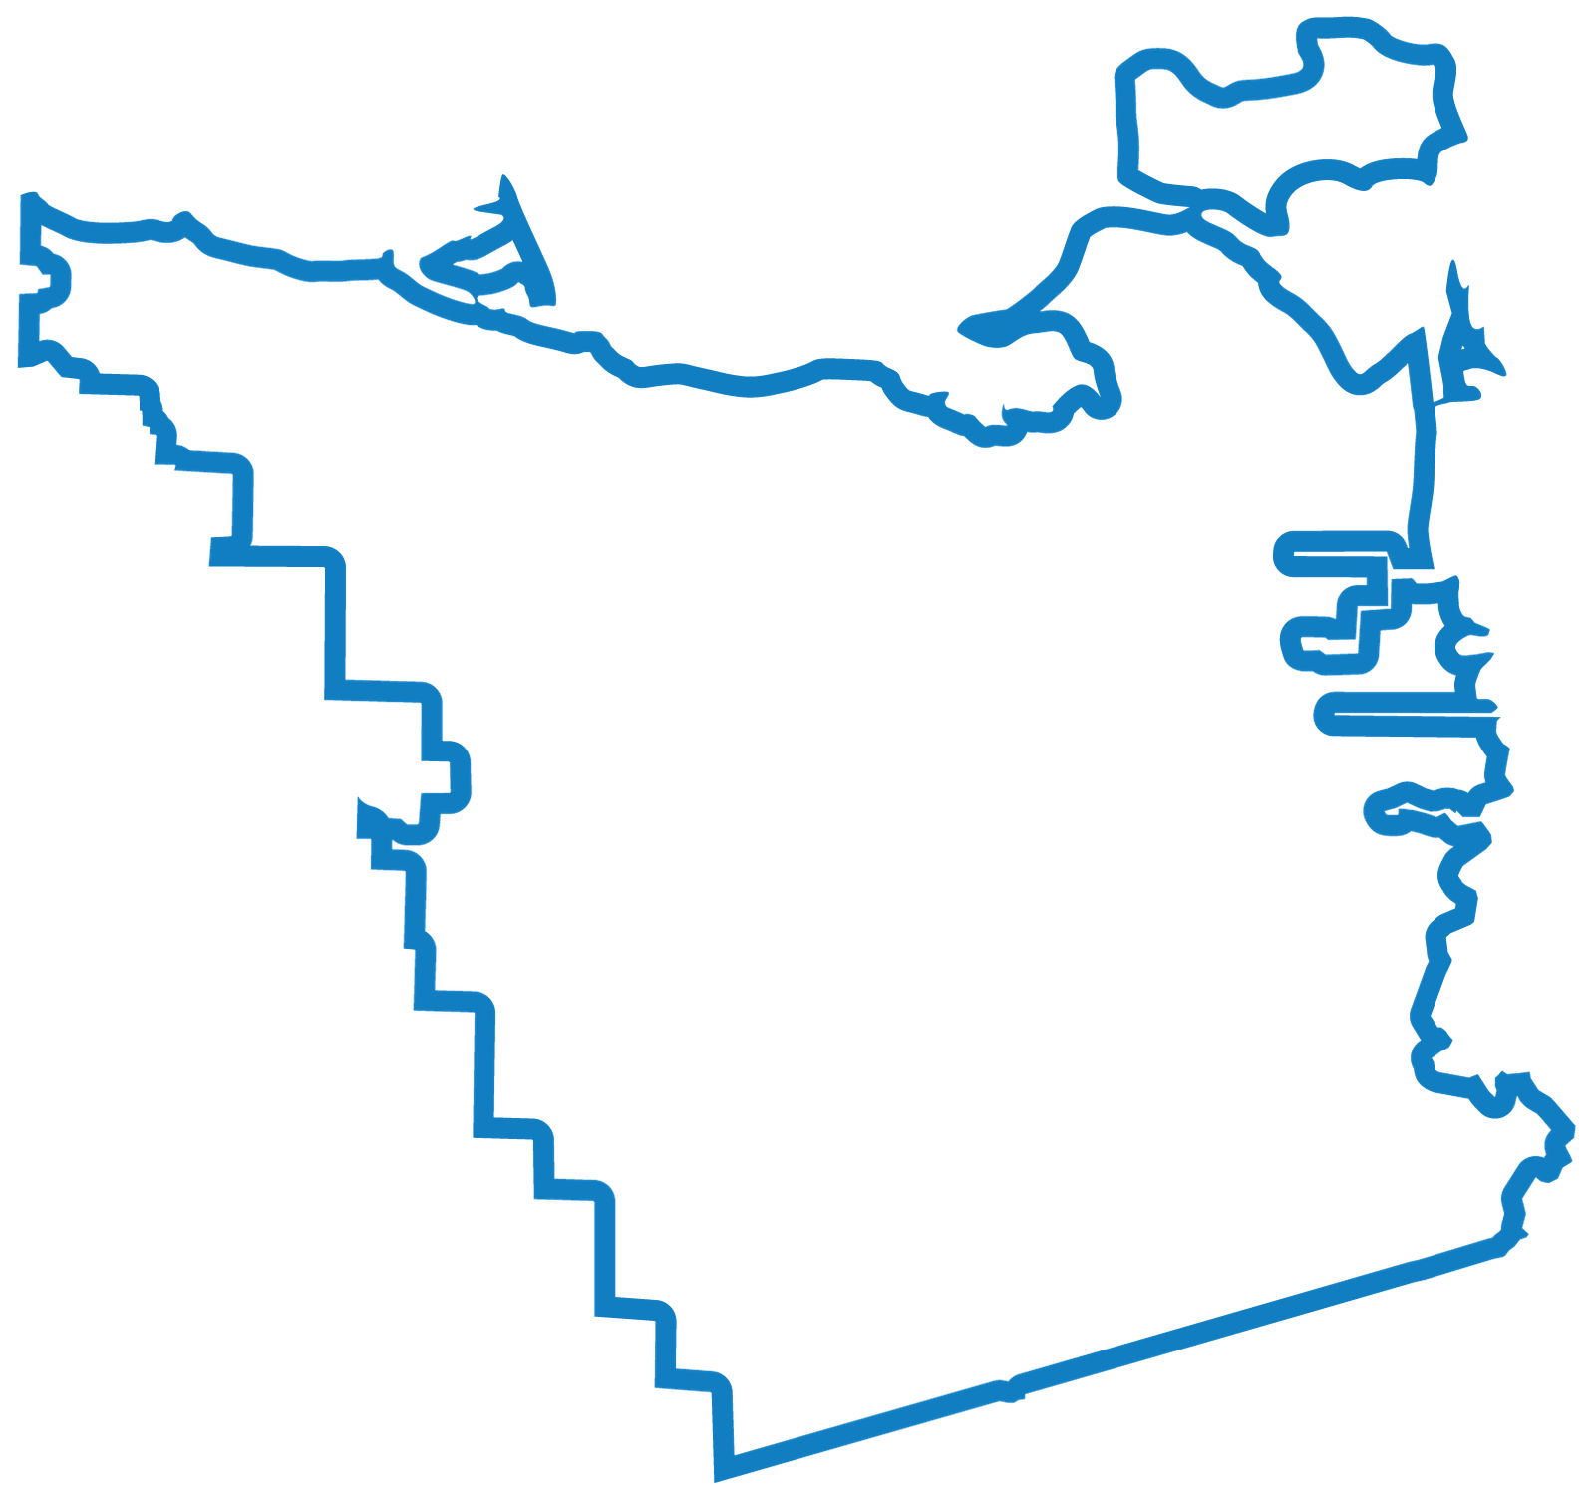
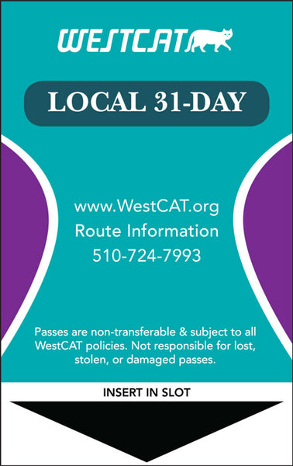





Youth programs vary by subregion in Contra Costa County.
The offerings are not uniform and the funding is complex.
West
Central
South
West
Central
South
East

Slide 5
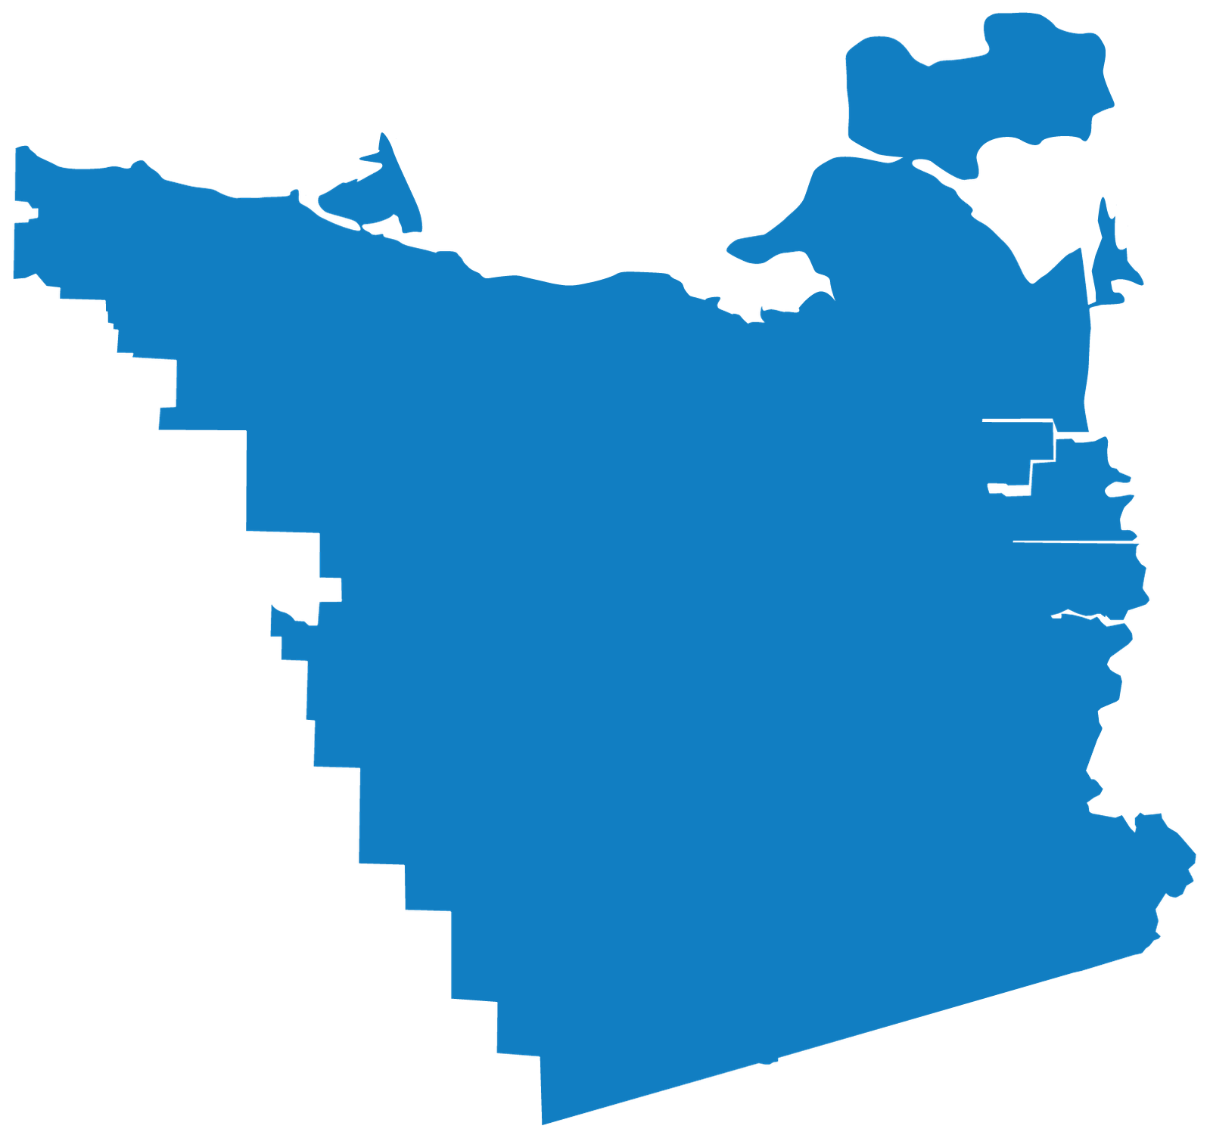


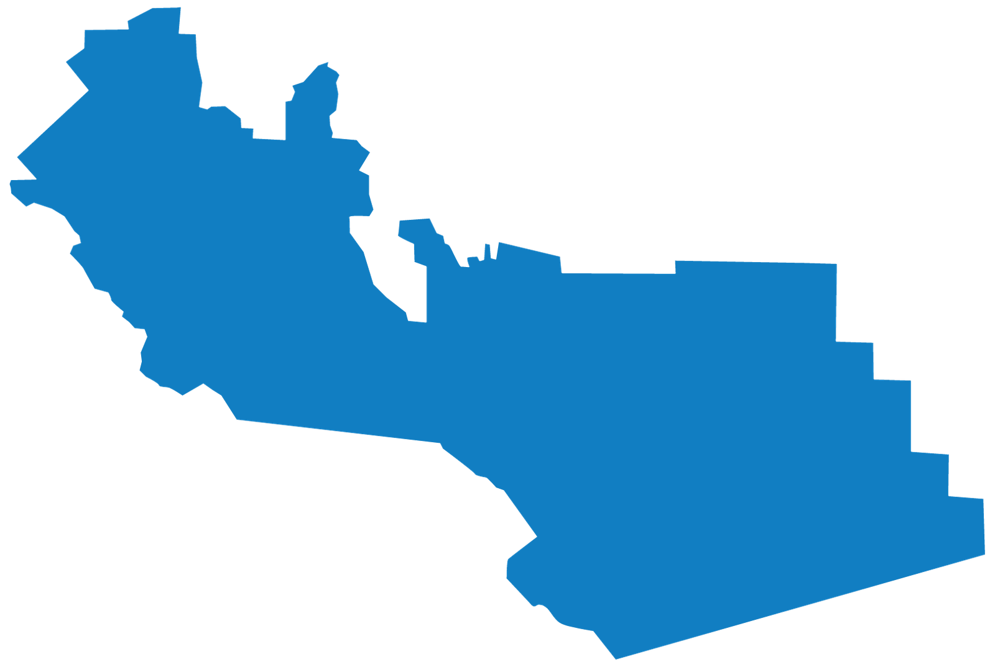
West
Central
South
East
CCTA is working on developing a pilot youth transportation program proposal that would create more uniform access to the menu of programs and create a better experience for residents
Notes:
As an example, all of these programs have different websites with NO universal place to learn/access about what is available.

Slide 6

West
Central
South
East

Slide 7
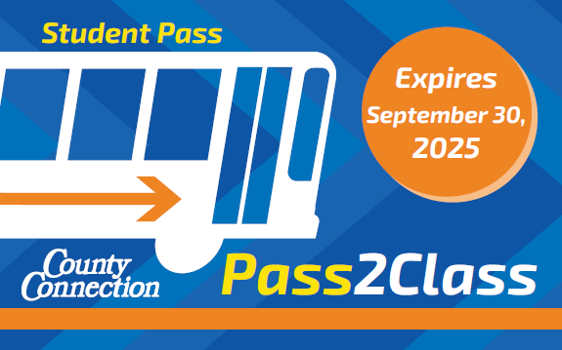

Pass2Class students receive up
to two months of free rides to build
bus riding habits at the start of the
school year.
  County Connection
  Tri Delta Transit
  WestCAT
  AC Transit
Pass2Class is delivered with Bay Area Air District
Transportation Fund for Clean Air (TFCA) 40% funds.

Slide 8
Most of the required TFCA data supporting program cost effectiveness was collected through the application to get 100% representation.
Data included:
Days of week expected to ride the bus
Length of car trip eliminated
How the student would have gotten to school if not riding the bus

Slide 9

Program surveys were sent to participating families in late November to allow time for students to use their free passes and to establish ongoing travel patterns.
A total of 675 valid survey responses were submitted across the four regions.
  County Connection: 406
    Central region: 211
    Southwest region: 195
  Tri Delta Transit: 122
  WestCAT: 46
  AC Transit: 101
Notes:
County Connection surveys are an over representation compared to the percentage of passes issued. Tri Delta Transit is underrepresented in survey responses compared to the percentage of passes issued.

Slide 10
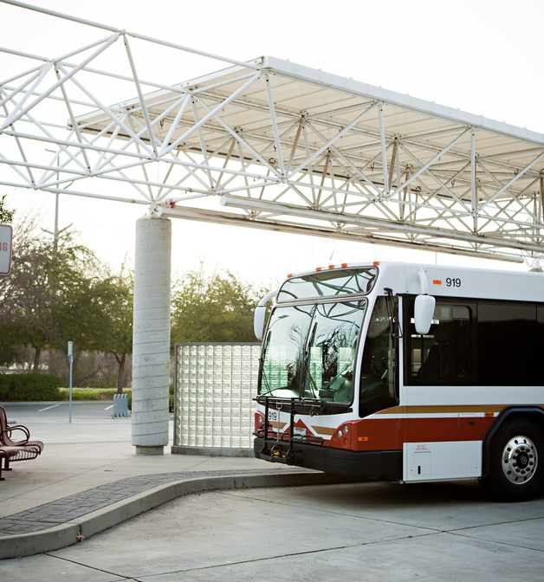
Youth Transit Pilot -Branding & Marketing

Slide 11
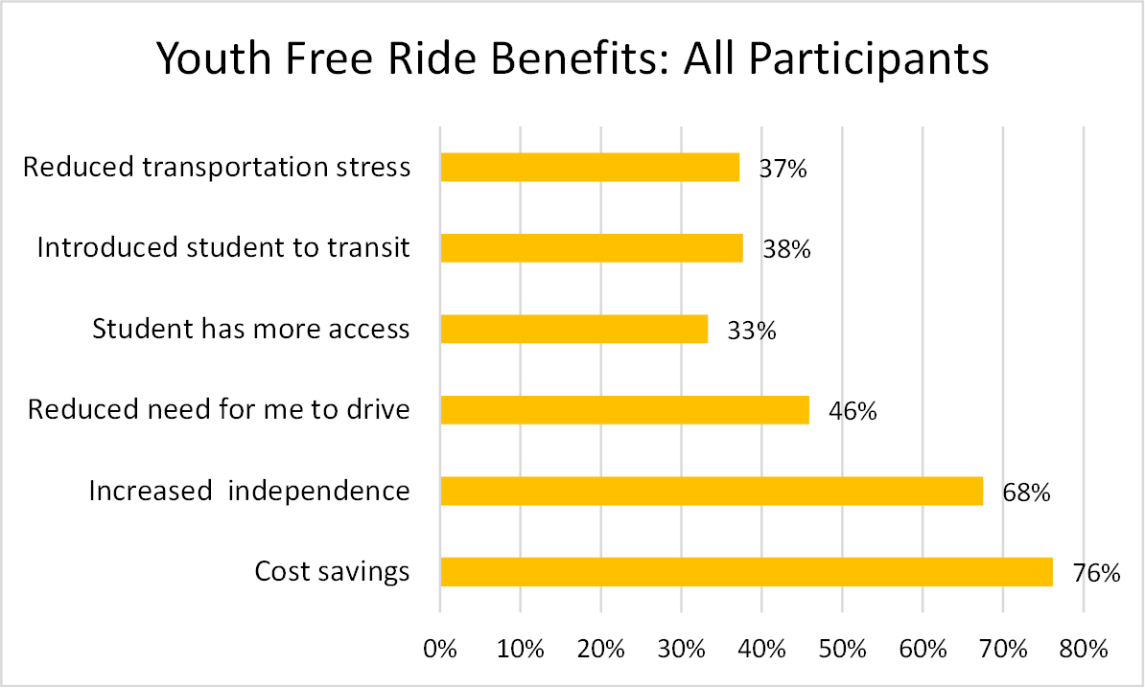
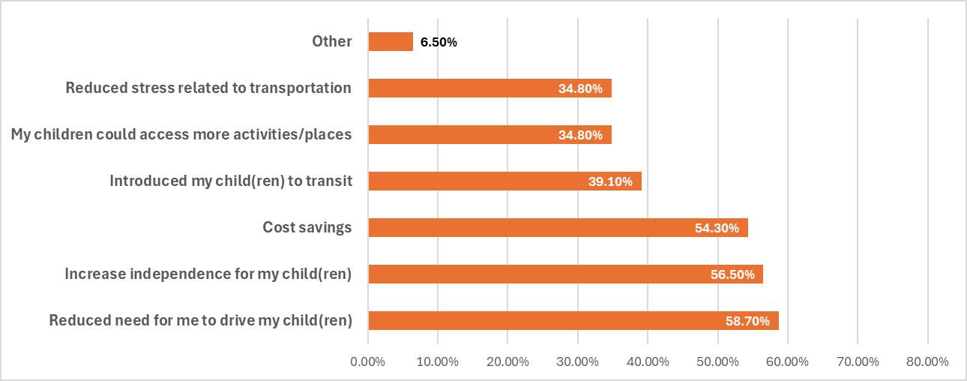
Youth Ride Free - County Connection Survey

Slide 12
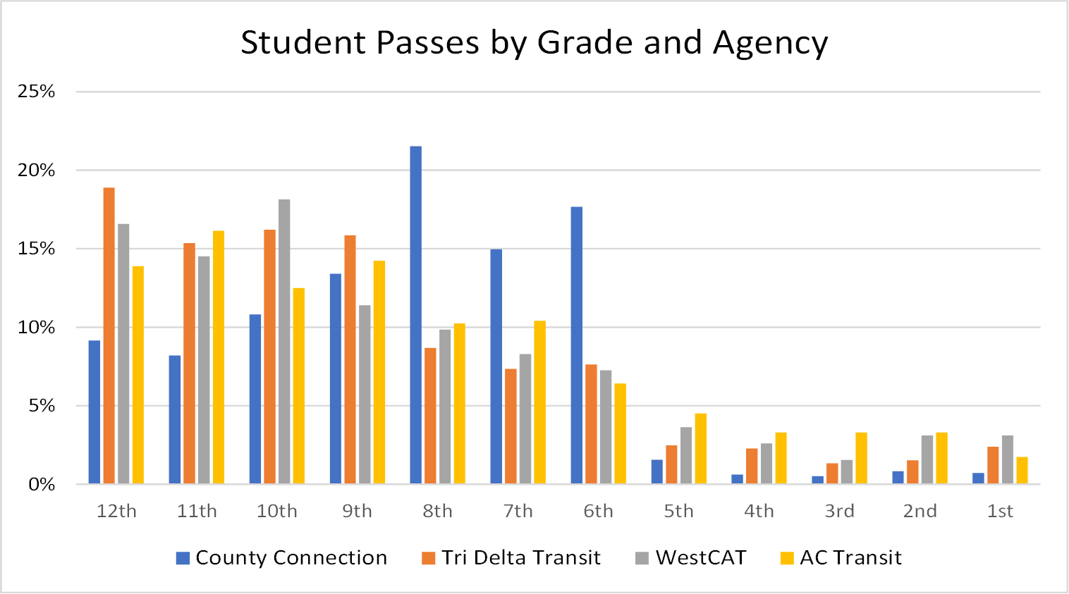

Slide 13
N = 675

Slide 14
Notes:
The survey included a chart by family size with 400% percent poverty line income for each family size. Respondents then were asked if their household income was below or above that income number for their family size. Better representation than asking just about income as it does not reflect family size.
We removed responses of ‘Prefer Not to Say’ – ¼ of all responses, from these percentages
If asked: 86% of WestCAT riders cite being below the 400% poverty line. The WCCUSD program mentioned earlier has a qualifying income level is 130% of the poverty line, Pass2Class appears to be well used by those who don’t meet the lower qualifier.

Slide 15
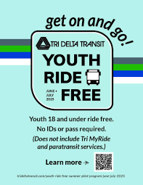
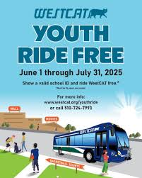


Youth Ride Free
Straightforward name
Great design – appeals to youth and allows for operators to customize colors
Existing assets and activities (leaderboard)

Slide 16
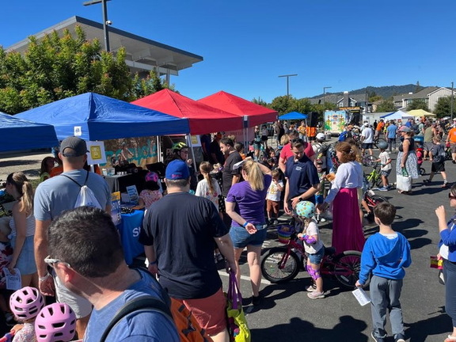

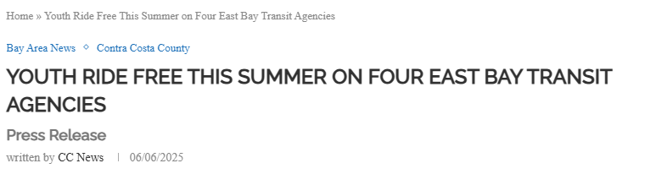
Outreach & Engagement
CCTA will support operator outreach to amplify messaging, leverage networks, help create graphics/video content, and provide digital advertising support
Direct Outreach
Earned Media and Digital Advertising
Partners

Slide 17

Youth Ride Free is your Pass2Summer!
Tired of being the family chauffeur?
🚍
With Youth Ride Free, kids and teens can ride the bus completely FREE – no cost, no application, no hassle.
That means:
✔️ Fewer daily drop-offs and pick-ups for you
✔️ More independence and confidence for your kids
✔️ Safe, reliable transportation to fun activities
Give your child the freedom to get where they need to go, while you get back some of your time (and gas money 💸).
It’s a win for the whole family.

Slide 18
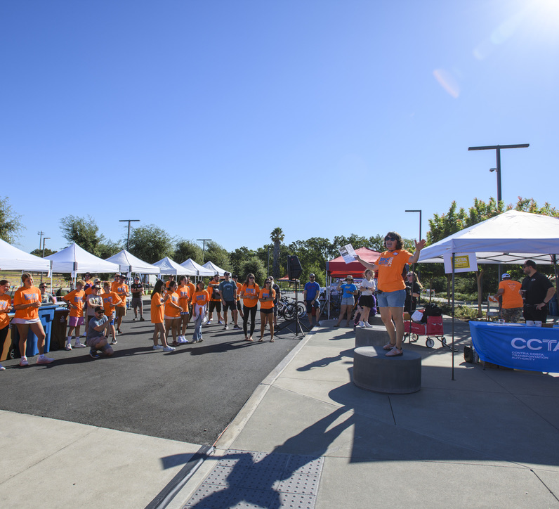
Outreach & Engagement
CCTA can support:
graphic/video assets
partner emails
newsletter blurbs
Social/digital advertising
printing
QR codes and unique links for tracking
direct outreach
youth-facing “how to ride” tips
CCTA support for operator-specific initiatives

Slide 19
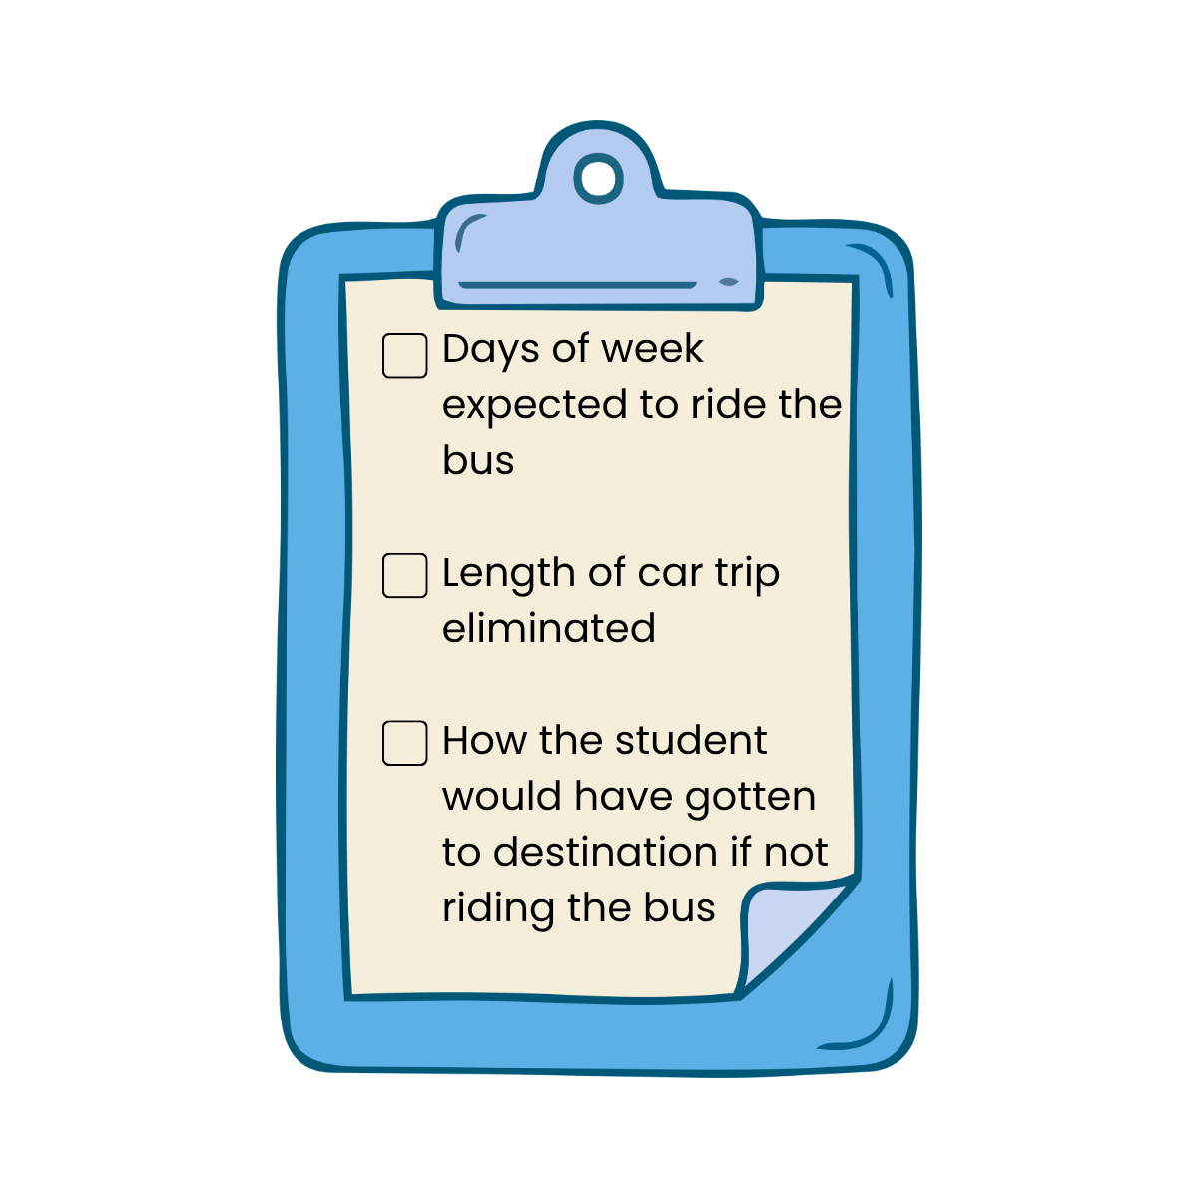
Survey Recommendations
Survey platform - Alchemer
Parent focused
Modeled after Pass2Class survey
Include incentive
Direct outreach through community events
Direct outreach on most popular lines
QR code and link tracking
Dynamic survey (students can respond)
Notes:
For students, the survey will be shorter and concentrate more on their experience as the results will be less likely to inform future funding opportunities

Slide 20
Future Funding
We currently have temporary funding for this summer's free youth transit program, but no long-term countywide funding source. To secure sustainable funding, like TFCA or One Bay Area Grant, we need data that can be used to evaluate the program’s impact.
Surveys are essential
South
East

Slide 21
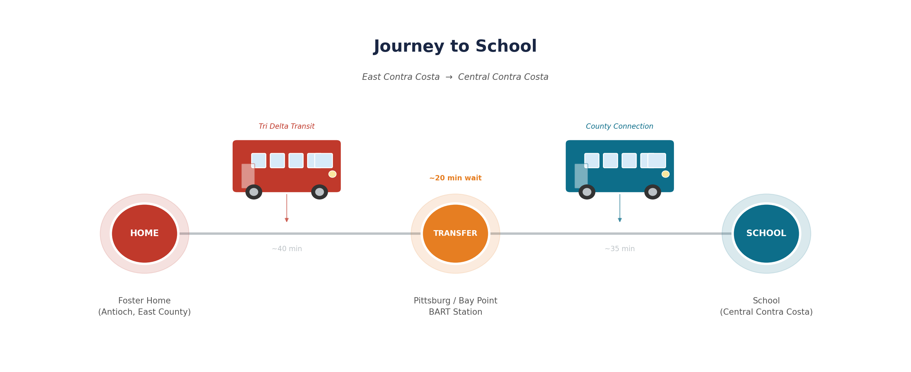
Student Transit Experience
Fare 1
Fare 2

Slide 22
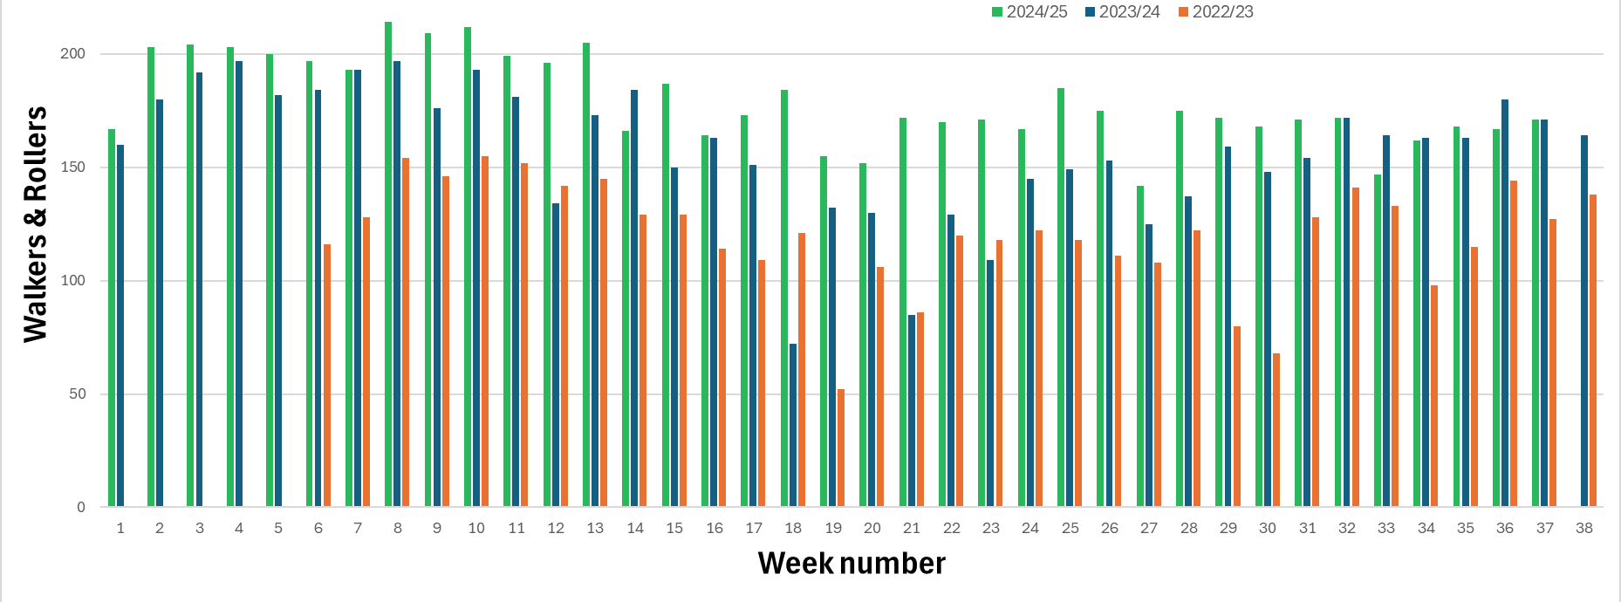
Walk N Roll Participation

Slide 23
Program Users: Walk N Roll
TRANSPAC School Coverage
Students Served (SY 25/26)
4,600
Schools enrolled
7 17
47%
today
100%
SY 2027-28
Year 1 Year 2

Slide 24
Program Users: Bike Family Fest
Pleasant Hill Only
* Number of children participants was not reported for 2022 and 2023, as these were pilot program years

Slide 25
Other Benefits
Pass2Class
90%
bus riders
Walk N Roll
67%
students
continue riding after their pass expires
walk or bike to school on non-WNR days
Attendance
Health
Community
Financial
+2% attendance
90%
#1
#1
-50% tardiness
of parents value health & physical activity benefits
benefit cited by parents
benefit citied by parents
Walk N Roll
Walk N Roll
Walk N Roll
Pass2Class

Slide 26

Next Steps

